Slide 1
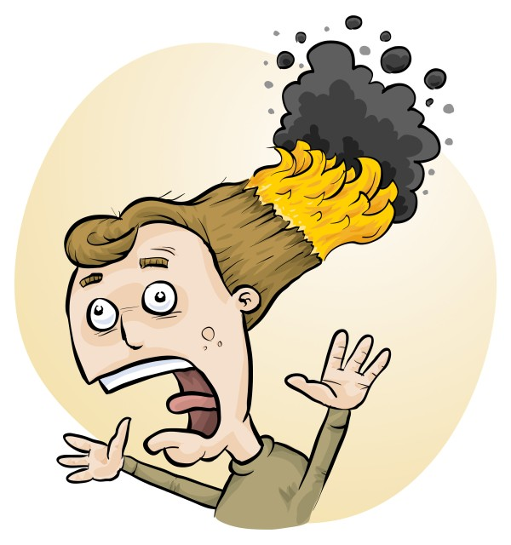
RiskAssess: latest tips, tricks and new features
James Crisp

Slide 2
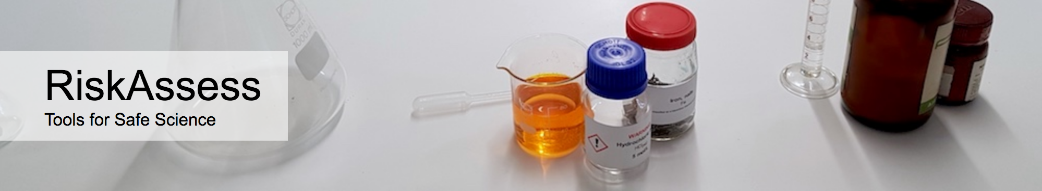

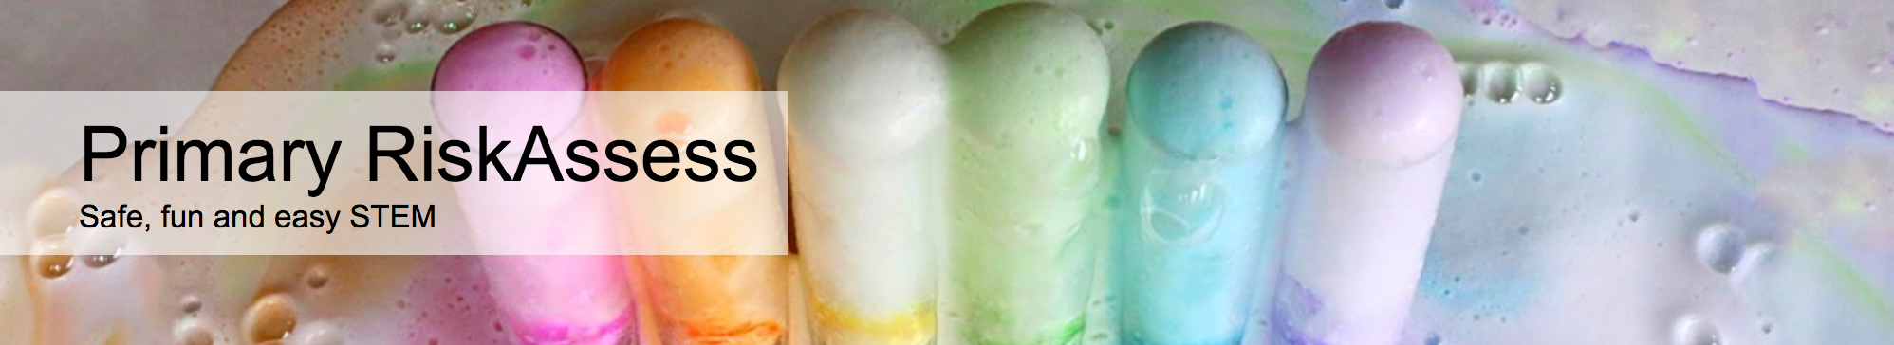
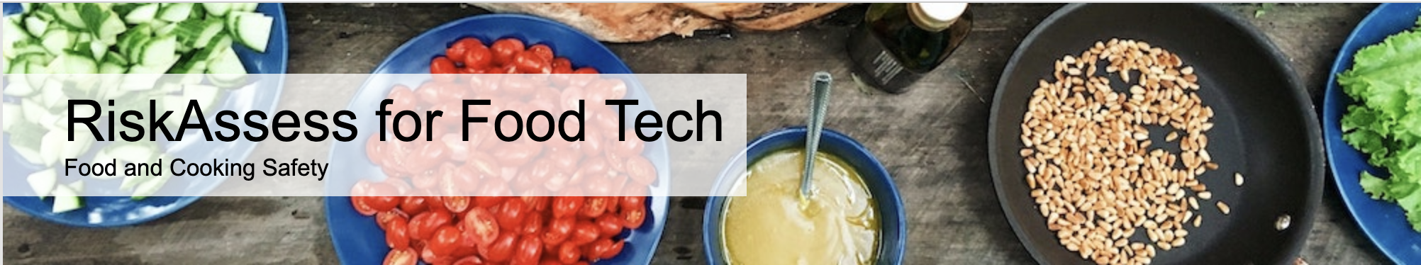
2400 schools
NSW: 728 (87%)
560 schools
NSW: 124 (14%)
190 schools
NSW: 182
30 schools
NSW: 12

Slide 3
New Features

Slide 4
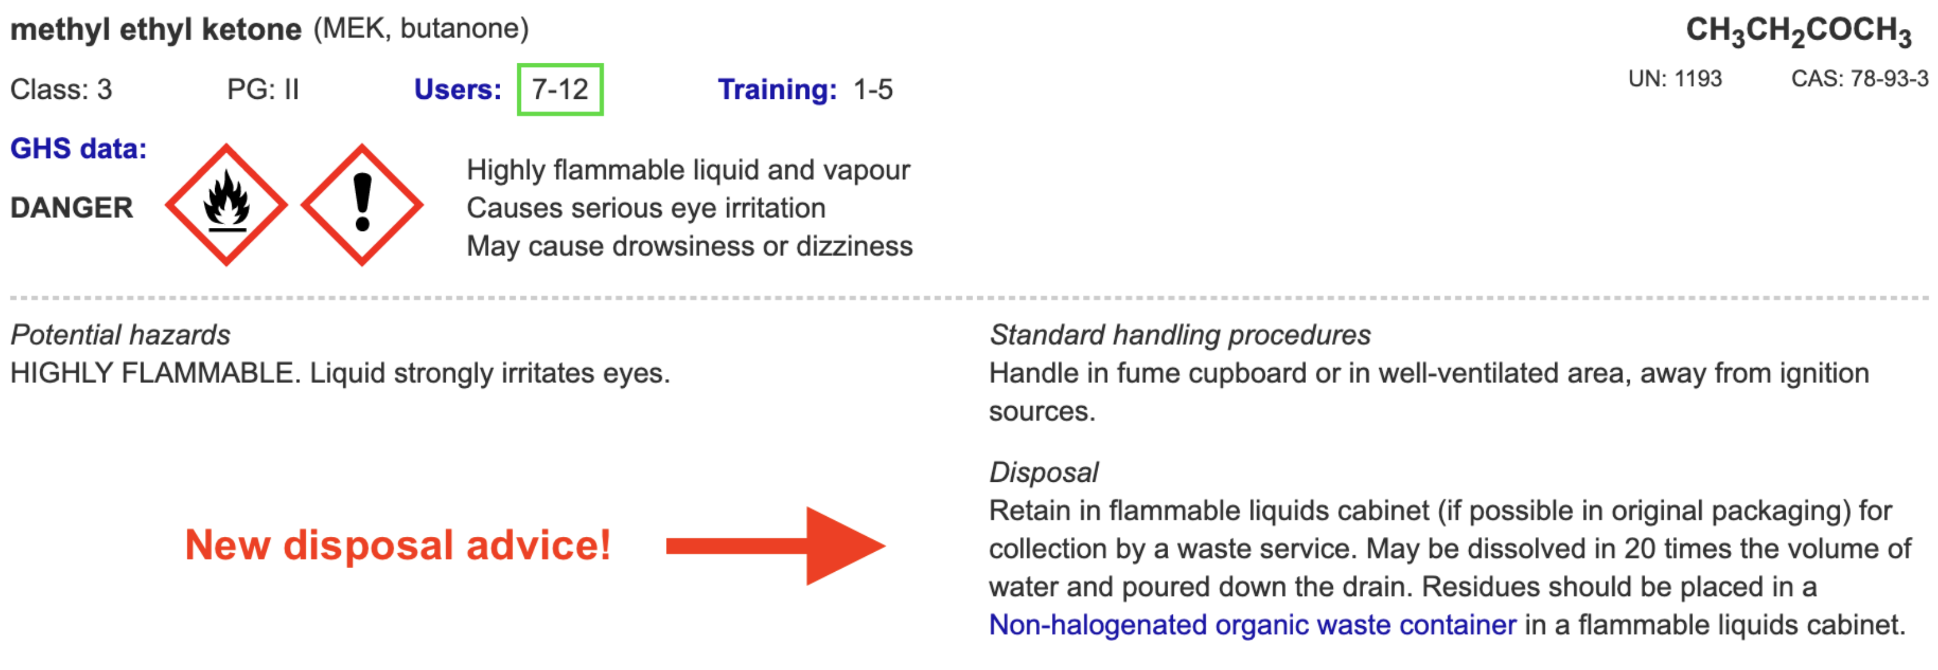
Disposal
Most recent advance in RiskAssess
Advice for all 3000 chemicals and solutions
Guide to disposal and waste container details

Slide 5
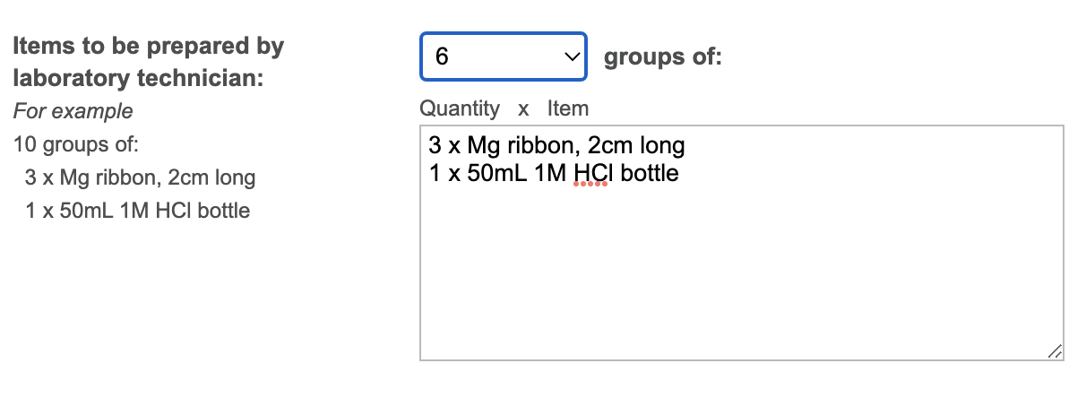
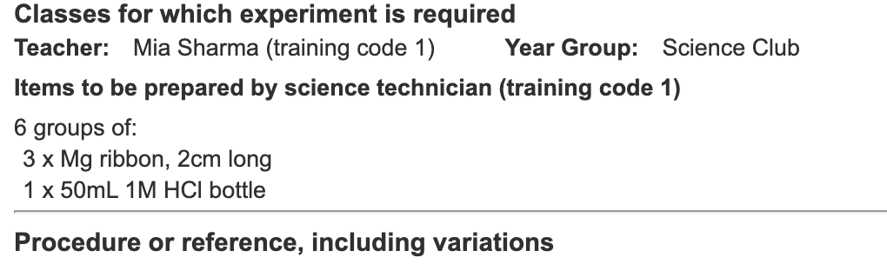
Notes:
Mandatory setting too in tools!

Slide 6
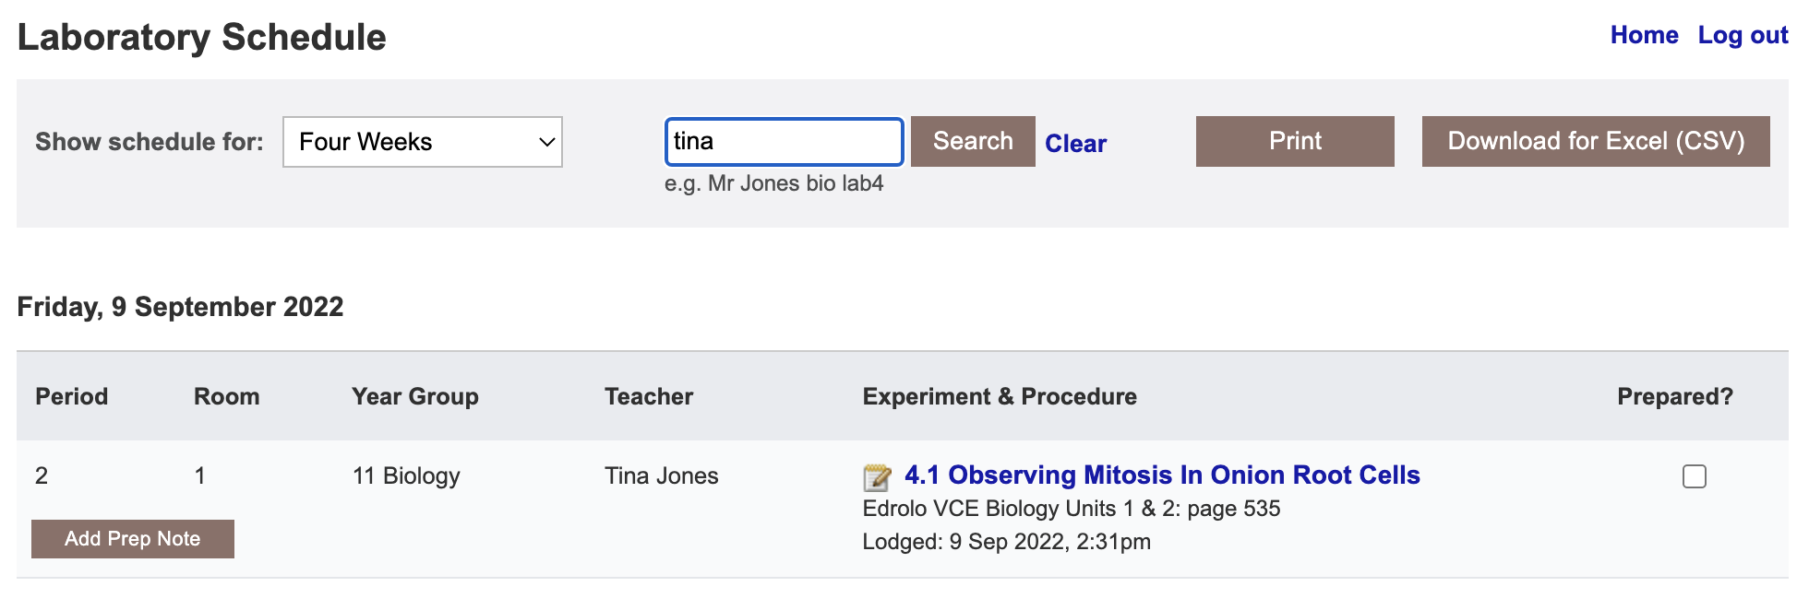

Slide 7
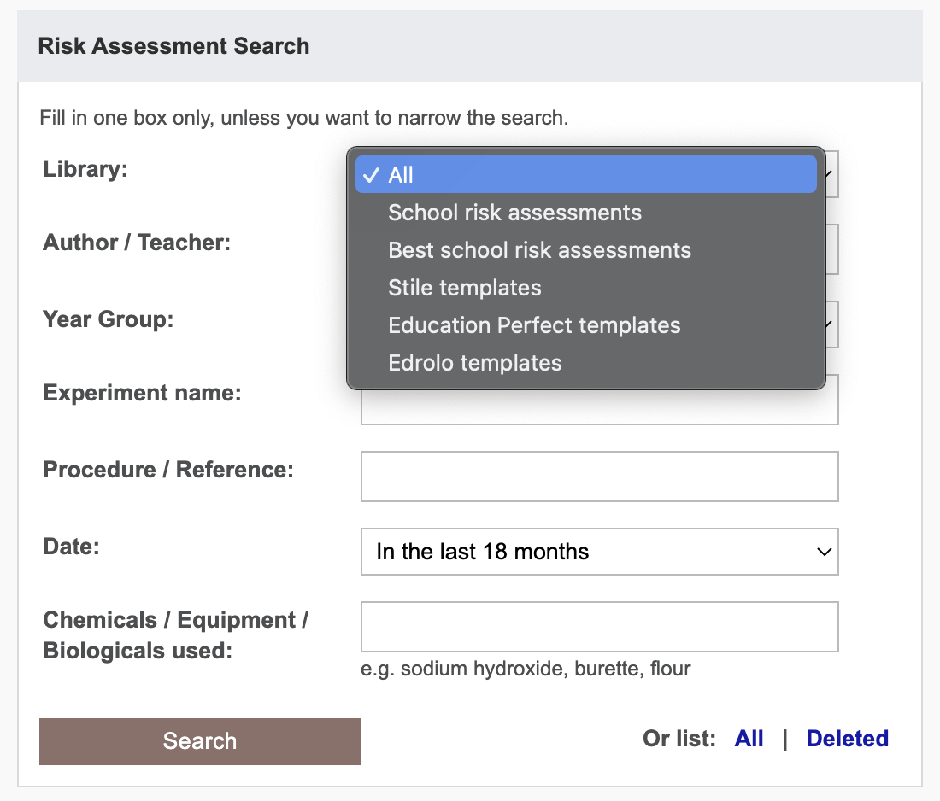

Slide 8
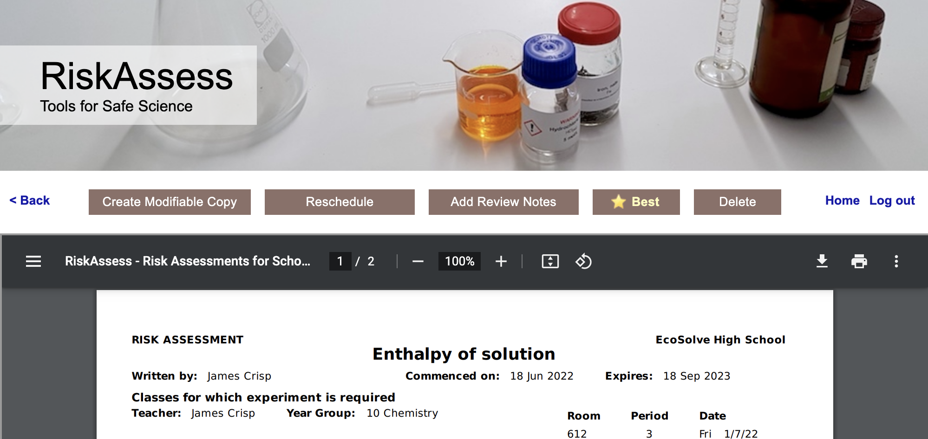
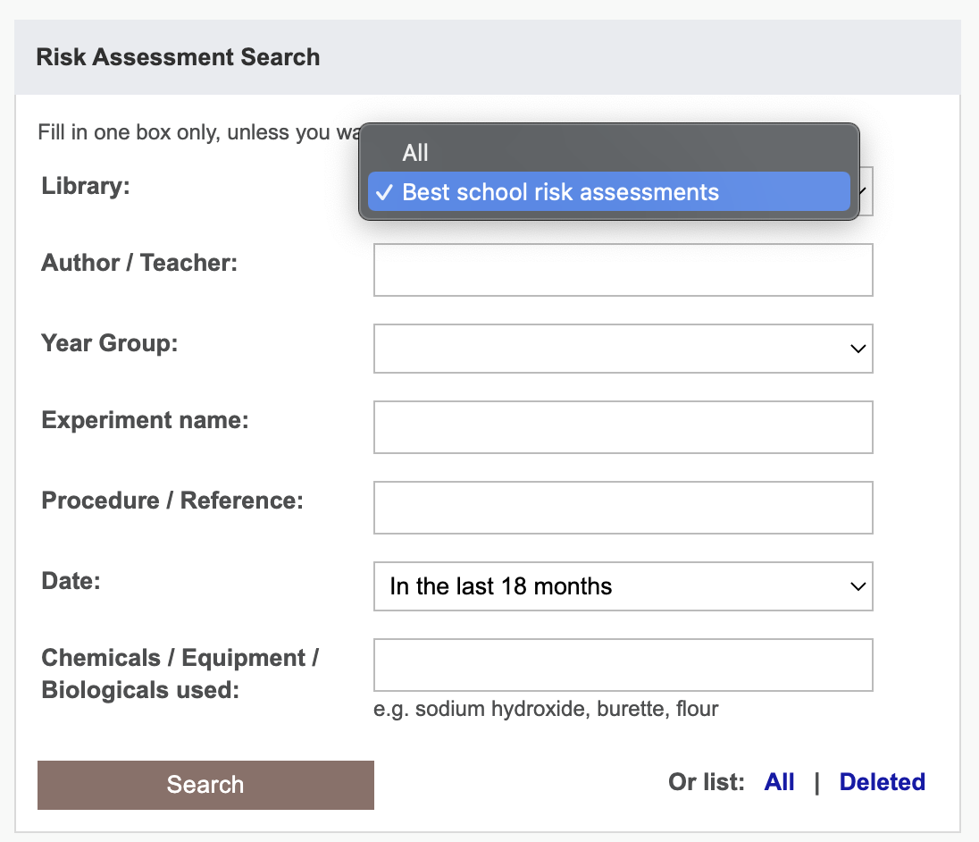
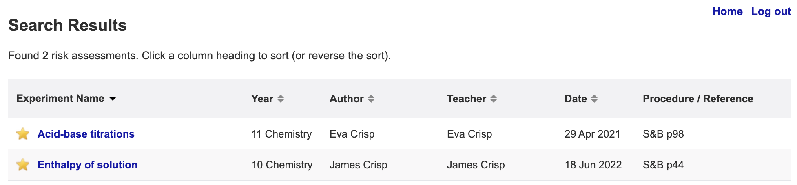

Slide 9
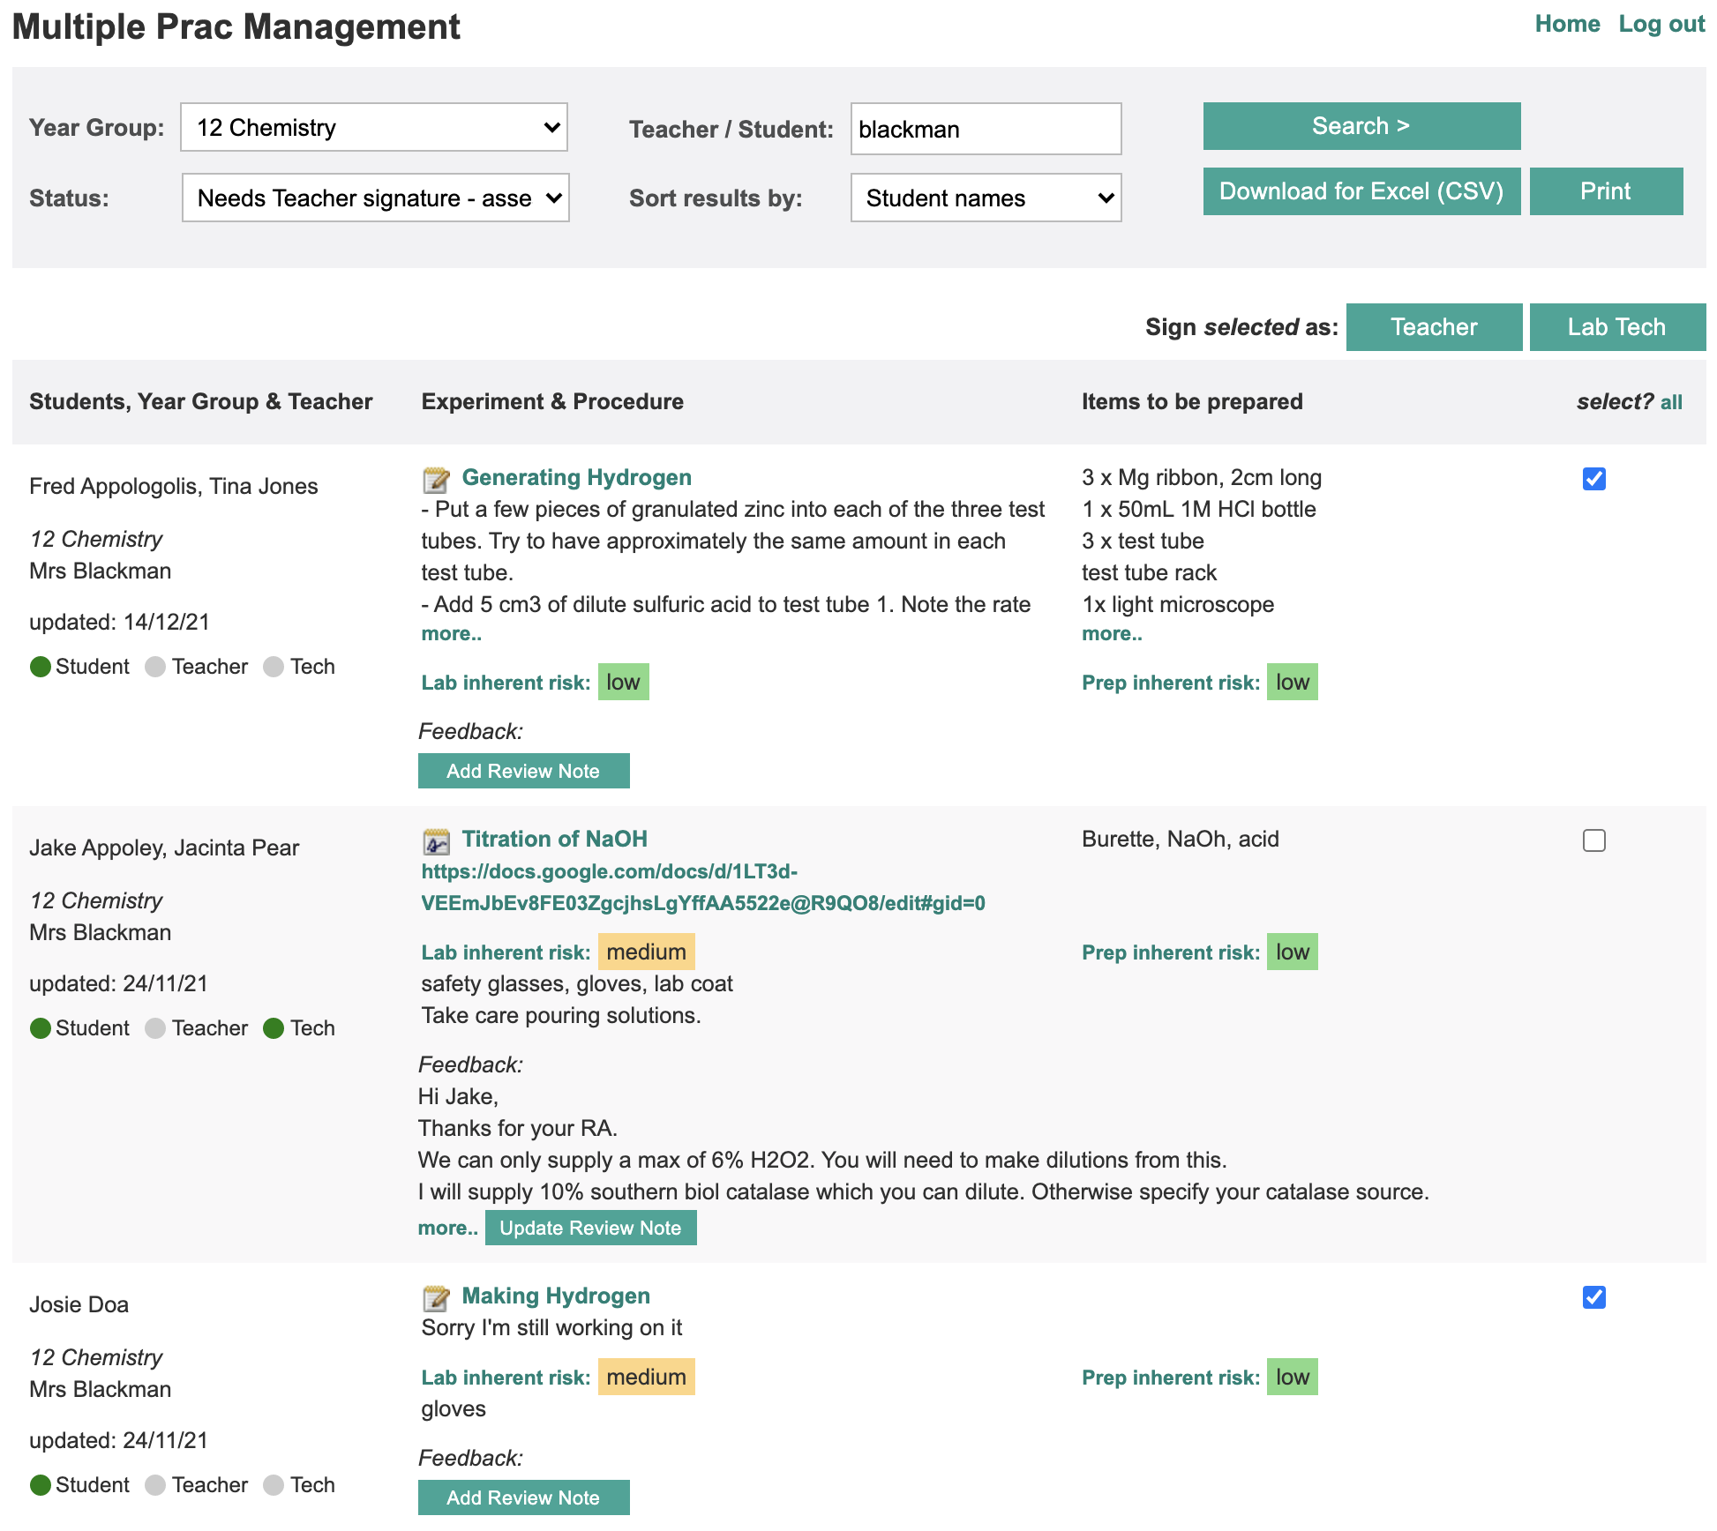

Slide 10
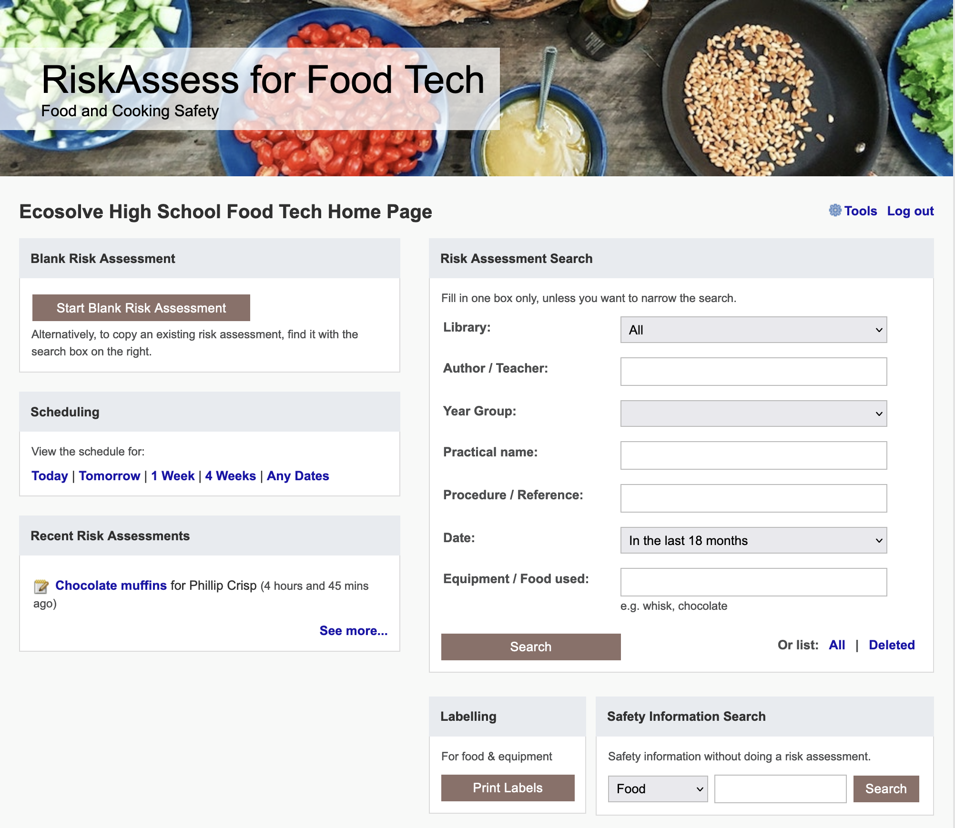

Slide 11
Tips & Tricks

Slide 12
Menu
Shortcuts
icons, hcl, part name, day/month,
click banner, links, hot links, delete,
Best RAs, search on less, # & sort
Scheduling
Excel/csv, any dates, last week,
search, no# pracs, prep notes,
double booking, lodged date
Tools
customise year groups,
stocktaking & usage, invoice,
backup system, defaults
Resources
learning resources, faq, eBook,
videos, libraries: Stile+EP+Edrolo
Labels
standard & custom labels
multiple chemicals on sheet
mixtures, non-chemicals
free text, biohazard symbol
Operations
reschedule, archive risk
assessments, annual review,
tech-only RAs, review notes,
high/extreme: 3 signatures, list
Multiple classes
author update/modifiable copy
Student RiskAssess
view student PINs, not last year
multiple prac management

