Slide 1
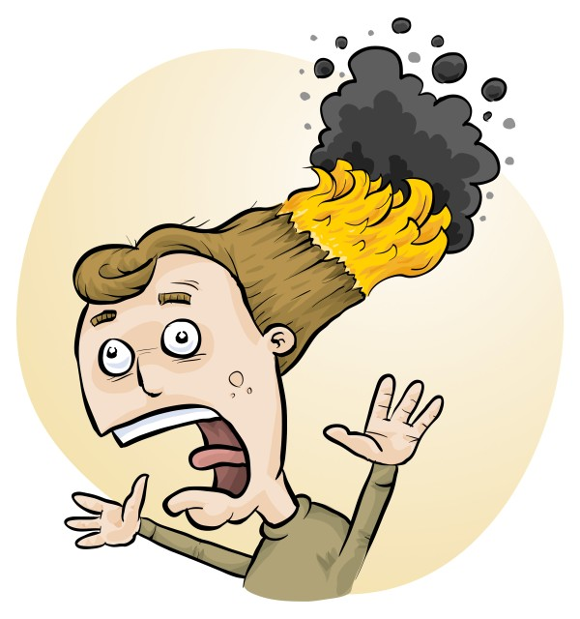
RiskAssess latest features, tips and tricks
James Crisp

Slide 2
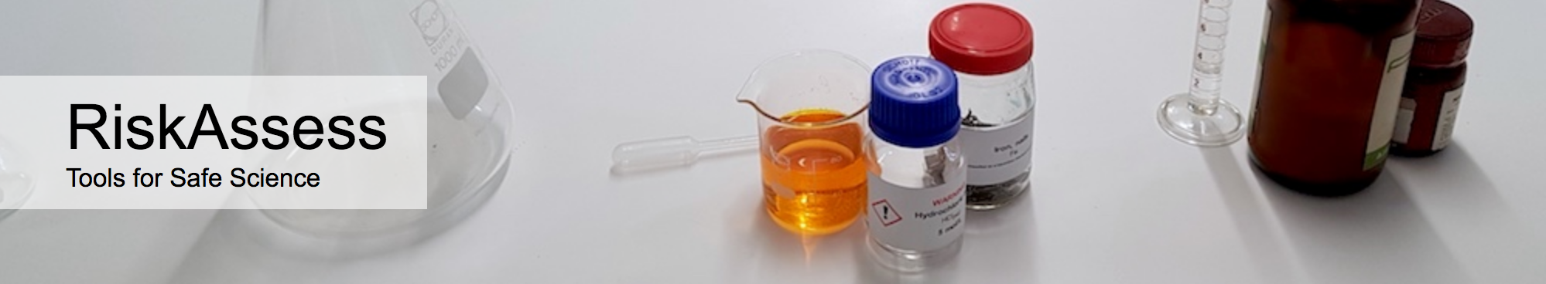
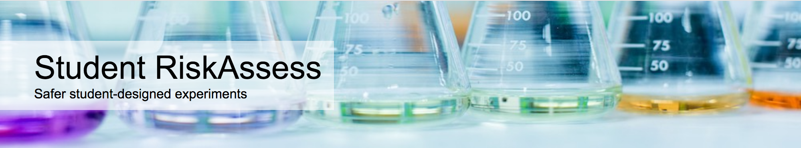
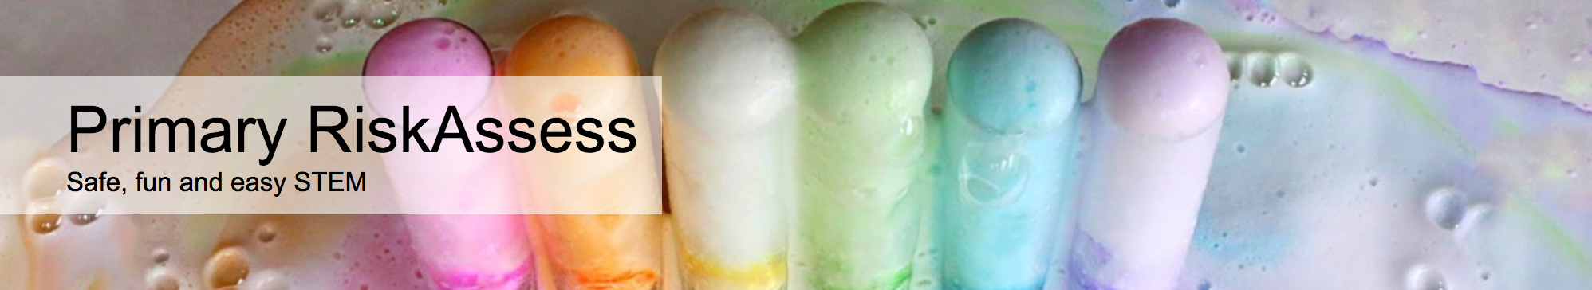
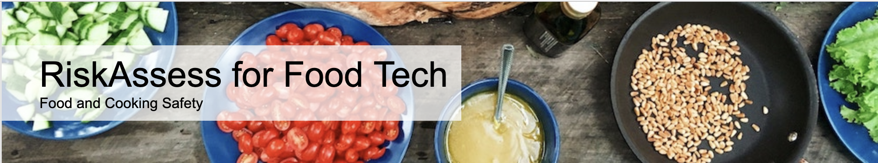
2700 schools
NSW: 777 (93%)
575 schools
NSW: 128 (15%)
201 schools
NSW: 186
50 schools
NSW: 18

Slide 3

Join the RiskAssess team!
Help people use RiskAssess and answer their questions
Develop documentation / screencasts
Design & test new features
Optionally present at conferences & meet-ups
10-20h/week, work from anywhere, flexible hours
Notes:
RiskAssess Support Manager

Slide 4
New Features

Slide 5
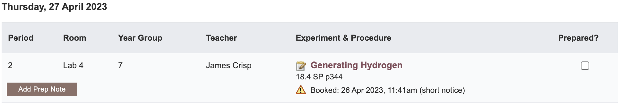
Notes:
Mandatory setting too in tools! Settable cut-off time coming soon (other than noon)

Slide 6
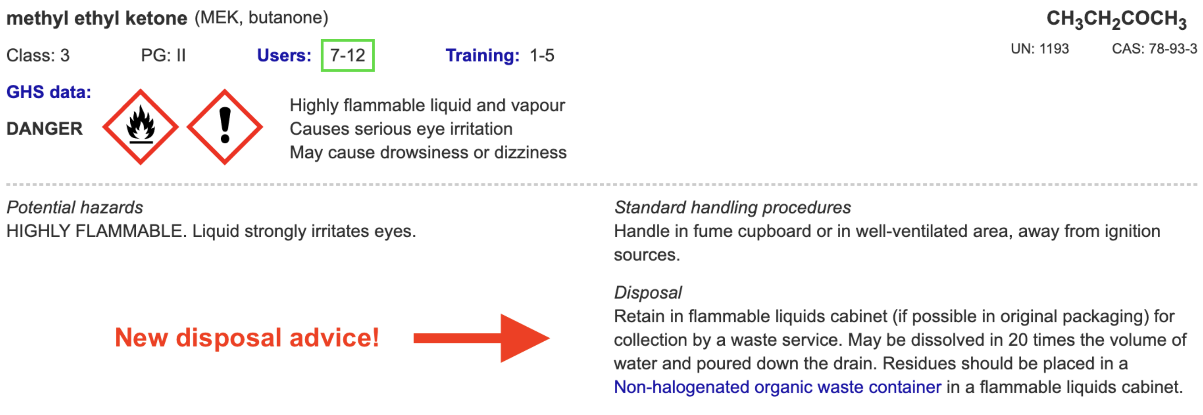
Disposal
Advice for all 3000 chemicals and solutions
Guide to disposal and waste container details
NEW Waste container labels!
Notes:
Requested at ASET last year

Slide 7
Safety Databases
>650
new and updated items!
Especially expanded coverage of
+ saturated solutions
+ test papers & reaction products
+ geological minerals and rocks

Slide 8
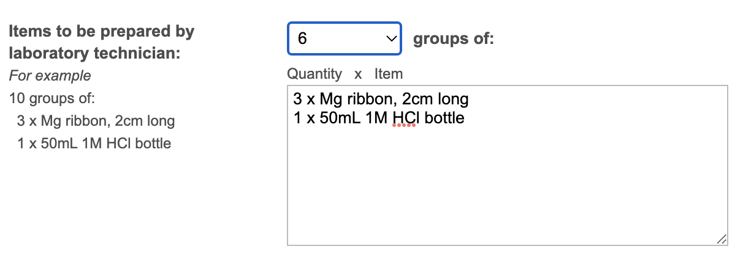
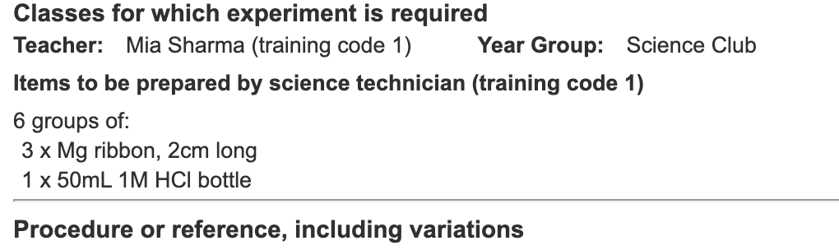
Notes:
Mandatory setting too in tools!

Slide 9
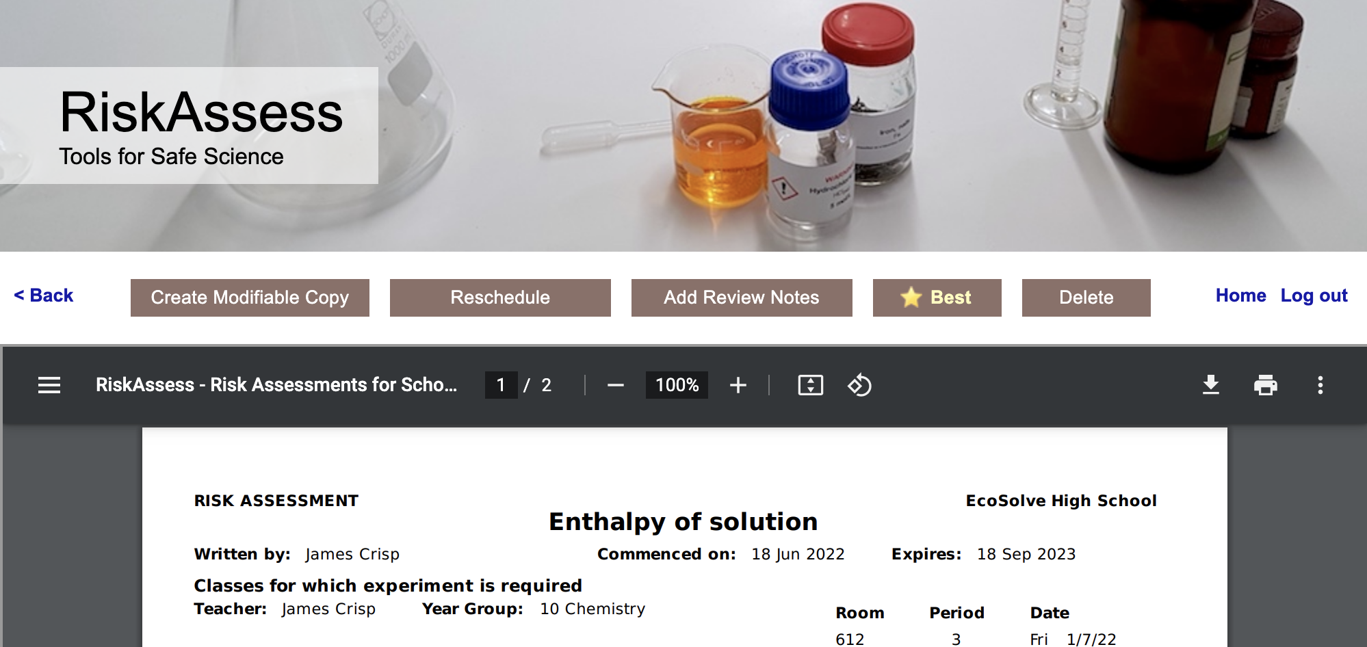
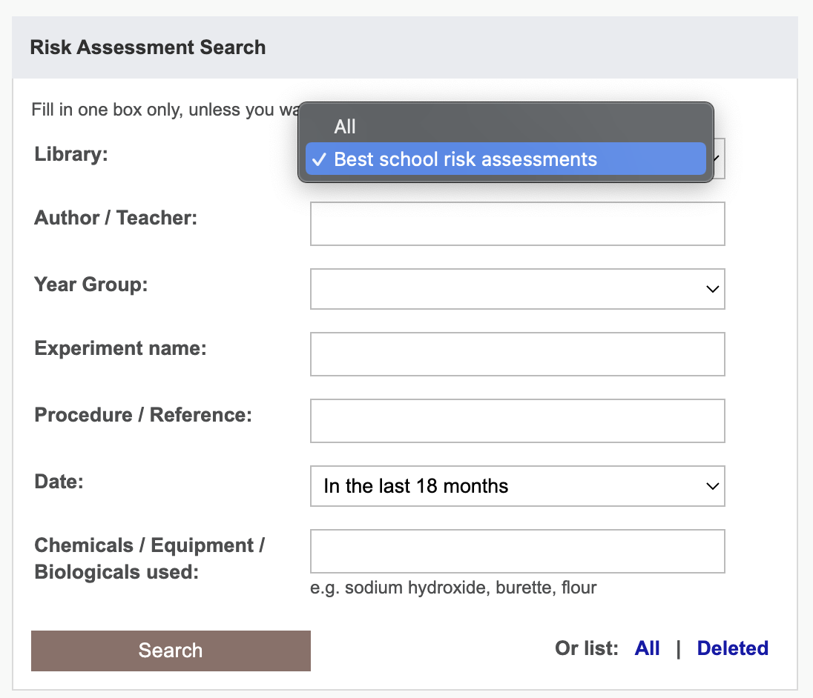
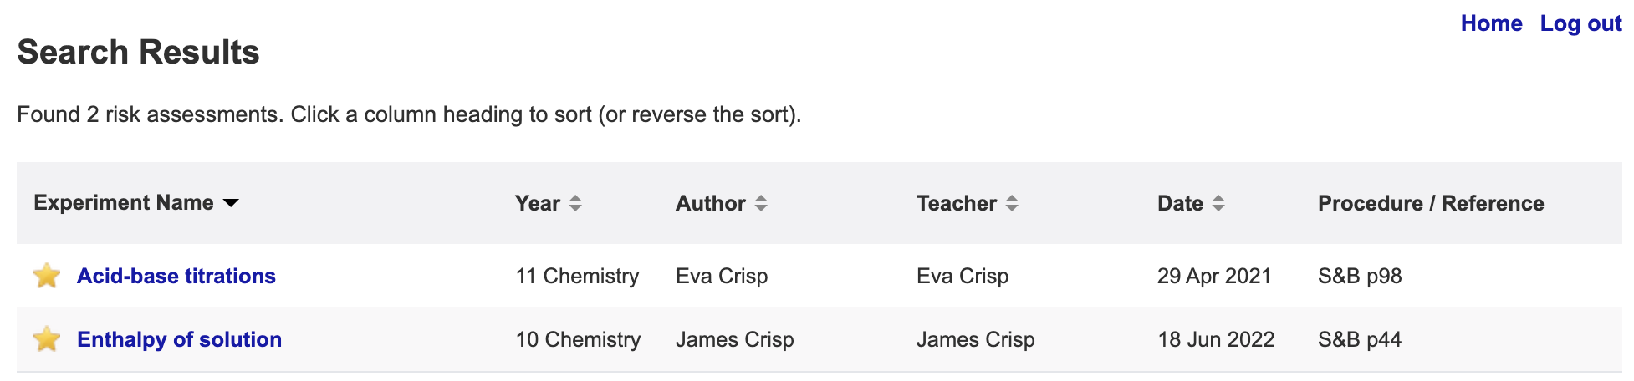

Slide 10

NESA: 7-10 Syllabus
The Working Scientifically strand involves students in the processes of:
…
Planning investigations
…
identifying ways of reducing risks and addressing ethical guidelines in the laboratory and in the field
…
Conducting investigations
…
assessing risks and addressing ethical issues in using equipment, materials and chemicals safely
Notes:
https://c.educationstandards.nsw.edu.au/wps/wcm/connect/57e31750-9802-4808-a6ce-7a3c2df0ff04/science-years-7-10-syllabus-2018.pdf?MOD=AJPERES&CVID=
From
https://c.educationstandards.nsw.edu.au/wps/portal/nesa/k-10/learning-areas/science/science-7-10-2018

Slide 11
NESA: Working Scientifically 11-12
Opportunities should be provided for students to engage with all the Working Scientifically skills in investigations.
…
Planning investigations
Students justify the selection of equipment, resources chosen and design of an investigation. They ensure that all risks are assessed, appropriate materials and technologies are sourced, and all ethical concerns are considered.
…
Conducting investigations
Students are to select appropriate equipment, employ safe work practices and ensure that risk assessments are conducted and followed. Appropriate technologies are to be used and procedures followed when disposing of waste.
Notes:
https://educationstandards.nsw.edu.au/wps/portal/nesa/11-12/stage-6-learning-areas/stage-6-science/biology-2017/working-scientifically
Same for chemistry, physics etc

Slide 12
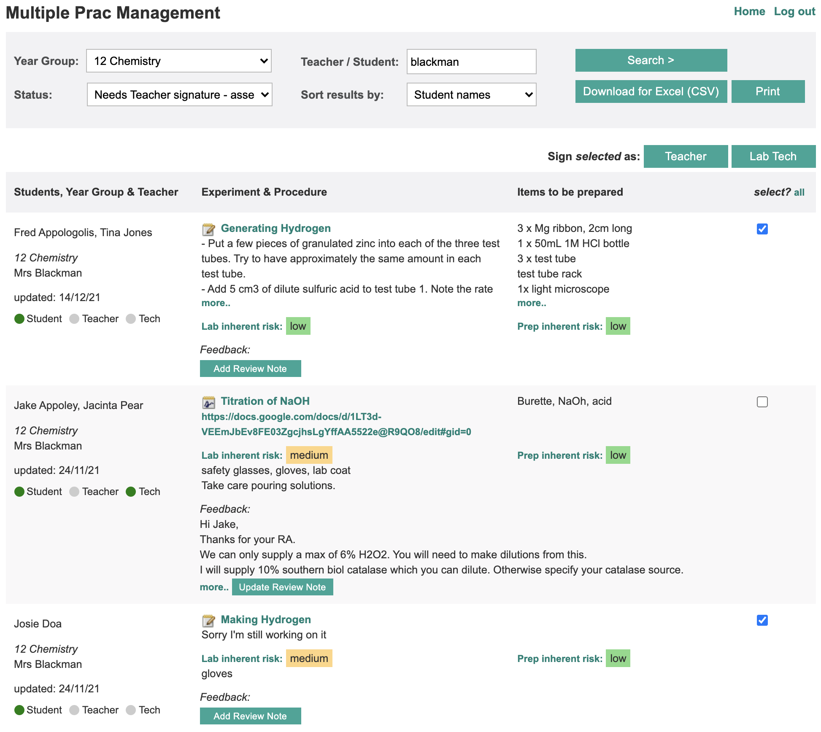

Slide 13
“Student RiskAssess helps students design their experiments more independently and become more aware of what they are doing rather than relying on the teacher to explain and confirm things like risks, and things to think about.”
Notes:
In the words of a teacher who put it better than I could..

Slide 14
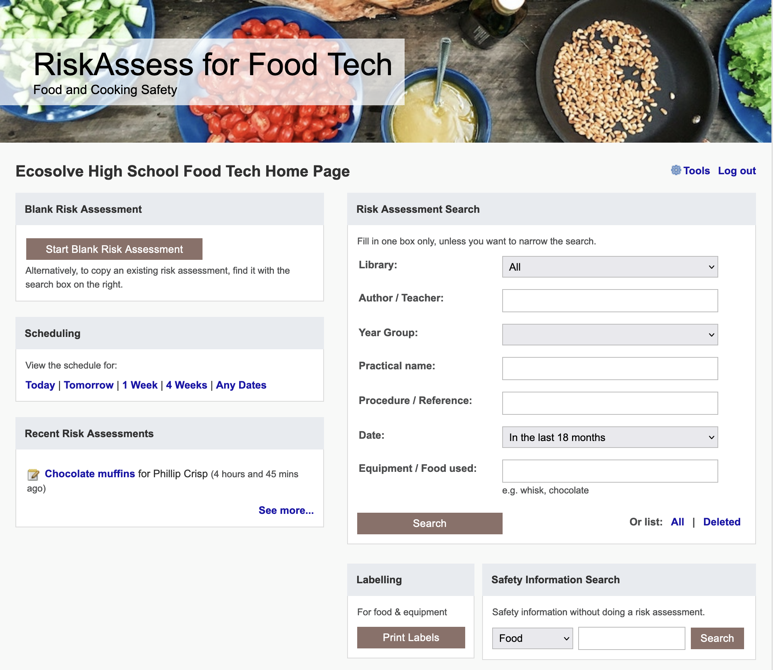

Slide 15
Future Ideas

Slide 16
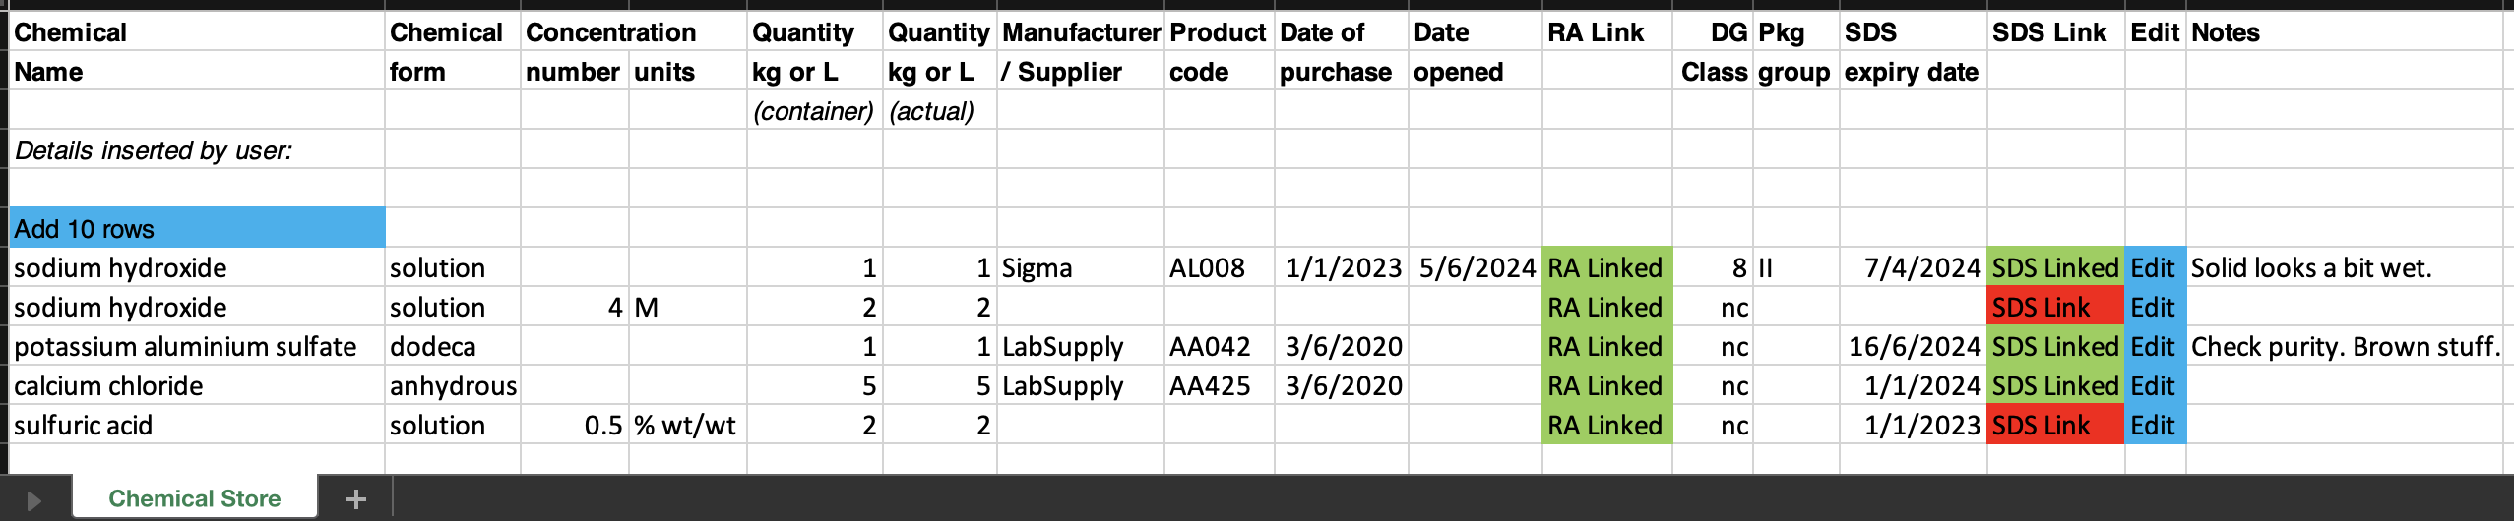
Chemical Register DRAFT
Import from CSV/template/Chemwatch??
Easy print out
Reports on SDS that need updating
Access for outside Science – Link/export/edit?
Location (building, room, location/shelf?); Split non-science?
Chemical Waste register? Same fields?

Slide 17
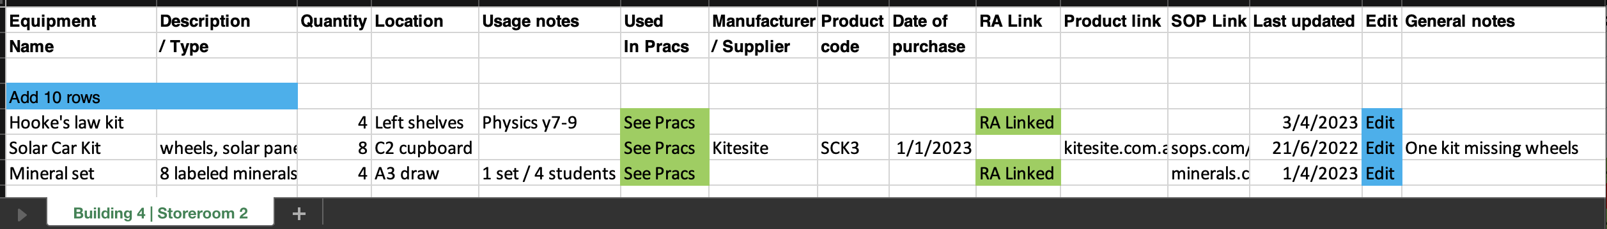
Equipment Inventory DRAFT
Import from CSV/template
Easy print out
Reports on not updated for X time?
Access for outside Science – not required?
Location (building, room, location/shelf?)
Other fields/reports? Need “Used in Pracs”?

Slide 18
Tips & Tricks

Slide 19
Menu
Shortcuts
icons, hcl, part name, day/month,
click banner, links, hot links, delete,
Best RAs, search on less, # & sort
Scheduling
Excel/csv, any dates, last week,
search, no# pracs, prep notes,
double booking, lodged date
Tools
customise year groups,
stocktaking & usage, invoice,
backup system, defaults
Resources
learning resources, faq, eBook,
videos, libraries: Stile+EP+Edrolo
Labels
standard & custom labels
multiple chemicals on sheet
mixtures, non-chemicals
free text, biohazard symbol
Operations
reschedule, archive risk
assessments, annual review,
tech-only RAs, review notes,
high/extreme: 3 signatures, list
Multiple classes
author update/modifiable copy
Student RiskAssess
view student PINs, not last year
multiple prac management

