Slide 1
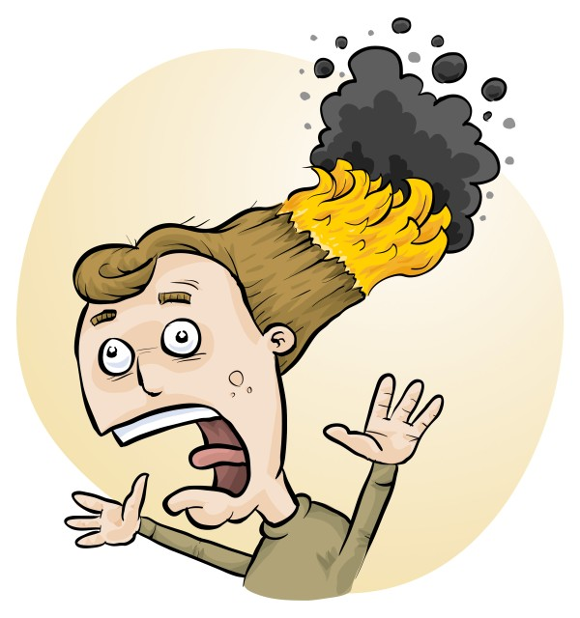
RiskAssess: New features and latest developments
Phillip Crisp and Eva Crisp

Slide 2
Major
• chemical disposal advice
• multiple prac management
• RiskAssess for Food Tech
• Allergy alert!
• Best school risk assessments
• scheduling search
• backups
• stocktaking

Slide 3
Significant
• printing multiple labels
• eBook libraries
• download for Excel (CSV)
• changing password
• rescheduling risk assessments
• advice on multiple scheduling

Slide 4
Convenient
• double-booking warnings
• add or remove year groups
• chemicals used and produced
• free text on large custom labels
• Biohazardous Infectious Materials
• labels: mol L⁻¹, M and % w/w
• CAS Registry Number
• icons partially-signed & rescheduled
• accounts email
• synchronise RA and SRA

Slide 5
Major
• chemical disposal advice
• multiple prac management
• RiskAssess for Food Tech
• Allergy alert!
• Best school risk assessments
• scheduling search
• backups
• stocktaking

Slide 6
Chemical Disposal
The quantity of chemical wastes generated in a school is very small compared with industry, agriculture, mining, etc.
HOWEVER
• A school is an educational institution
• Attitudes adopted during youth continue into adulthood
• Proper training should be given to those who will later be decision makers

Slide 7
The law
Follow local regulations for disposal of wastes to sewer and garbage, rather than the advice in RiskAssess.
Retain wastes for collection by a waste collection service, if not allowed to put down drain or in garbage
Inland waters usually have special requirements.

Slide 8
Disposal advice
Disposal advice in RiskAssess:
• provides a ‘default’, when no other advice is available
• prioritizes safety
• minimizes harm to the environment
• offers a responsible approach to student learning.

Slide 9
RiskAssess Advice
Individual chemical advice in ‘Disposal’ for each of 3000 chemicals and solutions
‘Disposal of chemical wastes’ https://www.riskassess.com.au/docs/DisposalOfChemicalWastes.pdf
‘Chemical waste containers’ https://www.riskassess.com.au/info/waste_containers
‘How to dispose of chemical wastes’ In: ‘Safety in Schools’ book, chapter C7

Slide 10
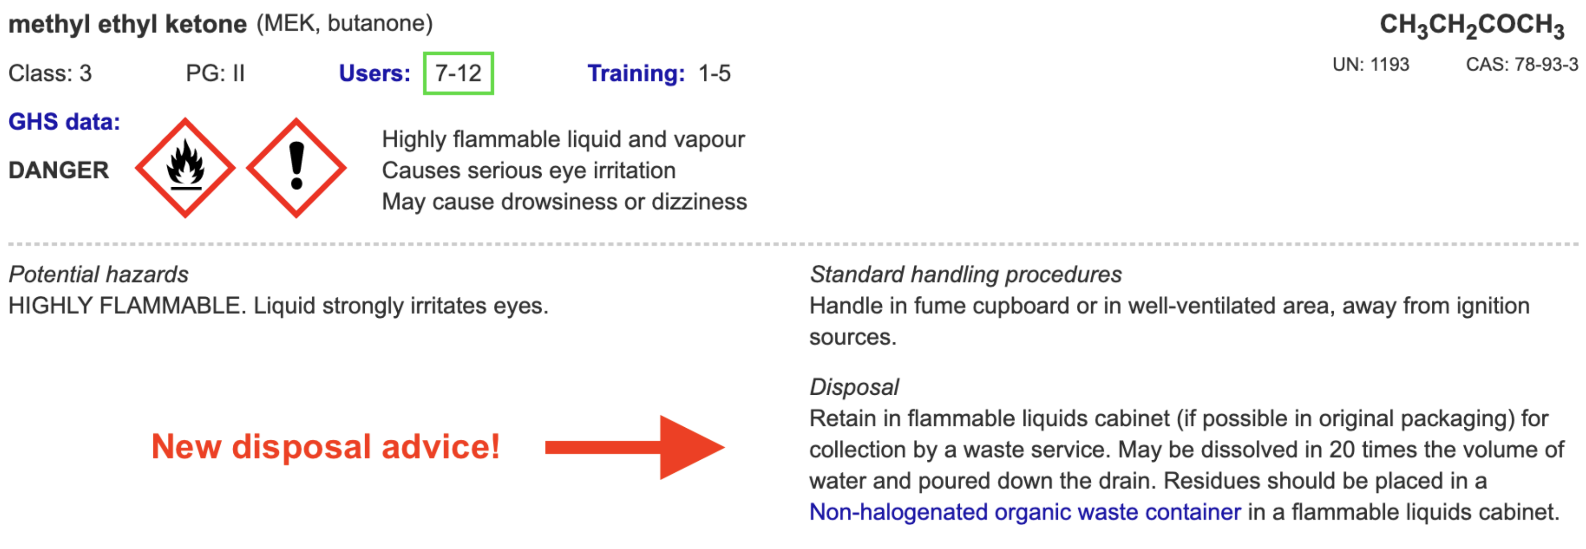

Slide 11
The improvement process
eliminate unwanted chemicals
redesign procedures to minimize waste production, e.g. spot reactions, recycling, destruction, less toxic chemicals
dispose of wastes LEGALLY SAFELY by - sewer - garbage - waste collection service

Slide 12
Chemical wastes in schools
*
Aqueous liquid wastes
• dissolved salts
• acidic or basic
• suspended particles
Water-miscible organic wastes
alcohols, e.g. methylated spirits
ketones, e.g. acetone
Water-immiscible organic wastes
• hydrocarbons, e.g. hexane, kerosene
• special chemicals, mostly for organic chemistry
Solid wastes
• precipitates, e.g. BaSO₄, Fe oxides

Slide 13
Problems in the sewer!
• toxic metals
e.g. Hg, Cd, Pb, As, . . . VERY BAD Cu, Ni, Co, . . . BAD since contaminate sludge $$$
• toxic persistent organic chemicals
e.g. pesticides since contaminate sludge $$$
• highly acidic/alkaline liquids since may damage pipes
• flammable liquids (water-immiscible) since may cause an explosion!

Slide 14
Aqueous liquid wastes
Pour down the sewer ONLY if the criteria of the water authority are met.
Otherwise, an environmentally responsible approach:
• neutralize to ~pH 6.5-8.5 (natural waters)
• only “safe” amount of each chemical down the drain
in order to minimise environmental harm from treated sewage when it is released into river or ocean.
All wastes exceeding a “safe” amount of a chemical should be retained for a waste collection service.
WHAT IS SAFE?

Slide 15
Estimation of “safe” quantities*
Consider the cation and anion in a salt separately.
Toxicity of a salt is dominated by the most toxic ion:
e.g. lead chloride, potassium dichromate
Some ions should not go down the drain at all
e.g. Hg²⁺, Pb²⁺, Cd²⁺, . . .
while others are OK almost without (school) limit
e.g. Na⁺, Ca²⁺, Cl⁻, SO₄²⁻, . . .
and other ions in between
* RiskAssess “Disposal of chemical wastes”, in Learning Resources

Slide 16
Tabulation and calculation
“Safe” disposal quantity for an ion for a class:
0 – 1000 g/day
Copper sulfate
copper: 1 g/day [Very toxic to aquatic life
with long lasting effects]
sulfate: 1000 g/day. [In solid laundry detergent]
Therefore, copper sulfate: 1 g/day (as solid or solution)
Enough for some spot tests down the drain.
Beyond that, wastes need to be collected!

Slide 17
Organic liquid wastes
Water-miscible
e.g. methylated spirits, acetone
Dilute 1 part to 20 parts water, then down the drain.
Prevents explosive air/vapour mixture.
Microorganisms in sewer will consume the chemicals.
Water-immiscible
e.g. hexane, kerosene
Retain for collection by waste service.
Separate hydrocarbon waste from halogenated waste.

Slide 18
Waste processing
Collection
Large bottles (e.g. 2.5 L ‘Winchesters’) correctly labelled, funnel at top (fume cupboard)
Treatment
Only if time and skilled people available
Disposal
To maximum recommended daily quantity:
• down the drain or into garbage
Otherwise, retain for waste collection
SEPARATE CONTAINER FOR EACH WASTE!

Slide 19
Solid wastes
Only “material of a domestic nature”
is allowed to be disposed of in the garbage
Consider
transport of garbage
leaching from landfill
Geologically-stable minerals
(precipitated during reactions)
e.g. barium sulfate (baryte)
No leaching of toxic chemicals in a domestic landfill.

Slide 20
Labelling and storage of wastes
All wastes must be
• labelled according to GHS e.g. RiskAssess custom label
• stored according to Dangerous Goods Class.
Flammable wastes in a flammable liquids cabinet!
Place each toxic waste in a SEPARATE container!
Recommend both:
large RA custom label with GHS information
large blank label for hand-writing the quantity and identity of each waste added to the container

Slide 21
Purpose of disposal advice
• assists decision making
• promotes safe disposal techniques
• focuses on avoiding serious environmental harm
• reduces the cost of waste collection service
• decreases emphasis on less harmful substances
• provides a learning tool for staff and students
• promotes care for the environment

Slide 22
Allergy alert!
Chemicals
If one or both hazard statements:
• May cause an allergic skin reaction
• May cause an allergy or asthma symptoms or
breathing difficulties if inhaled
Biological/Food
If known to cause anaphylaxis:
• One of 14 allergens listed by the European Union
• Multiple documented cases of anaphylaxis

Slide 23
Chemical allergens
Allergic skin reaction
common, may require medical attention
e.g. metal salts: Co, Ni, etc
chloroxylenol (Dettol)
epoxy resin/hardener
eucalyptus oil
Breathing difficulties
uncommon, but may be life threatening
e.g. persulfates
penicillin (ampicillin, . . . )
ammonium dichromate

Slide 24
14 allergens mandated in EU
Cereals containing gluten
Crustaceans
Eggs
Fish
Peanuts
Soybeans
Milk
Nuts
Celery
Mustard
Sesame seeds
Sulfur dioxide and sulfites
Lupin
Molluscs

Slide 25
Biological/Food allergens
Peanut allergy (and tree-nut allergy)
has been of most concern in schools
Other allergies
are common and sometimes severe or life-threatening
Distinguish ’food allergy’ and ‘food intolerance’:

Slide 26
Food allergy
Food allergy is an immune system reaction that usually occurs soon after eating or contact with a certain food. Even a tiny amount of the allergy-causing food can trigger signs and symptoms such as digestive problems, hives or swollen airways. In some people, a food allergy can cause severe symptoms or even a life-threatening reaction known as anaphylaxis.
Food intolerance
An adverse reaction to specific foods, which occurs in an estimated 10% of the population. Food intolerances are usually less serious than food allergies and do not involve the immune system.

Slide 27
Demonstration
• chemical disposal advice
• multiple prac management
• RiskAssess for Food Tech
• Allergy alert!
• Best school risk assessments
• scheduling search
• backups
• stocktaking

