Slide 1
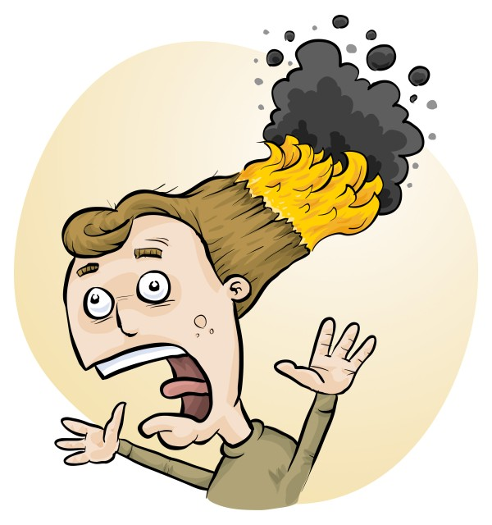
Primary STEM: Safe or Sorry?
James Crisp, Phillip Crisp, Eva Crisp
RiskAssess

Slide 2
Dilemma

Slide 3
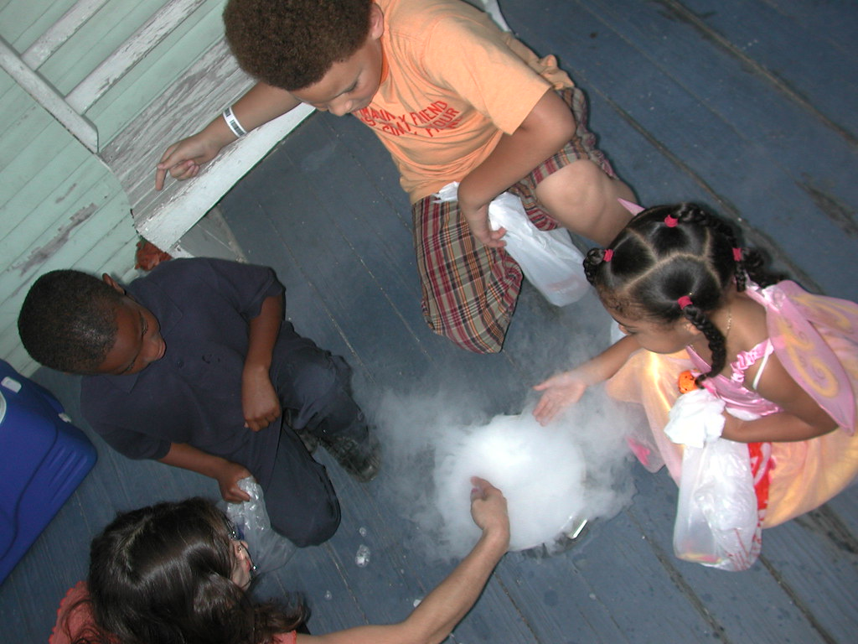
Photo by Bart Everson
https://www.flickr.com/photos/editor/286954900
Notes:
You want to do something cool.. That gets the kids interested and teaches them something.. But don’t want anyone to get hurt.
Maybe this one not such a great idea, with kids touching dry ice…

Slide 4
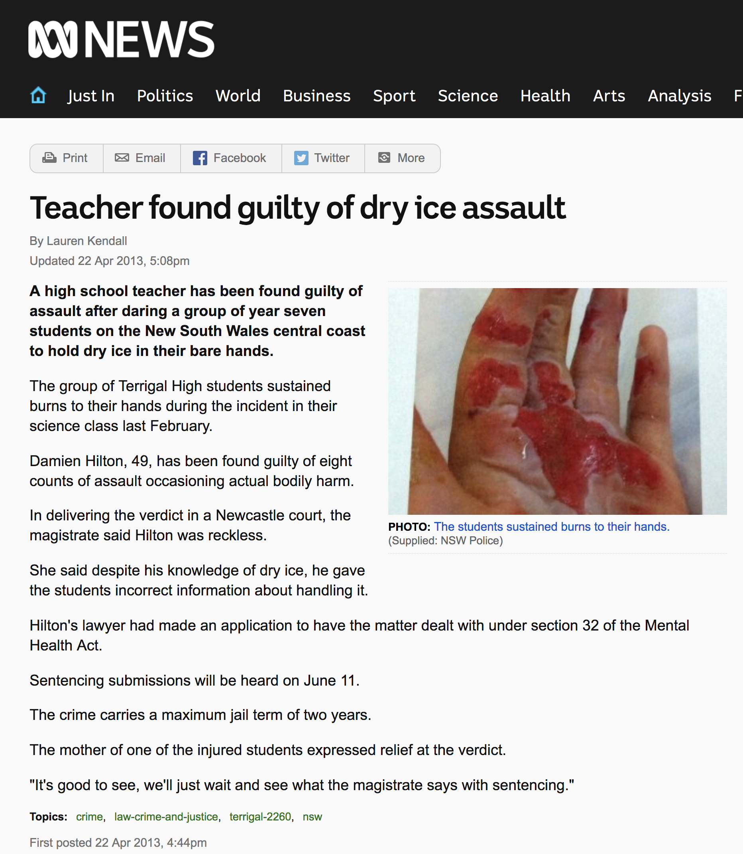
Notes:
If you touch dry ice with a damp/sweaty hand, the surface layer of moisture freezes and. when you pull away your finger, a layer of skin may be ripped off.
Terrigal High School: teacher got students to hold dry ice for a competition to see who could hold it the longest, videoed by one of the students in the class with phone.

Slide 5
THE LAW Work Health & Safety Act
. . . a duty . . . to eliminate/minimise risks to health and safety as far as is reasonably practicable.
. . . taking into account and weighing up all relevant matters including: (a) the likelihood of the hazard or the risk concerned occurring; and (b) the degree of harm that might result from the hazard or the risk . . . .
Part 2, Sections 17 and 18
Notes:
Then there’s the law …

Slide 6
all relevant matters includes
facilities available
behaviour of the class
students with special needs
students with allergies, etc
(NOT book “risk assessment”, tick sheet, etc)
likelihood
degree of harm consideration requires
proper risk assessment using a risk matrix
e.g. Aust/ISO Standard on Risk Management

Slide 7
Safety requirements in the Australian Curriculum for Science
Years 3-4 Safely use appropriate materials, tools or equipment . . . (C) Discussing safety rules for equipment and procedures (E) (Students) discuss ways to safely use equipment . . (A) Years 5-6 Use equipment and materials safely, identifying potential risks (C) Discussing possible hazards involved in conducting investigations and how these risks can be reduced (E) (Students) describe potential safety risks when planning methods (A) C = Content description E = Elaboration A = Achievement standard
Notes:
And the curriculum

Slide 8
Challenges
Science training for Primary teachers
Lots to places to find STEM investigations.. But how good are they??
Risk assessment paperwork!
But serious injuries could occur if something goes wrong
Notes:
Science background or Training is rare
Find experiments on youtube, web etc

Slide 9
And never enough time to do it all !!!

Slide 10
Wouldn’t it be good if there was...

Slide 11
A simple tool that gives you:
easy access to previous experiments done at your school
easy access to safety information
easy system for risk assessment with minimal paperwork

Slide 12
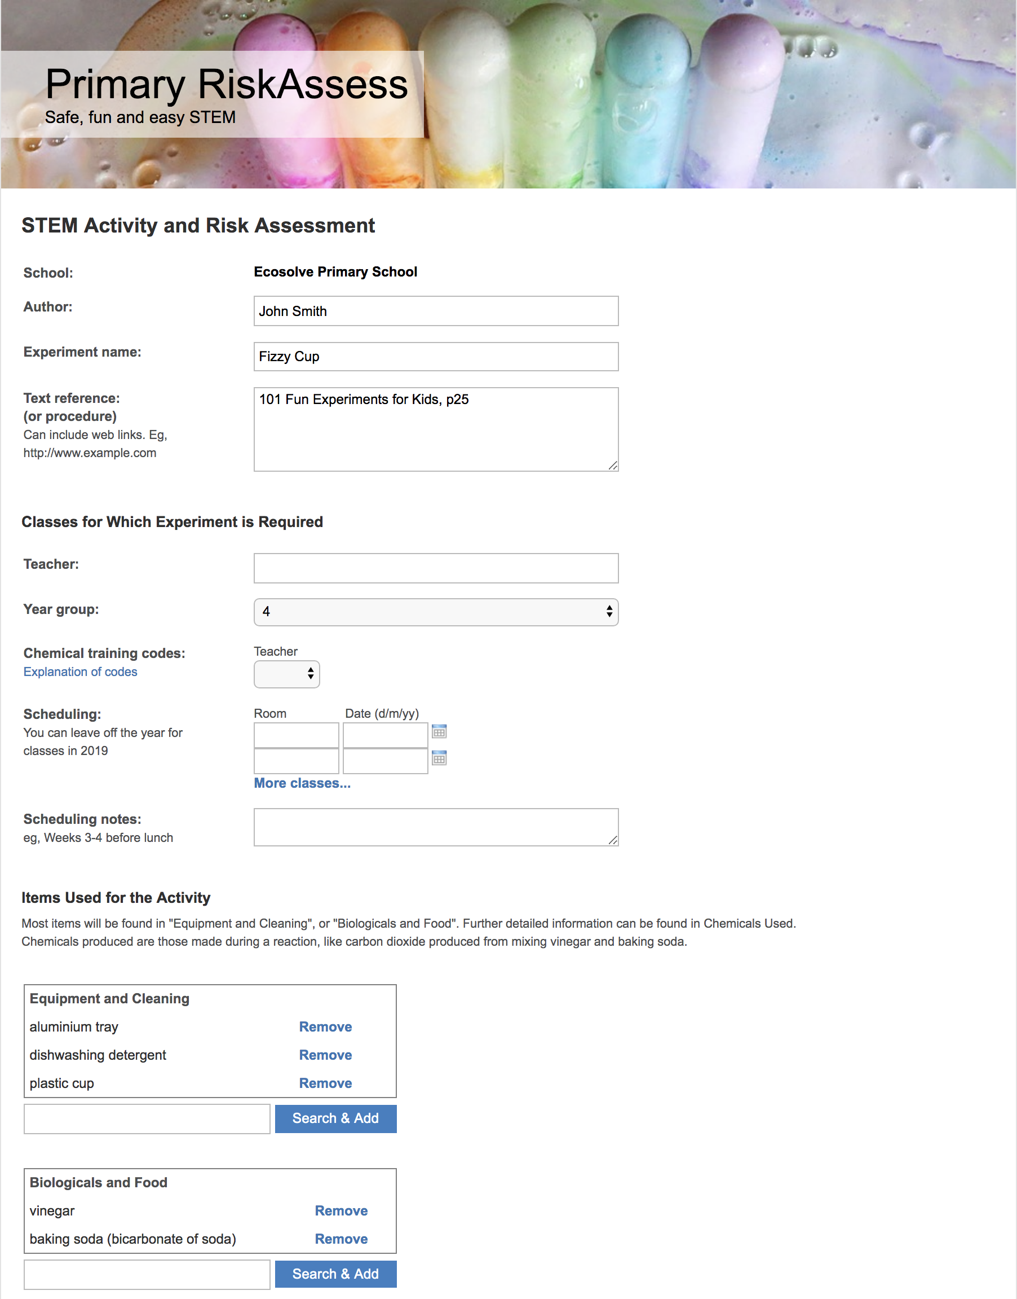
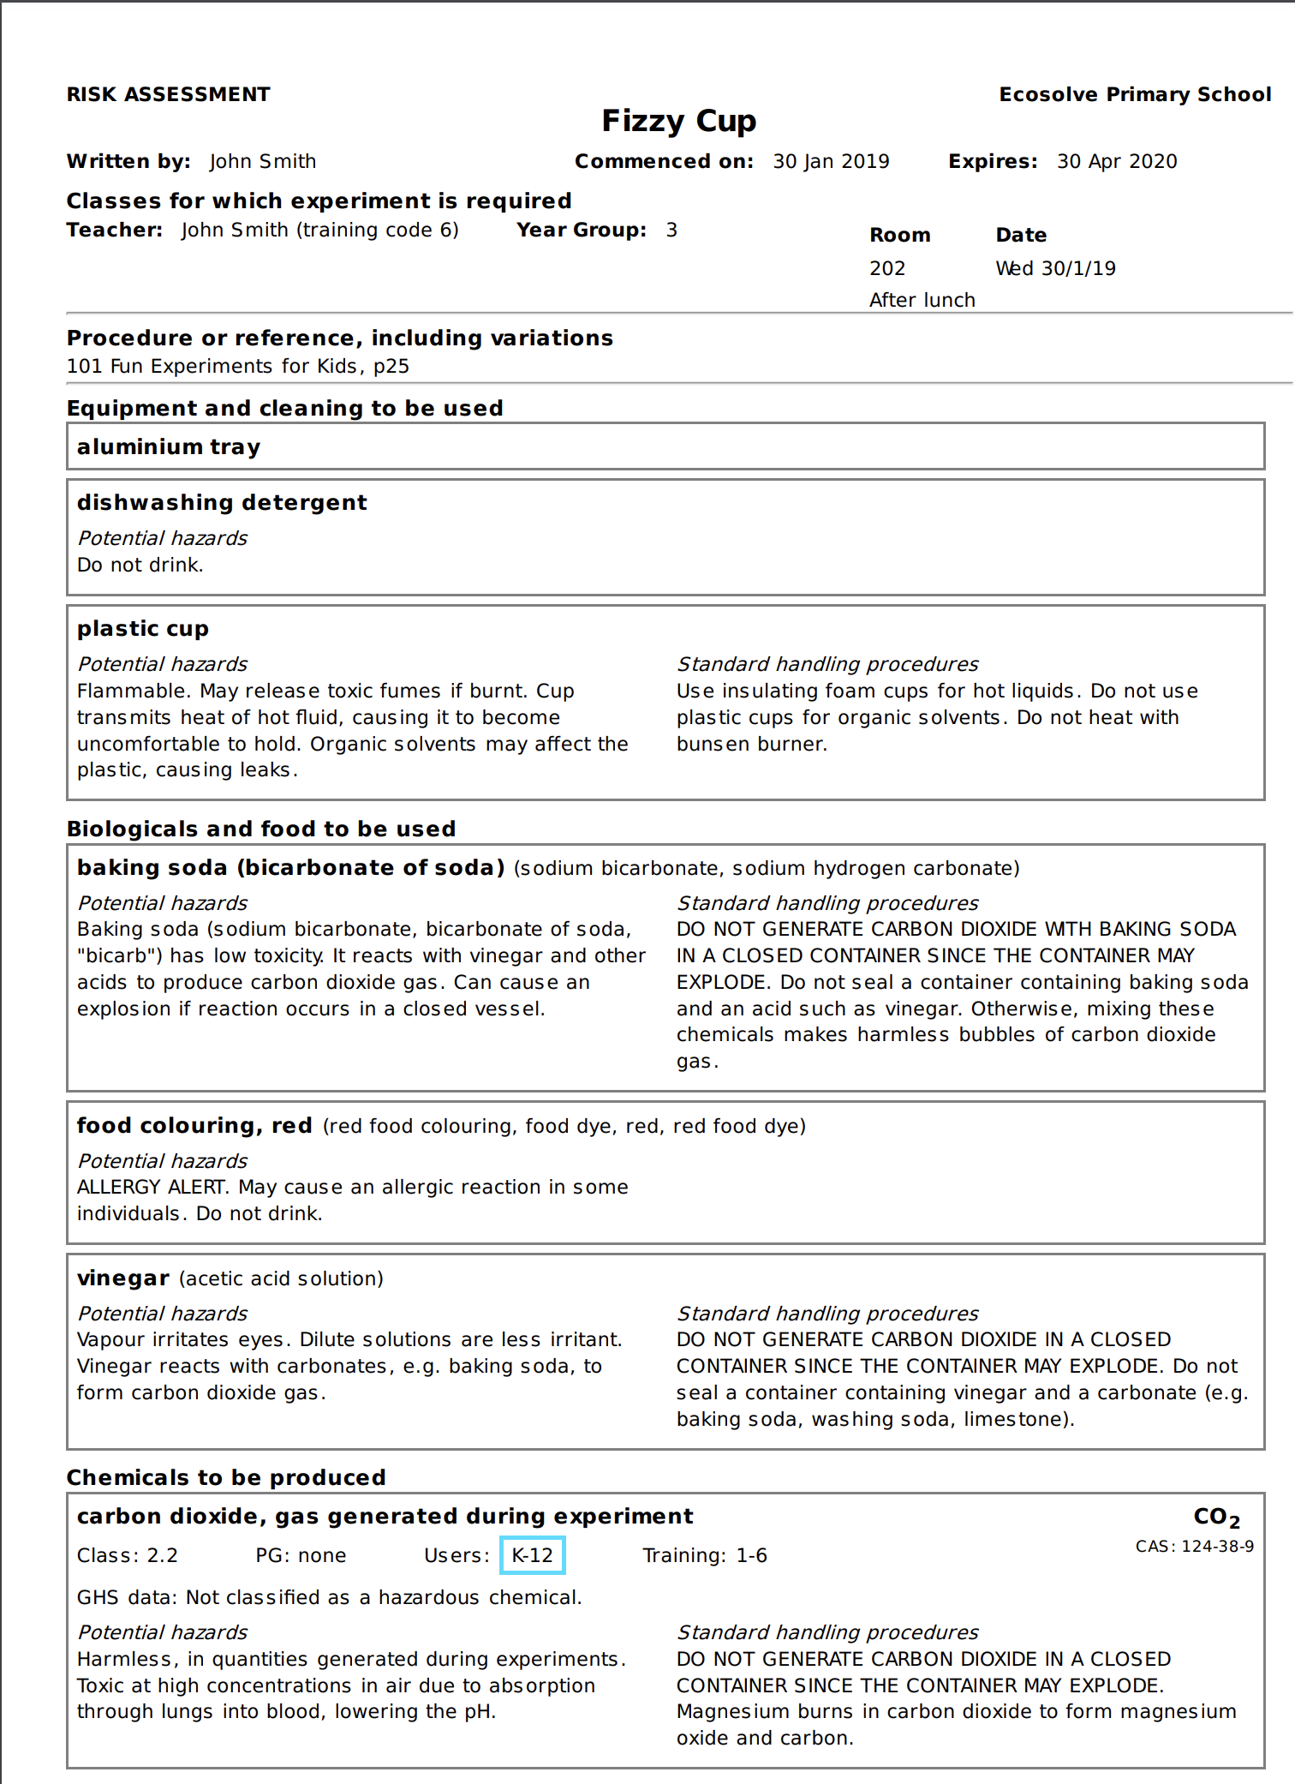

Slide 13
Primary RiskAssess
Safety information and risk assessment system
Web based, nothing to install
Designed for Primary use
Quickly find and re-use previous investigations with “Create Modifiable Copy”
Minimal paperwork

Slide 14
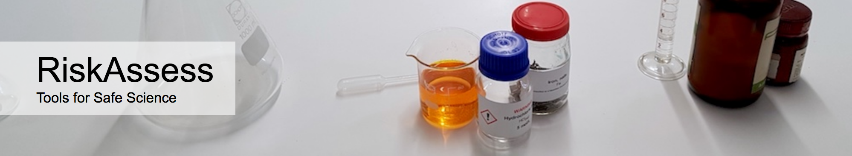
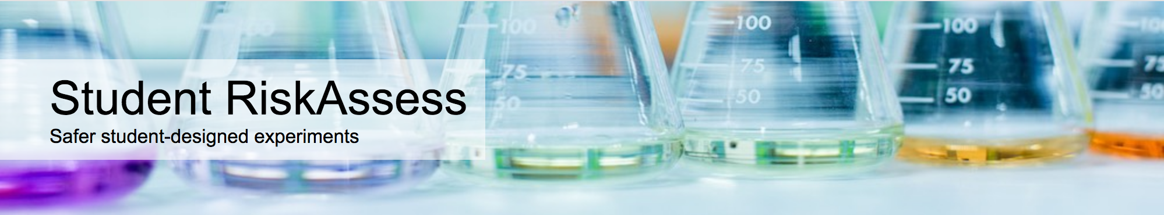
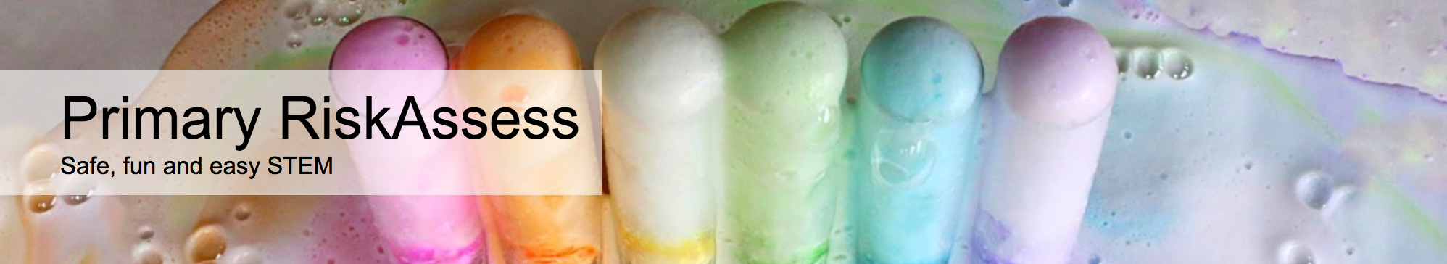
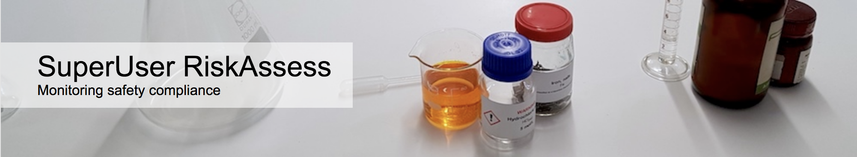
High Schools AU: 1770, 65% NZ: 140, 26%
460 high schools
170 primary schools
6 groups
Notes:
From a good pedigree of RiskAssess for high schools,
tried and tested with 170 primary schools using it

Slide 15
Assess risks
≥Medium
risk level
Low
risk level
Add control measures
DO
EXPERIMENT
Inherent level of risk
= risk level without any control measures besides “routine procedures”
Residual level of risk
= risk level with control measures in place
Notes:
Cyclical process.
Control measures become part of the STEM activity.

Slide 16
Risk control
Hierarchy of options:
elimination
substitution
isolation
engineering
administration
personal protective equipment
Notes:
elimination: Don't use caustic soda (corrosive, used for clearing drains) substitution: Use vinegar, in place of hydrochloric acid (e.g. with baking soda) isolation: Hole in the ground with fence around it to stop children falling in engineering: Sensor to stop door closing on person entering lift administration: Rule about not leaving school grounds unaccompanied personal protective equipment: Apron, gloves (for messy activities)

Slide 17
Details
Access from school / home / mobile device
Unlimited number of users allowed
Frequent updates based on user feedback
Free learning resources, support and advice
Inexpensive: $250 + GST per school campus

Slide 18
Advantages
Enables you to do more fun and interesting investigations
BUT Safely!
Plus
It’s quick and easy
And you comply with the law and curriculum

Slide 19
DEMO

