Slide 1
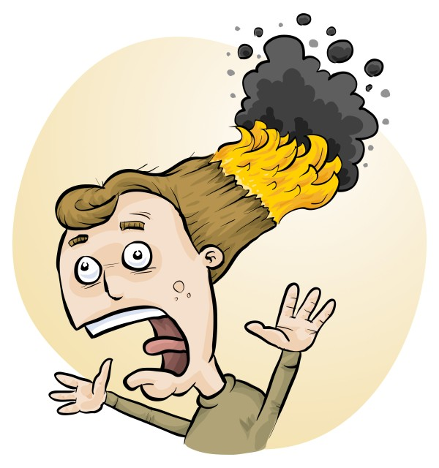
School laboratory ‘accidents’: recent injuries and how to prevent more
Phillip Crisp and Eva Crisp

Slide 2
Most common laboratory injuries
MAJOR
methylated spirits fires
hot water scalding
chlorine, sulfur dioxide inhalation
sodium hydroxide in eyes
biological: extreme allergies, blood
MINOR
acids/alkalis on skin (or in eyes)
heat burns, esp. Bunsen
cuts, esp. broken glass

Slide 3
Flammable liquids
methylated spirits
e.g. steam engine
chlorophyll extraction *
coloured flames (MCl_{n}, borates)
Others
petrol and liquid hydrocarbons
acetone
Bunsen burner on ‘safety’ = ignition source
Tools (e.g. angle grinder) = ignition source *

Slide 4
Flammable solids
sulfur
e.g. plastic sulfur *
paper
e.g. student ignition in Bunsen
Others
charcoal blocks *
sulfur + KClO₃ *
gummy bear + KClO₃ *

Slide 5
Flammable gases
Town gas
e.g. whole building explosion *
leak from fitting/Bunsen
Hydrogen
e.g. Na + water *
Al + NaOH(aq) *
LPG
e.g. leaks from fittings (barbeque)
LPG + O₂ *

Slide 6
Toxic gases
sulfur dioxide
e.g. heating sulfur *
chlorine
e.g. bleach + acid (e.g. coca cola) *
ammonia, e.g. spills
• bromine + hexene *
• iodine vapour

Slide 7
Corrosive chemicals
alkalis e.g. NaOH, concentrated and hot *
acids
e.g. H₂SO₄, conc (carbon+soda snakes) *
HCl, conc
ammonia
e.g. conc NH₃

Slide 8
Hot objects
Bunsen burner + tripod + gauze e.g. numerous minor burns
hot beakers, flasks, test tubes
e.g. numerous minor burns
hot glass rods/tubing, wires, crucibles
e.g. flame tests, glass working
hot plates
e.g. burns to forearm
• thermite reaction *

Slide 9
Cold burns
dry ice e.g. prolonged skin contact *
liquid nitrogen
e.g. prolonged skin contact *
asphyxiation *
Don’t drink! *

Slide 10
Scalding liquids
Beaker of liquid on tripod & gauze e.g. major burns; easy to knock over
Liquid ejected from test tube
e.g. minor or major burns

Slide 11
Biological
extreme allergies e.g. nuts * (Epipen training, avoid peanut oil, etc)
human blood e.g. blood group testing *
• animal bites
• microbiology: contamination, flames

Slide 12
FIRST AID
FOR
corrosive chemicals on skin or in eyes
heat burns and scalds
APPLY
COLD WATER
Flush skin, eyes until chemical removed or for at least 20 minutes for burns (exceptions: benzene, HF)
If significant incident, follow emergency procedures without delay

Slide 13
Perspective
Manual handling injuries cause most days off work
Extreme allergies, especially to nuts
cause life-threatening situations
Motor vehicle accidents
(bus, parent vehicle) cause severe injuries
• Laboratory injuries are significant
and nearly all can be prevented.

Slide 14
Accidents don’t just happen!
*

Slide 15
Burns to student
Flame
apparently
extinguished
Large volume of
methylated spirits
Incorrect
first aid
Inexperienced
teacher
Teacher
not
trained
Students
not
trained
No
fire
blanket
Almost
colourless
flame
Container
too large
Inadequate
labelling
No risk assessment
Inadequate
training
Non-compliance
with law

Slide 16
How to spot dangers
Untrained people doing things
Failure to assess risks
Disorganised workplace
Change without preparation
. . . . . .

Slide 17
How to prevent an “accident”
Understand the potential hazards associated with equipment, chemicals and biological/food items
Carry out a risk assessment before you do anything!
Introduce control measures:
Protect against likely problems (e.g. tray beneath)
Physically protect the work area (e.g. fume cupboard)
Protect yourself (e.g. safety glasses, gloves)
Know emergency procedures and first aid
RiskAssess can help!

Slide 18
RiskAssess demonstration

