Slide 1
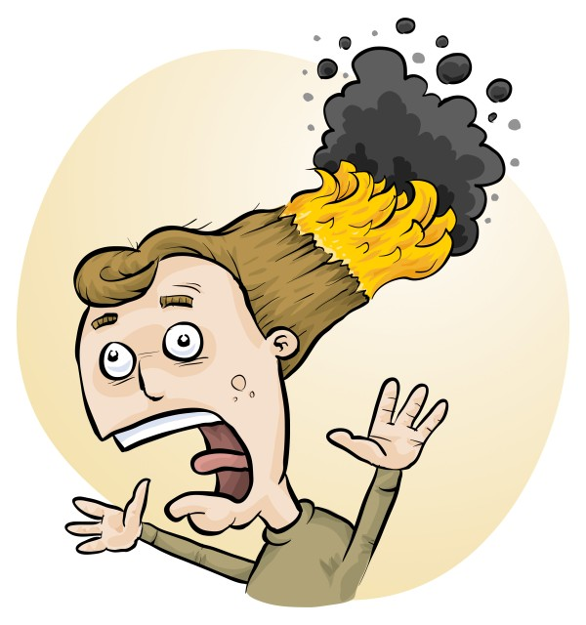
Identifying risks in popular laboratory experiments
Phillip Crisp and Eva Crisp

Slide 2
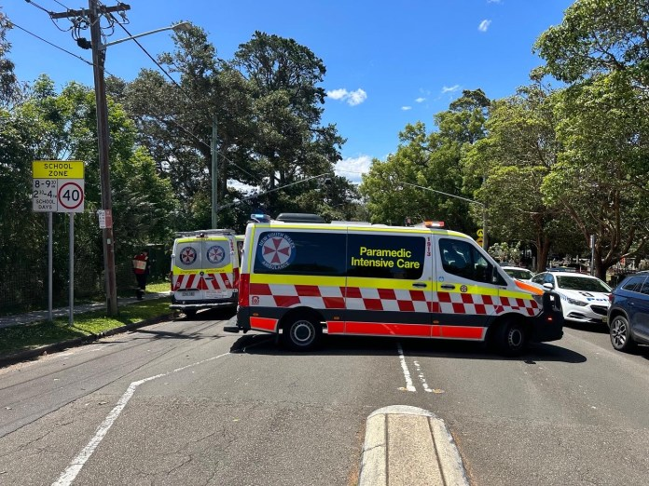
21 November 2022 Manly West Public School
2 students with serious burns
9 students with superficial burns
1 teacher with minor burns
• S Keoghan, M. Muroi and M. Gorrey “’Something had to be up’: Children in hospital as experiment goes wrong” Sydney Morning Herald, 21/11/22.
• “Hazmat incident at Manly West Public School”, Manly Observer, 21/11/22.
• E. Visontay and T. Rose “Children suffer serious burns after outdoor science experiment goes wrong at Sydney school” The Guardian, 21/11/22.

Slide 3
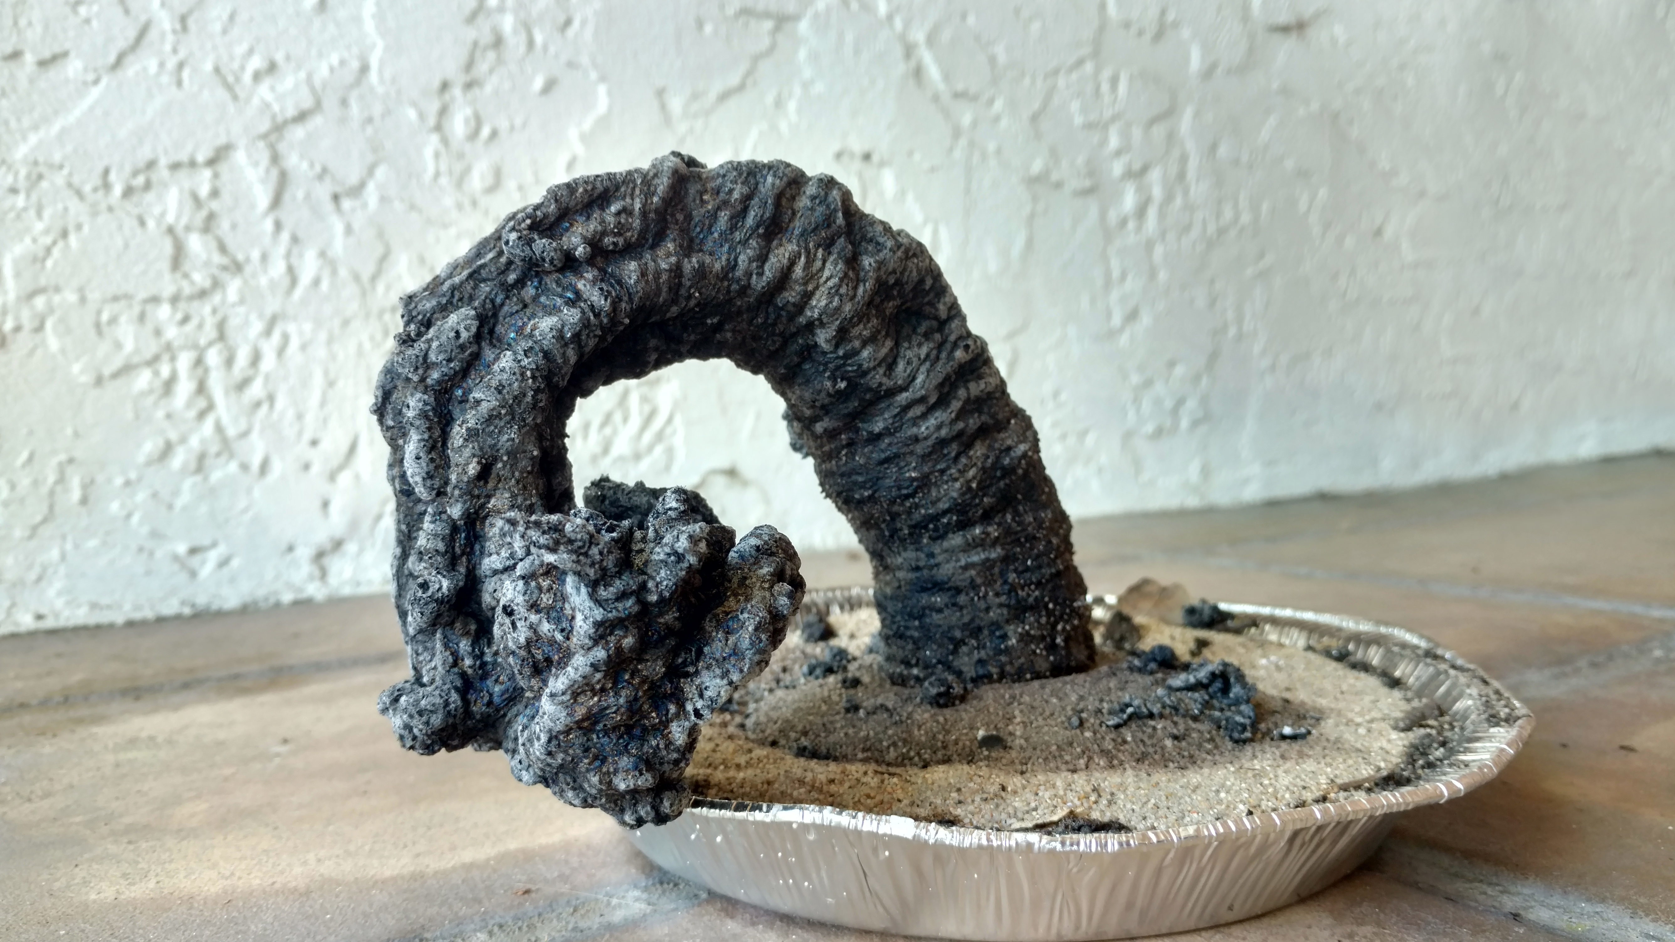
What happened?
Carbon sugar snake
(black snake, sugar snake)
sugar
sodium bicarbonate
methylated spirits / lighter fluid
From the limited information in the news reports, apparently:
• Demonstration performed outdoors on a very windy day
• Gust of wind blew burning material onto students
• Suspect a large-scale demonstration (since so many injured)
Further information?

Slide 4
Work Health & Safety Act 2011
. . . a duty . . . to eliminate/minimise risks to health and safety as far as is reasonably practicable.
. . . taking into account and weighing up all relevant matters including: (a) the likelihood of the hazard or the risk concerned occurring; and (b) the degree of harm that might result from the hazard or the risk . . . .
Part 2, Sections 17 and 18

Slide 5
all relevant matters includes
facilities available
behaviour of the class
students with special needs
students with allergies
• . . . . . . . .
(NOT book “risk assessment”, tick sheet, etc)
likelihood
degree of harm consideration requires
proper risk assessment using a risk matrix
e.g. Aust/ISO Standard on Risk Management

Slide 6
Chemicals most likely to cause injury
MAJOR
methylated spirits fires
hot water scalding
chlorine, sulfur dioxide inhalation
sodium hydroxide in eyes
MINOR
acids/alkalis on skin (or in eyes)
Don’t follow YouTube without further research!

Slide 7
Flammable liquids
methylated spirits
e.g. chlorophyll extraction *
steam engine
coloured flames (MCl_{n}, borates)
Others
petrol and liquid hydrocarbons
acetone
Bunsen burner on ‘safety’ = ignition source
Tools (e.g. angle grinder) = ignition source *

Slide 8
Flammable solids
sulfur
e.g. plastic sulfur *
paper
e.g. ignition in Bunsen flame
Others
sulfur + KClO₃ *
gummy bear + KClO₃ *

Slide 9
Flammable gases
Town gas
e.g. whole building explosion *
leak from fitting/Bunsen
Hydrogen
e.g. Na + water *
Al + NaOH(aq) *
LPG
e.g. leaks from fittings (barbeque)
LPG + O₂ *

Slide 10
Toxic gases
sulfur dioxide
e.g. heating sulfur *
chlorine
e.g. bleach + acid (incl. coca cola) *
ammonia, e.g. spills
• bromine + hexene *
• iodine vapour

Slide 11
Corrosive chemicals
alkalis e.g. NaOH, concentrated and hot *
acids
e.g. H₂SO₄, conc (another black snake) *
HCl, conc
ammonia
e.g. conc NH₃

Slide 12
Cold burns
dry ice e.g. prolonged skin contact *
liquid nitrogen
e.g. prolonged skin contact *
asphyxiation *
Don’t drink! *

Slide 13
Scalding liquids
Beaker of liquid on tripod & gauze e.g. major burns; easy to knock over
Liquid ejected from test tube
e.g. minor or major burns

Slide 14
Equipment most likely to cause injury
COMMON
• hot objects, e.g. Bunsen, hotplate, glue gun
• sharp objects, e.g. broken glass, scalpel
• cracked beakers, flasks, etc
LESS COMMON
• short-circuited batteries
• latex gloves
Students throwing things!

Slide 15
Hot objects
Bunsen burner + tripod + gauze e.g. numerous minor burns
hot beakers, flasks, test tubes
e.g. numerous minor burns
hot glass rods/tubing, wires, crucibles
e.g. flame tests, glass working
hot plates
e.g. burns to forearm
• thermite reaction

Slide 16
Biological materials most likely to cause injury
Extreme allergic reactions to foods:
• peanuts, peanut oil, peanut products
• tree nuts
• shellfish and crustaceans (including sea monkeys *)
and, less commonly, eggs, milk, wheat, soy, fish, sesame, . .
Allergic reactions to plant materials, including:
• rhus (leaves, stems)
• London Plane tree (trichomes)
• pollens and moulds
Animal bites and stings
e.g. ticks, leeches, bees, pet animals

Slide 17
extreme allergies e.g. nuts * (Epipen training, avoid peanut oil, etc)
human blood e.g. blood group testing *
• culturing pathogens

Slide 18
Laboratory injuries are significant
and nearly all can be prevented.

Slide 19
How to spot dangers
Lack of knowledge
Untrained people doing things
Failure to assess risks
Failure to test experiment beforehand
Disorganised workplace
No ‘routine procedures’ for lab
Spur-of-the-moment experiments
Change without preparation
YouTube without thinking
. . . . . .

Slide 20
How to prevent an “accident”
Understand the potential hazards associated with equipment, chemicals and biological/food items
Carry out a risk assessment before you do anything!
Introduce control measures to make risk level LOW:
Protect against likely problems (e.g. tray beneath)
Physically protect the work area (e.g. fume cupboard)
Protect yourself (e.g. safety glasses, gloves)
Know emergency procedures and first aid
RiskAssess can help!

Slide 21
RiskAssess demonstration
Website
www.riskassess.com.au
Learning resources
www.riskassess.com.au/info/learning_resources

