Slide 1
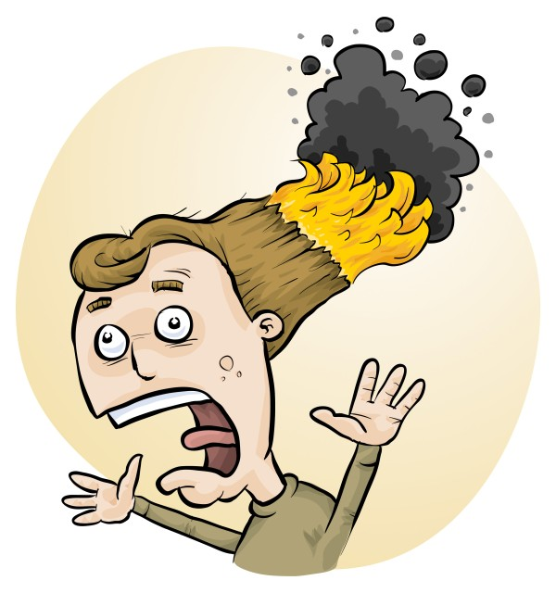

The joy of student-designed experiments
Phillip Crisp, Eva Crisp & James Crisp

Slide 2
QCAA
YEARS 7-10
Achievement standard
Students plan and conduct safe, reproducible investigations to test relationships and aspects of scientific models.
(following Australian Curriculum: Science)

Slide 3
QCAA
YEARS 11-12 Syllabus objectives
For: Biology, Chemistry, Physics, Earth and Environmental Science, Marine Science, Agricultural Science
Investigate phenomena
They manage risks, environmental and ethical issues and acknowledge sources of information.

Slide 4
QCAA
YEARS 11-12 Syllabus objectives
For Science in Practice
Execute procedures
Students follow workplace health and safety procedures and ethical and environmental considerations.
Plan investigations and projects
They ensure that workplace health and safety and ethical considerations and environmental considerations are incorporated into planning.

Slide 5
Why do a risk assessment?
Reduced frequency of injuries
  to students
  to school staff
Reduced costs for paperwork, litigation and payouts
Compliance with the law
(training for industry)
Helps maintain variety of chemicals and equipment
Compliance with the Queensland Curriculum
Students learn a lifelong skill

Slide 6
Steps for Student Designed Pracs
Staff collaborate & plan type of investigation
Students design the investigations and do risk assessments
Staff review and provide feedback on planned pracs
Source items required and prepare for all the pracs
Get the items to the right students
Students do the pracs
Disposal and cleanup
Student write up investigation
Marking and feedback
Student RA

Slide 7
Steps for Student Designed Pracs
Staff collaborate & plan type of investigation
Students design the investigations and do risk assessments
Staff review and provide feedback on planned pracs
Source items required and prepare for all the pracs
Get the items to the right students
Students do the pracs
Disposal and cleanup
Student write up investigation
Marking and feedback

Slide 8
Type of Investigation
Small variations in procedure
Suggested experiments
Fixed set of items
Open ended

Slide 9
Ideas for Student Designed Pracs
Look at the de-identified data in Student RiskAssess (620 schools)!

Slide 10
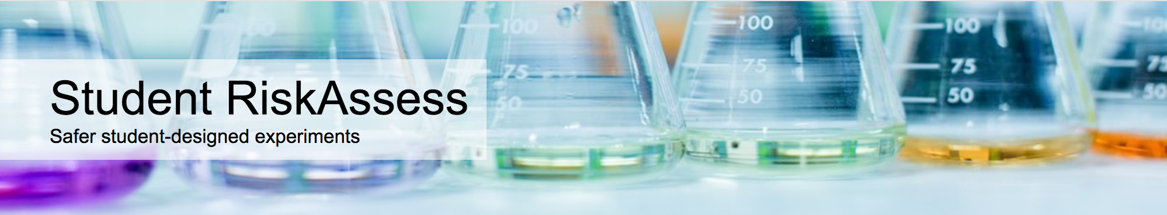
Online system that helps:
  students design and document their pracs
  staff to review, provide feedback and sign off on the pracs
  ordering & preparation
  disposal afterwards
  lots of learning resources
Used by 620 schools

Slide 11
Finding the most popular…
2025 data only
74351 pracs
By year group
More than 30 with same name

Slide 12


Slide 13
Precipitation reactions
☺
Notes:
(11,453 including variations of name)

Slide 14
Most Popular in Year 10
Precipitation reactions
Elephant toothpaste
Pass the salt
Investigating fibres
Rates of reaction

Slide 15
Most Popular in 11 & 12
Chemistry
Reactivity of metals
Empirical formula of copper oxide
Precipitation reactions
Empirical formula of magnesium oxide
Titration
Heat of combustion
Rate of reaction
Gravimetric analysis
Biology
Kidney dissection
Physics
Acceleration due to gravity
Notes:
Some might be class pracs

Slide 16
Suggestions
Amazing slime mould solves a maze!
Determine the pH ranges of indicators from lichens and bush-tucker fruits
Build a moisture meter using a one-transistor circuit and test local soils
Show the effects of osmosis with naked eggs
Measure Vitamin C in bush foods,
e.g., finger lime

Slide 17
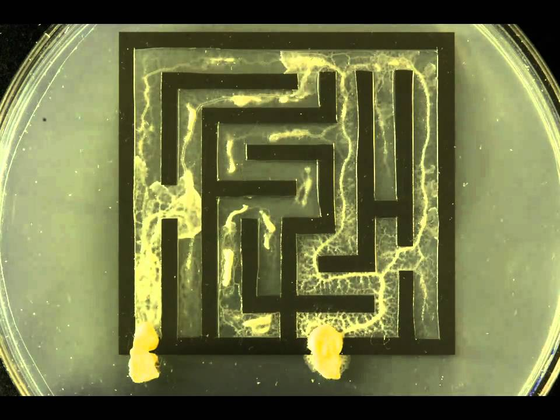
https://edenney.weebly.com/egg-osmosis-experiment/egg-osmosis-experiment
https://www.youtube.com/watch?v=5UfMU9TsoEM

Slide 18
Steps for Student Designed Pracs
Staff collaborate & plan type of investigation
Students design the investigations and do risk assessments
Staff review and provide feedback on planned pracs
Source items required and prepare for all the pracs
Get the items to the right students
Students do the pracs
Disposal and cleanup
Student write up of investigation
Marking and feedback
Notes:
Back to our steps – let’s look at software that can help students design their investigations and do risk assessments.

Slide 19
Student RiskAssess: advantages for students
easy, follow your nose, stores procedure, links to online documents, etc
private, if use PINs
good for obtaining teacher feedback
can check hazards of any chemicals, equipment, biological/food items
fun!
See DEMO !

Slide 20
“Student RiskAssess helps students design their experiments more independently and become more aware of what they are doing rather than relying on the teacher to explain and confirm things like risks, and things to think about.”

Slide 21
Steps for Student Designed Pracs
Staff collaborate & plan type of investigation
Students design the investigations and do risk assessments
Staff review and provide feedback on planned pracs
Source items required and prepare for all the pracs
Get the items to the right students
Students do the pracs
Disposal and cleanup
Student write up of investigation
Marking and feedback
Notes:
Tackle these 3 in a demo from the staff perspective.

Slide 22
Student RiskAssess: advantages for staff
see risk assessments without entering PINs
enter comments and corrections in Notes
view lab schedule & stocktaking
sign that risks are adequately controlled
quickly review, provide feedback and sign off
Multiple Prac Management system
handles large numbers of student RAs easily
See DEMO !

Slide 23
Student RiskAssess:
Details
web based: nothing to install, access from school/home
unlimited number of simultaneous users and risk assessments
inexpensive: $350+GST per year
legal record with electronic signatures and documents
training videos, support and advice

Slide 24
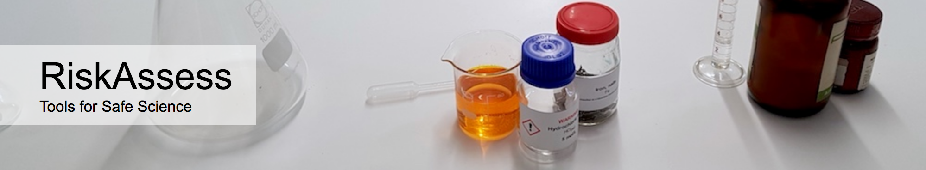
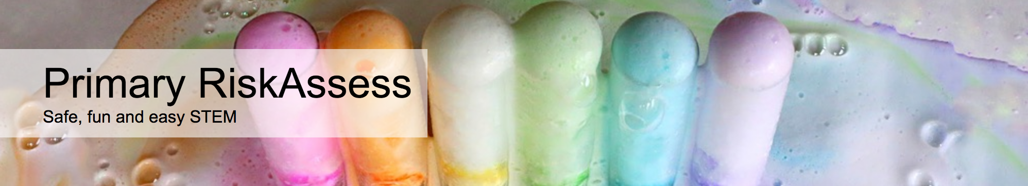

2800 schools
QLD: 461 (84%)
620 schools
QLD: 215 (39%)
200 schools
QLD: 8
120 schools
QLD: 31

Slide 25
Steps for Student Designed Pracs
Staff collaborate & plan type of investigation
Students design the investigations and do risk assessments
Staff review and provide feedback on planned pracs
Source items required and prepare for all the pracs
Get the items to the right students
Students do the pracs
Disposal and cleanup
Student write up of investigation
Marking and feedback

Slide 26
Student RiskAssess: advantages for disposal
disposal advice for every chemical and solution
explanatory documentation on disposal
advice on waste containers + labels
advice on waste minimization & recycling
See DEMO !

Slide 27
Summary of benefits
• student engagement
• can be used for assessment
• uses newest technologies
• training in life skills
• inexpensive
• happy students and teachers!

Slide 28
DEMO
From a STUDENT perspective
From a STAFF perspective
Disposal information

