Slide 1
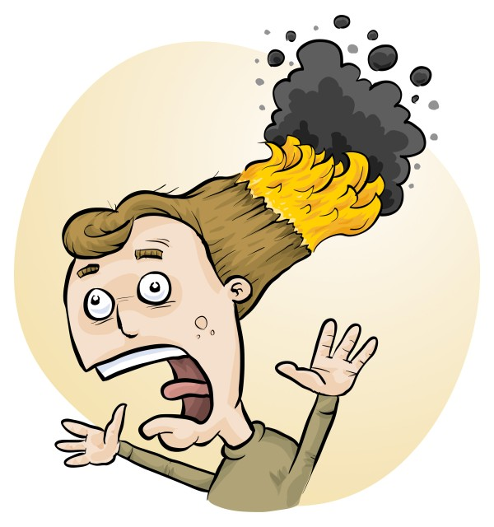
Risk assessments made easy!
Phillip and Eva Crisp

Slide 2
• reduce injuries • increase legal protection
Why do risk assessments?

Slide 3
THE LAW Work Health & Safety Act 2020
. . . a duty . . . to eliminate/minimise risks to health and safety as far as is reasonably practicable.
. . . taking into account and weighing up all relevant matters including: (a) the likelihood of the hazard or the risk concerned occurring; and (b) the degree of harm that might result from the hazard or the risk . . . .
Part 2, Sections 17 and 18
www.riskassess.com.au/info/wa_whs_act
Came
into force
2022
Notes:
NOT book “risk assessment”, tick sheet, etc
likelihood
degree of harm consideration requires
proper risk assessment using a risk matrix
e.g. Aust/ISO Standard on Risk Management

Slide 4
Relevant matters
facilities available
behaviour of the class
students with special needs
students with allergies
. . . . . . . .
Issues may, and commonly will,
differ from class to class.
A new risk assessment for each class doing each experiment!

Slide 5
What is RiskAssess?
• web-based risk assessment tool
• customised to the school situation
• provides - electronic templates (AU/ISO) - database information on risks (chemical, equipment, biological) - equipment ordering/lab scheduling - labelling (GHS)
- learning resources
• easy sharing of experiment templates for customisation

Slide 6
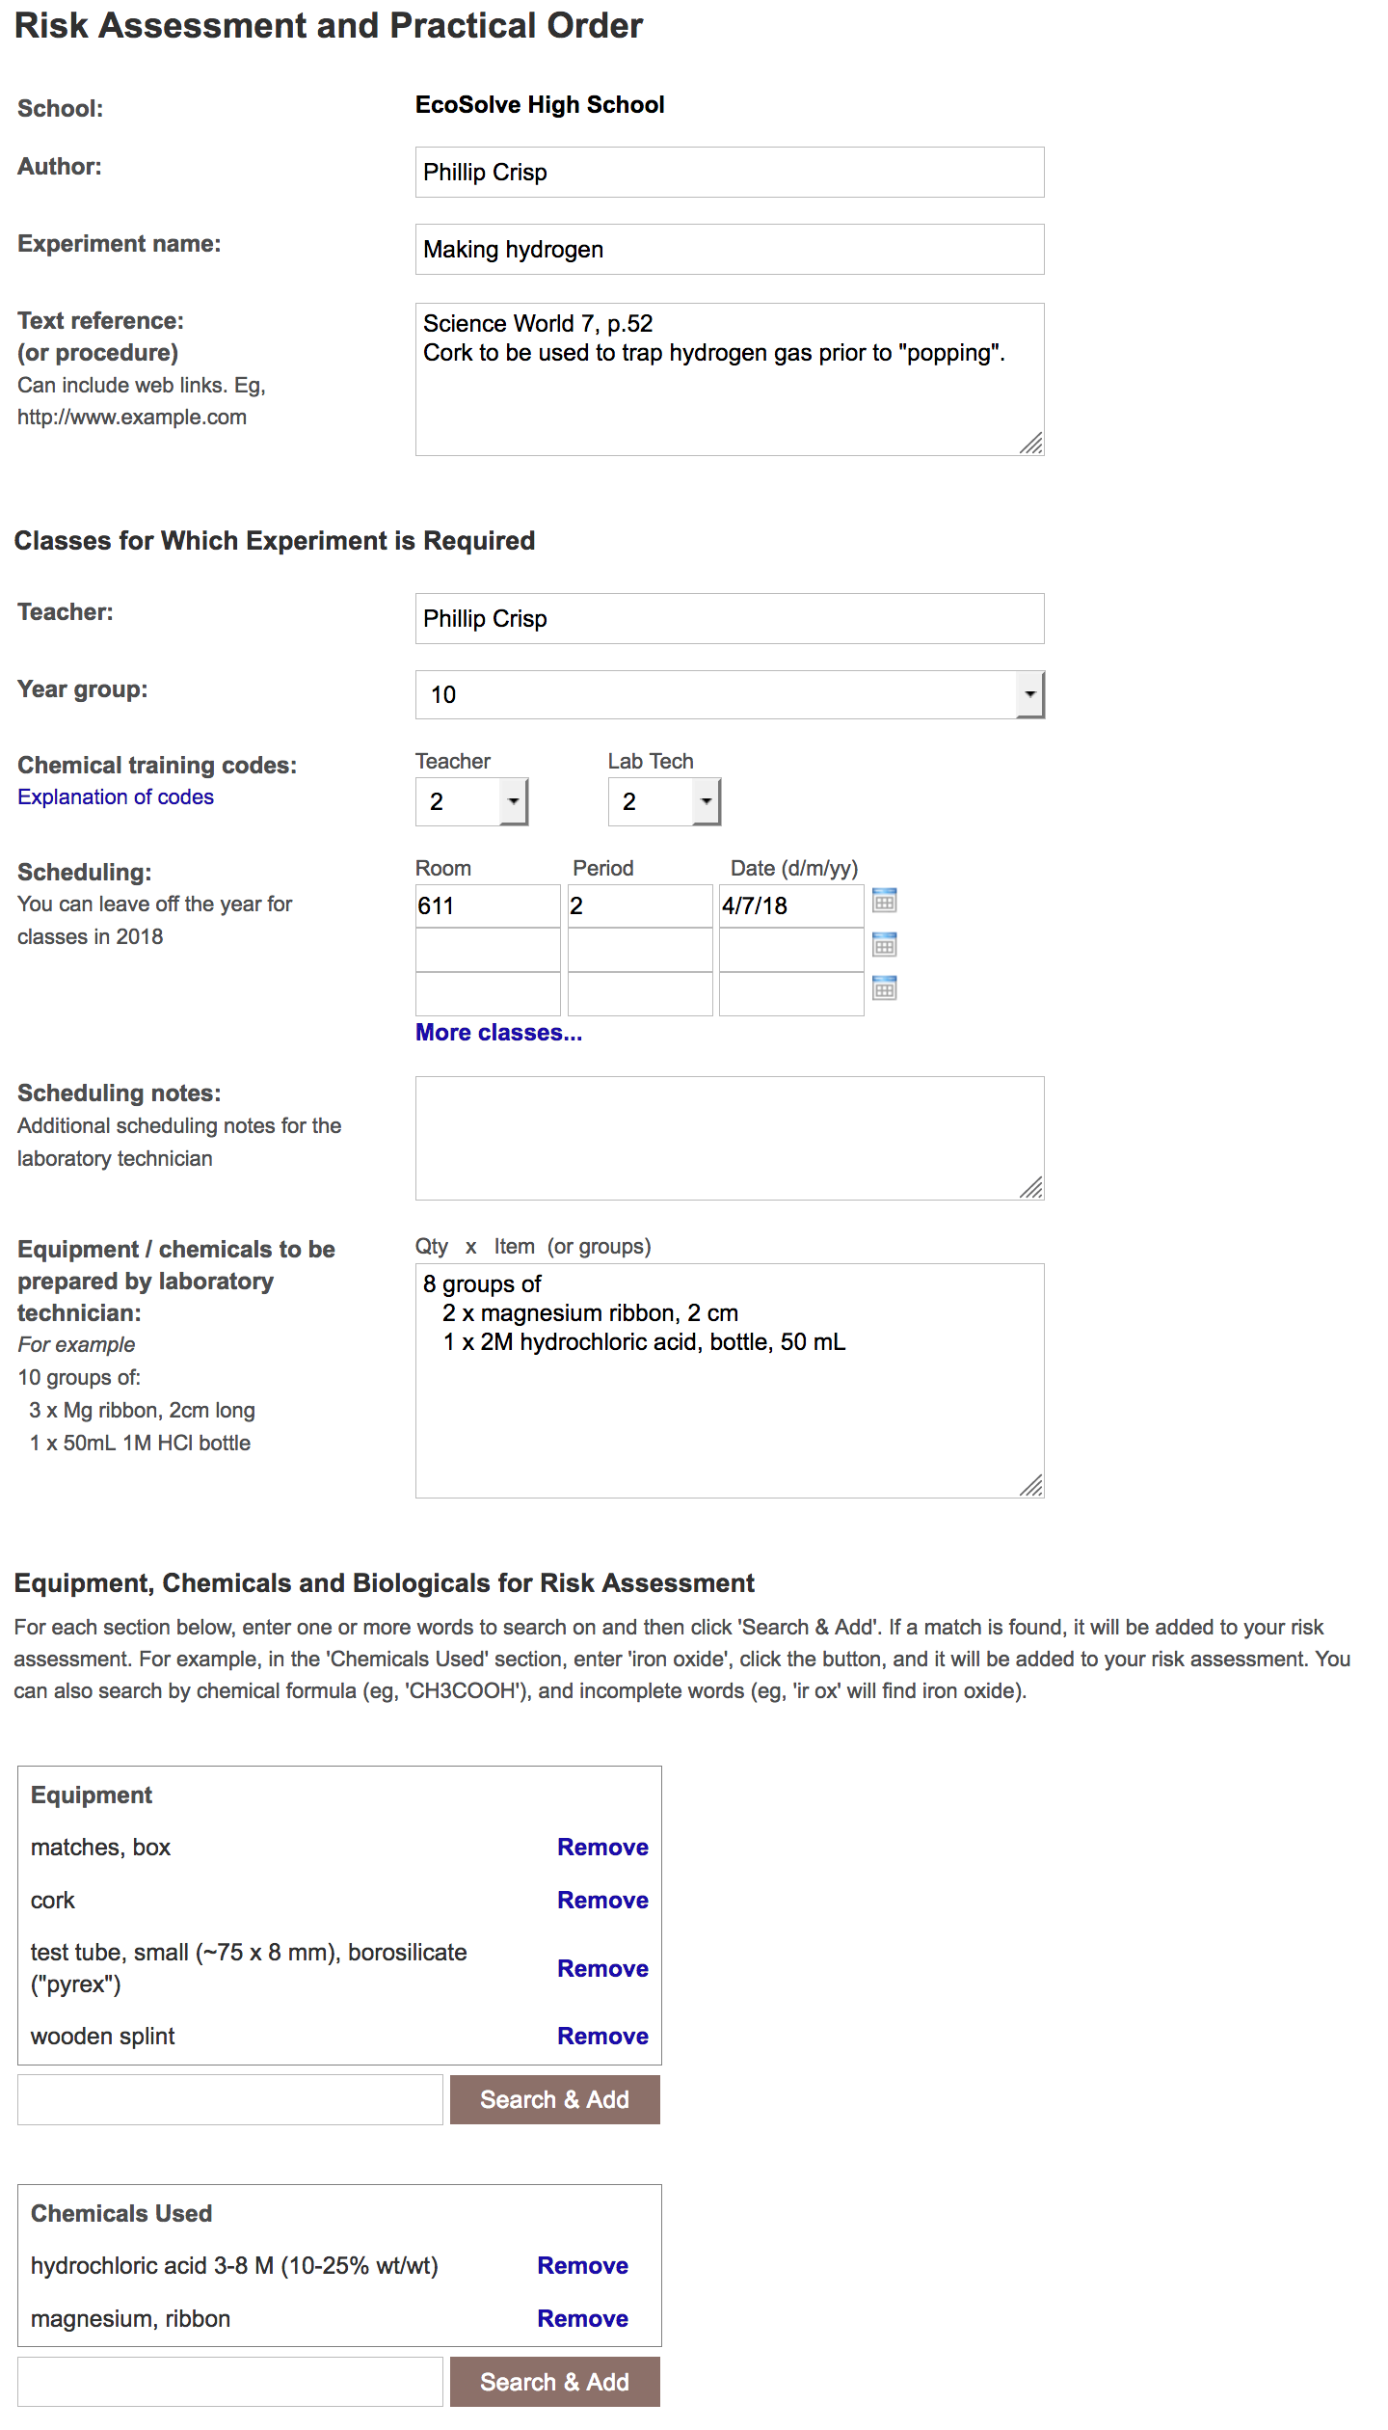
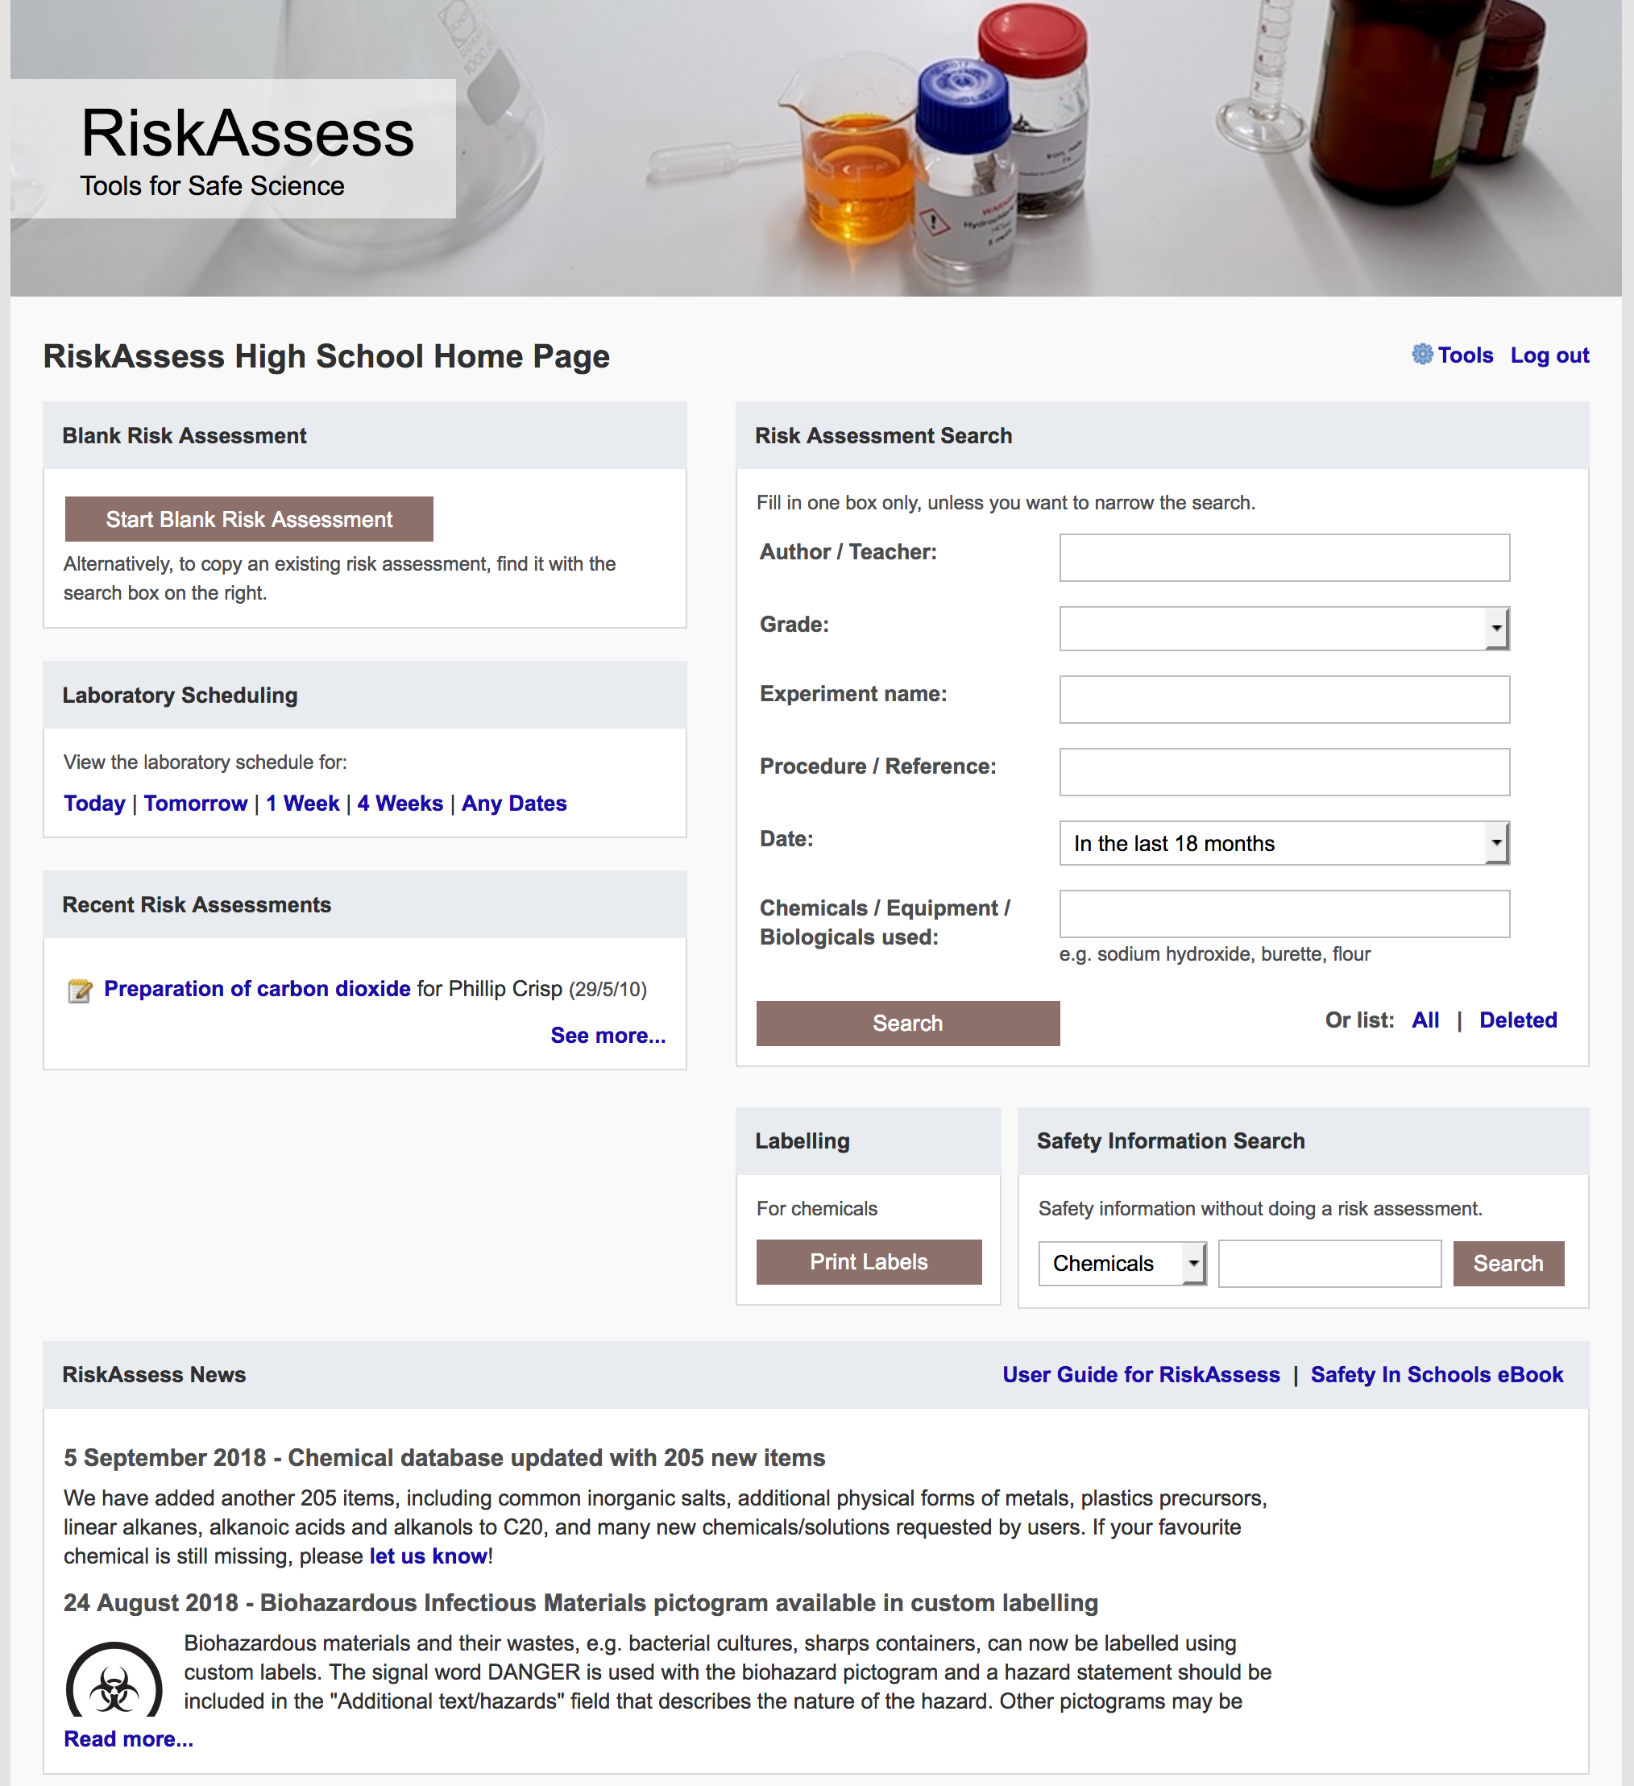

Slide 7
Logic
• separate sections for teacher and science technician
• initial assessment of inherent risk - if low, go to end - if medium or more, introduce control measures - if high or extreme, third reviewer required
• cross-checking by teacher/scitech/reviewer
• scheduling, ordering, labelling to save time
• inexpensive ($300+GST per campus per year)

Slide 8
Electronic system
• relatively rapid
• prompts sensitive to context
• reduces paper consumption
• easy to review and update
• easy monitoring and statistics
• easy storage
• demonstrated to work in schools RiskAssess: 2600 schools AU+NZ+CA
5,500,000 risk assessments
20% WA

Slide 9
Details
• access from school/home
• nothing to install on computer, tablet or phone (instant update)
• unlimited number of simultaneous users and risk assessments
• minimal data entry
• complements SDSs
• continuing input from science staff
• multiple backups of data & backup server
• support and advice

Slide 10
Advantages of RiskAssess
• proper consideration of risks and control measures
• standardisation
• storage of records for legal purposes
• communication between teachers and laboratory technicians
• discourages spur-of-the-moment experiments
• useful for new/inexperienced staff

Slide 11
Outcomes
• reduced frequency of injuries - to students - to school staff
• reduced costs for paperwork, litigation and payouts
• compliance with the law
• helps maintain variety of chemicals and equipment
• compliance with the WA Curriculum

Slide 12
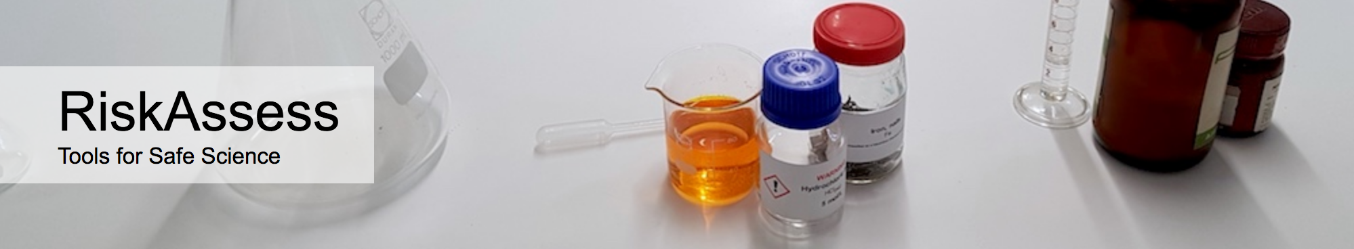

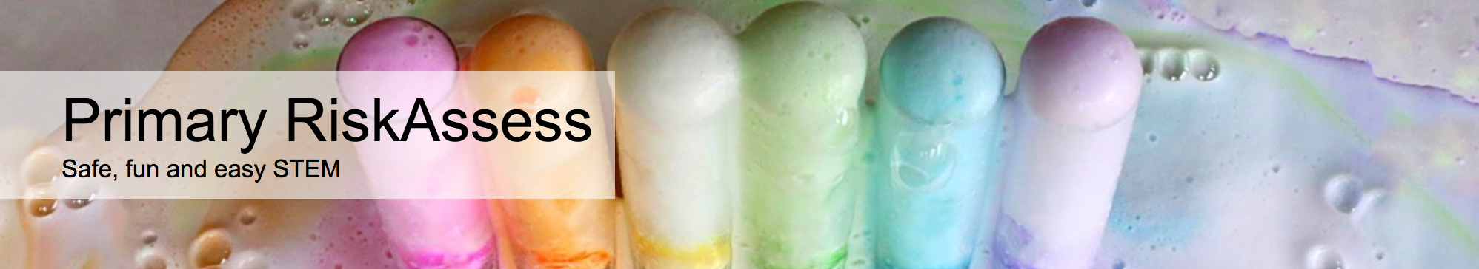

2600 schools WA: 70 (20%)
560 schools WA: 2
200 schools WA: 0
50 schools WA: 1
Notes:
Hands up for usage of each. If some non RA users, show very quick doing a RA before the menu.

Slide 13
Demonstration

