Slide 1
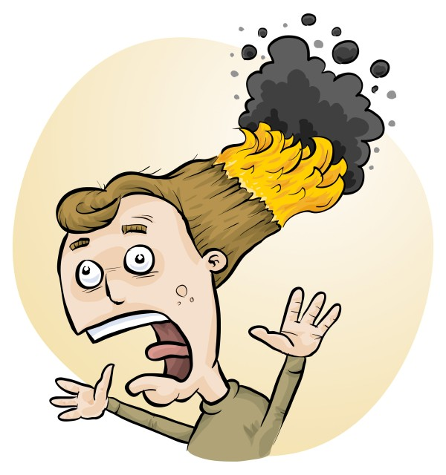
WHS Act 2020: Do I now need to do risk assessments?
Phillip and Eva Crisp

Slide 2
YES! Work Health & Safety Act 2020
. . . a duty . . . to eliminate/minimise risks to health and safety as far as is reasonably practicable.
. . . taking into account and weighing up all relevant matters including: (a) the likelihood of the hazard or the risk concerned occurring; and (b) the degree of harm that might result from the hazard or the risk . . . .
Part 2, Sections 17 and 18
Came
into force
2022
Notes:
NOT book “risk assessment”, tick sheet, etc
likelihood
degree of harm consideration requires
proper risk assessment using a risk matrix
e.g. Aust/ISO Standard on Risk Management

Slide 3
KEY POINTS Work Health & Safety Act 2020
Maximum penalties:
5 years prison
680K fine (individual) or 3M fine (corporation)
Industrial Manslaughter:
20 years prison or
10M fine (corporation)
Like all other States/Territories except VIC
www.riskassess.com.au/info/wa_whs_act
Notes:
NOT book “risk assessment”, tick sheet, etc
likelihood
degree of harm consideration requires
proper risk assessment using a risk matrix
e.g. Aust/ISO Standard on Risk Management

Slide 4
NEW TERMS Work Health & Safety Act 2020
‘Person Conducting a Business or Undertaking’ = PCBU (Principal, School Board, etc)
'Officer' is 'any person who makes, or participates in making, decisions’ (HOD>Teacher>LabTech)
Proactive: Officers must exercise 'due diligence' to ensure that the PCBU complies
Notes:
NOT book “risk assessment”, tick sheet, etc
likelihood
degree of harm consideration requires
proper risk assessment using a risk matrix
e.g. Aust/ISO Standard on Risk Management

Slide 5
The law
Risk assessments must take into account
all relevant matters including
facilities available
behaviour of the class
students with special needs
students with allergies, etc
Each class doing each experiment should be the subject of a separate risk assessment

Slide 6
• reduce injuries • increase legal protection
Why do risk assessments?

Slide 7
You should:
identify
assess
control
risks
Before: Establish the context
After: Monitor and review
Always: Consult and communicate

Slide 8
Risk assessment
To assess the severity of a risk,
you need to consider:
• the consequences of the event, and
• the chance that it will occur (likelihood)
Severity (risk level) may be
Low Medium High Extreme
AU ISO 31000:2018 “Risk management”
Risk matrices used in schools are 3 x 3 to 5 x 5
See www.riskassess.com.au/learning_resources

Slide 9
Assess risks
≥Medium
risk level
Low
risk level
Add control measures
DO
EXPERIMENT
Inherent level of risk
= risk level without any control measures besides “routine procedures”
Residual level of risk
= risk level with control measures in place

Slide 10
Risk control
Hierarchy of options:
elimination
substitution
isolation
engineering
administration
personal protective equipment

Slide 11
What is RiskAssess?
• web-based risk assessment tool
• customised to the school situation
• provides - electronic templates (AU/ISO) - database information on risks (chemical, equipment, biological) - equipment ordering/lab scheduling - labelling (GHS)
- learning resources
• easy sharing of experiment templates for customisation

Slide 12
Logic
• separate sections for teacher and laboratory technician
• initial assessment of inherent risk - if low, go to end - if medium or more, introduce control measures - if high or extreme, third reviewer required
• cross-checking by teacher/labtech/reviewer
• scheduling, ordering, labelling to save time
• inexpensive ($300+GST per campus per year)

Slide 13
Electronic system
• relatively rapid
• prompts sensitive to context
• reduces paper consumption
• easy to review and update
• easy monitoring and statistics
• easy storage
• demonstrated to work in schools RiskAssess: 2600 schools AU+NZ+CA
5,500,000 risk assessments
20% WA

Slide 14
Details
• access from school/home
• nothing to install on computer, tablet or phone (instant update)
• unlimited number of simultaneous users and risk assessments
• minimal data entry
• complements SDSs
• continuing input from science staff
• multiple backups of data & backup server
• support and advice

Slide 15
Advantages of RiskAssess
• proper consideration of risks and control measures
• standardisation
• storage of records for legal purposes
• communication between teachers and laboratory technicians
• discourages spur-of-the-moment experiments
• useful for new/inexperienced staff

Slide 16
Outcomes
• reduced frequency of injuries - to students - to school staff
• reduced costs for paperwork, litigation and payouts
• compliance with the law
• helps maintain variety of chemicals and equipment
• compliance with the WA Curriculum

Slide 17
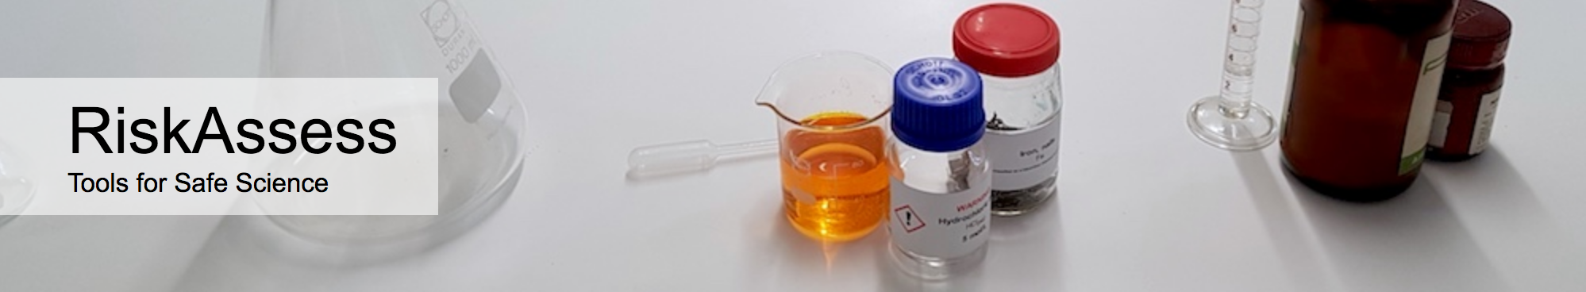

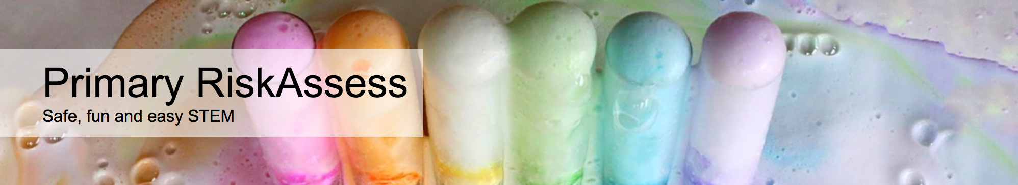

2600 schools WA: 70 (20%)
560 schools WA: 2
200 schools WA: 0
50 schools WA: 1
Notes:
Hands up for usage of each. If some non RA users, show very quick doing a RA before the menu.

Slide 18
Demonstration

