Slide 1
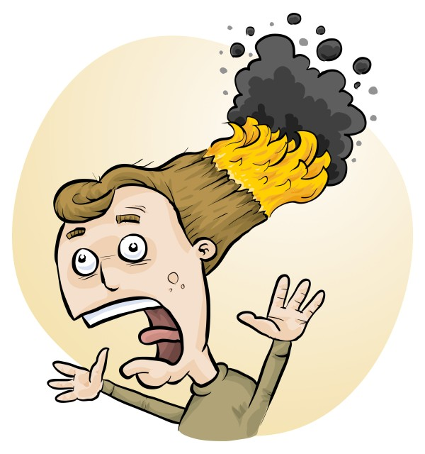
RiskAssess: tips, tricks and latest features
Phillip Crisp and Eva Crisp

Slide 2
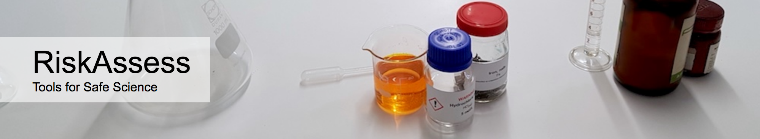
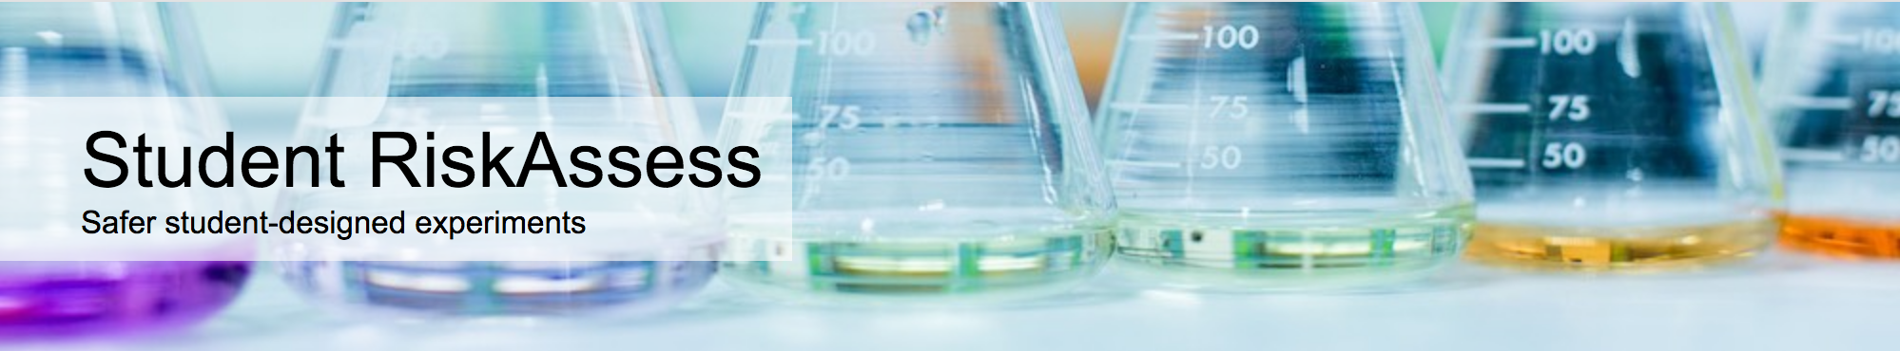
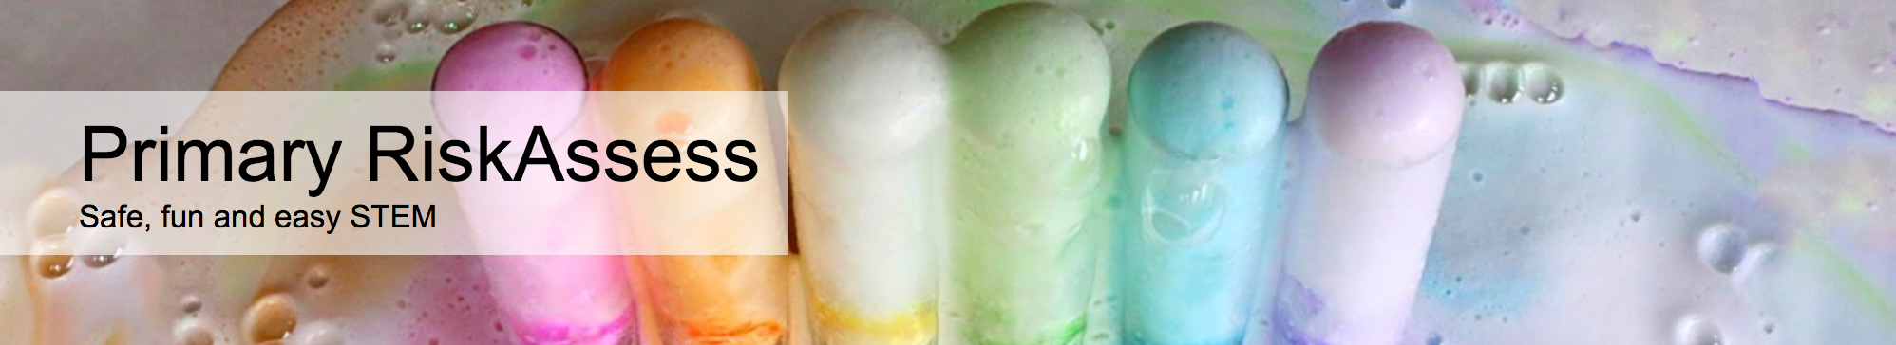
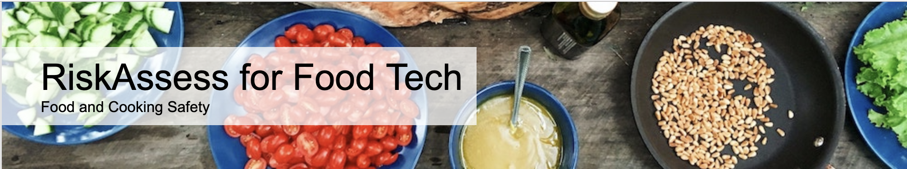
2400 schools QLD: 428 (78%)
560 schools QLD: 193 (35%)
190 schools QLD: 0 (0%)
20 schools QLD: 3 (0%)

Slide 3
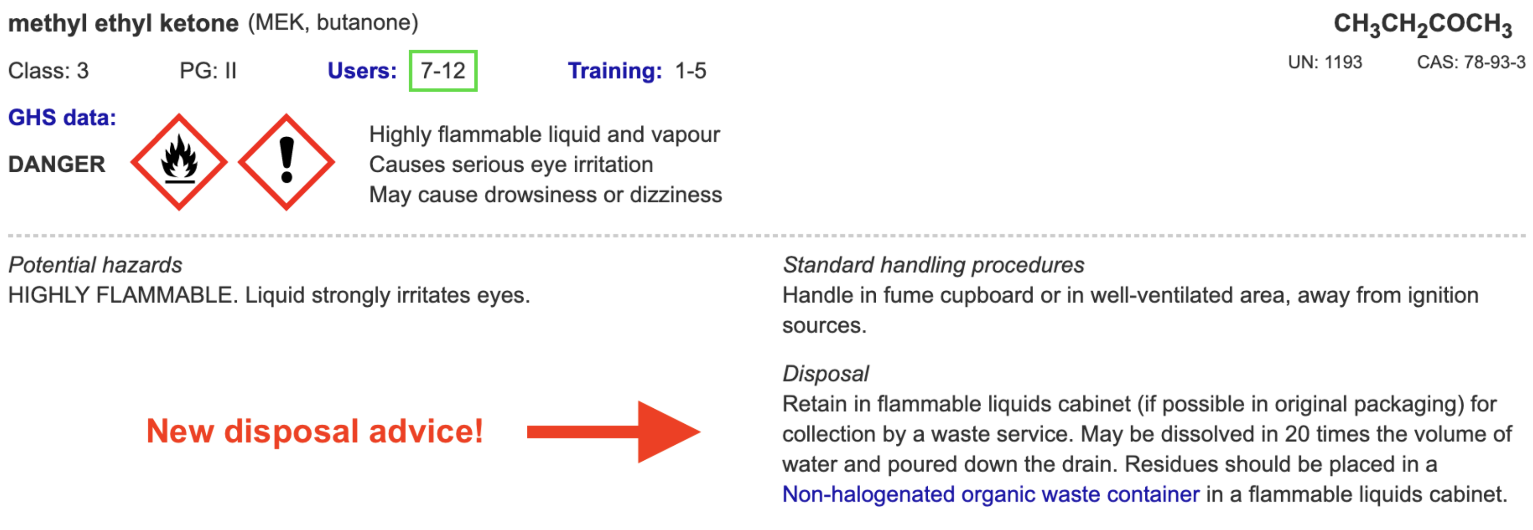
Disposal
Most recent advance in RiskAssess
Advice for all 3000 chemicals and solutions plus guide to disposal and waste container details
Separate presentation
e.g.

Slide 4
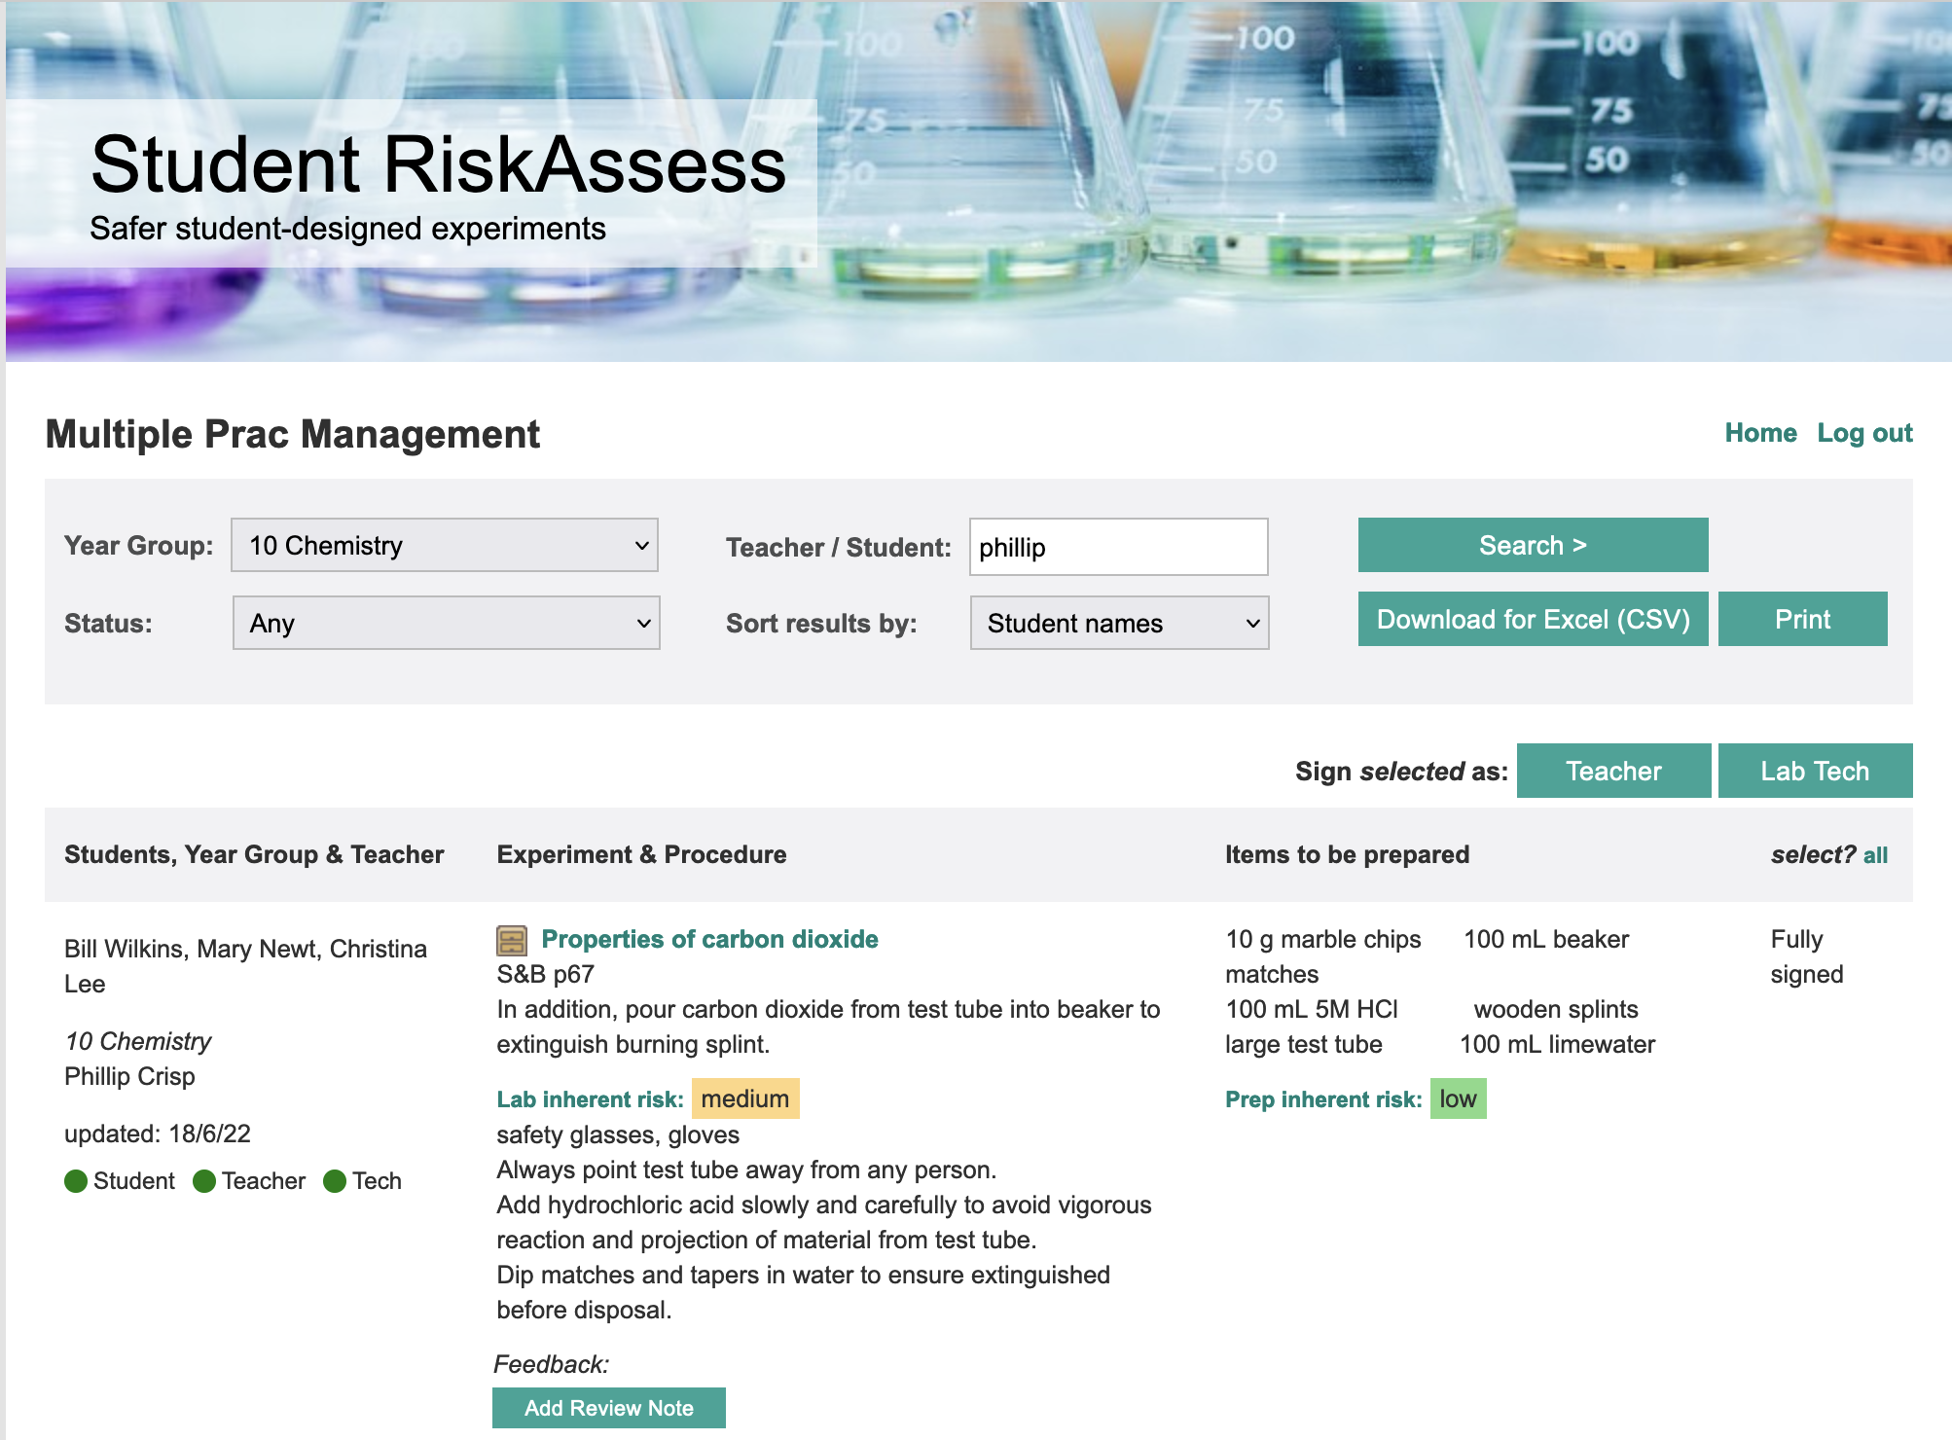

Slide 5
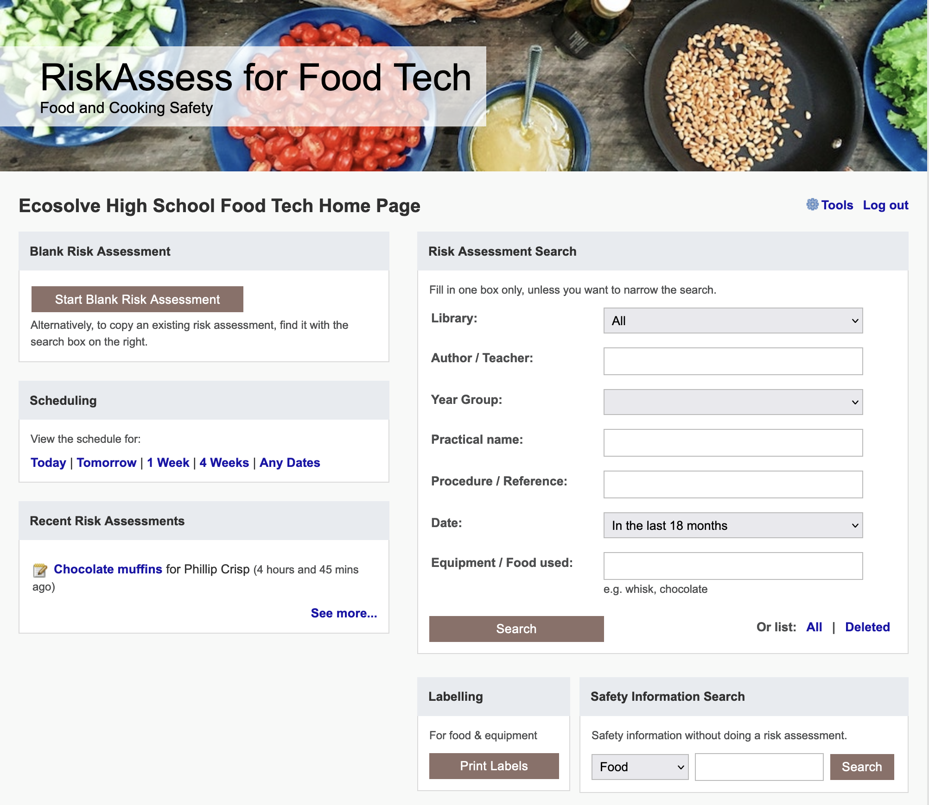

Slide 6
Menu
Shortcuts
hcl, icons, part name, click banner
links, hot links, ‘Best’ RAs, delete
Scheduling
download csv, double booking
new schedule search
Tools
customise year groups
stocktaking & usage, invoice,
backup system, defaults
Resources
learning resources
questions and answers
eBook, videos
Libraries: Stile+EP+Edrolo
Labels
standard & custom labels
multiple chemicals on sheet
mixtures, non-chemicals
free text, biohazard symbol
Operations
reschedule experiments
archive risk assessments
labtech-only risk assessments
annual review, CARA
Multiple classes
author update/modifiable copy
Student RiskAssess
view student PINs, not last year
multiple prac management

