Slide 1
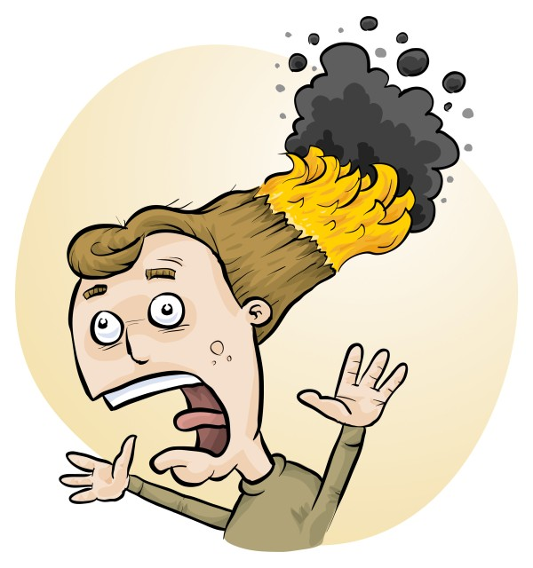
Risk Assessments
Phillip and Eva Crisp

Slide 2
• burns • cuts • allergies • slips, trips, falls • fires • fumes, vapours • eye injuries • cleaning chemicals • electric shock, food poisoning, . . .
Kitchen hazards

Slide 3
• touching hot objects pot, pan, hot plate, oven Beware: heat retention • spatter, splashes pouring boiling liquids, frypan spatter • steam kettle, lifted pot lid, steamer, microwave • flames gas burner, blowtorch, loose clothing
Burns

Slide 4
• knives chef knife, paring knife, all knives! • slicer, peeler slicing fingers, peeler blade cuts • shredder, grater grating fingers • electric cutters electric knives, openers • tin cans, glass sharp edges, broken glass
Cuts

Slide 5
• peanuts and peanut products peanuts, peanut oil, peanut impurities • tree nuts almonds, cashews, walnuts, . . . • shellfish, crustaceans different “seafood allergies” • sesame seeds, oil, Asian products • eggs, milk, wheat, soy, fish usually less extreme allergic reactions
Allergies

Slide 6
• water water spills on floor, water leaks • oil spatter and spills frypan accumulated spatter Beware: needs careful cleanup • trip hazards bags, equipment, cords, etc
Slips, trips, falls

Slide 7
• gas flame ignition of flammables, kitchen blowtorch • overheated oil deep frying, frypan oil • griller fat fire • barbeque leaking gas fitting, flammable cleaner
Fires

Slide 8
• frying high temperature frying fumes • grilling charring smoke • barbeque wood smoke, fumes Long-term harm (respiratory, cancers) VENTILATION
Fumes and vapours

Slide 9
• eye injuries oil spatter, steam, frying fumes, doors • cleaning chemicals flammable, corrosive • electric shock wet areas, defective equipment • food poisoning bacterial contamination, poor storage
Less common hazards

Slide 10
• assess the risks • introduce control measures
Given the hazards . . . .
it seems like a good idea to
This is required by law

Slide 11
Occupational Health & Safety Act 2004
Persons who control or manage matters that give rise or may give rise to risks to health or safety are responsible for eliminating or reducing those risks so far as is reasonably practicable . . . .
Part 1, 4(2)

Slide 12
The law
Risk assessments must take into account
all relevant matters including
facilities available
behaviour of the class
students with special needs
students with allergies, etc
Each class doing each activity should be the subject of a separate risk assessment

Slide 13
• reduce injuries • increase legal protection
Why do risk assessments?

Slide 14
Risk assessment
To assess the severity of a risk,
you need to consider:
• the consequences of the event, and
• the chance that it will occur (likelihood)
Severity (risk level) may be
Low Medium High Extreme
AU ISO 31000:2018 “Risk management”
Risk matrices used in schools are 3 x 3 to 5 x 5
See www.riskassess.com.au/learning_resources

Slide 15
Assess risks
≥Medium
risk level
Low
risk level
Add control measures
DO
ACTIVITY
Inherent level of risk
= risk level without any control measures besides “routine procedures”
Residual level of risk
= risk level with control measures in place

Slide 16
What is RiskAssess for Food Tech?
• web-based risk assessment tool - customised to the school situation - electronic templates (AU/ISO)
• safety information on 1000+ food items and 600+ kitchen equipment items
• shopping lists - magical conversion! - list for prac or for week’s shopping
• ordering, scheduling & labelling
• recipe storage and sharing

Slide 17
Logic
Risk Assessment (LEGAL)
• separate sections for teacher and assistant
• initial assessment of inherent risk - if low, go to end - if medium or more, record control measures - if high or extreme, third reviewer required
• cross-checking by teacher/assistant/reviewer
Practical help (SAVE TIME)
• shopping lists
• recipe storage and sharing
• scheduling & ordering
• labelling

Slide 18
Electronic system
• relatively rapid
• prompts sensitive to context
• reduces paper consumption
• easy to review and update
• search and statistics
• long term storage
• demonstrated to work in schools
RAFT: >100 schools, 21,000 RAs
RiskAssess: 2,700 schools AU+NZ+CA
88% AU, ~100% VIC
9,000,000 risk assessments

Slide 19
Details
• access from school/home
• nothing to install on computer, tablet or phone (instant update)
• unlimited number of simultaneous users and risk assessments
• minimal data entry
• continuing input from Food Tech staff
• multiple backups of data & backup server
• support and advice
• inexpensive ($350+GST per campus per year)

Slide 20
DEMO

Slide 21
Conclusion
• BY LAW, risk assessments must be carried out for all school activities
• RiskAssess offers the fastest/easiest way _____________________
• BONUS: RiskAssess also provides
• weekly shopping lists
• recipe storage and sharing
• scheduling
• prac ordering
• labelling
Simpler
than other
systems

