Slide 1
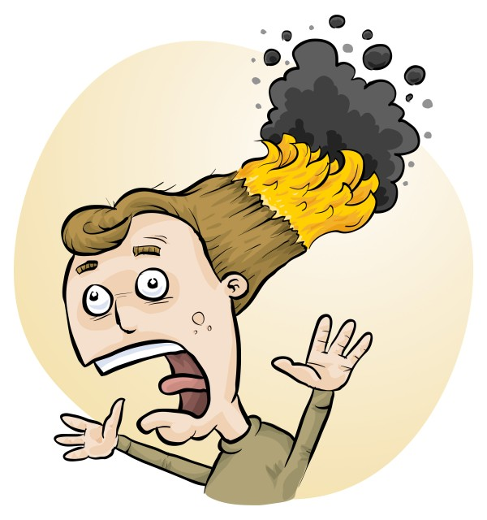
RiskAssess for Experienced Users latest features, tips and tricks
Phillip and Eva Crisp

Slide 2
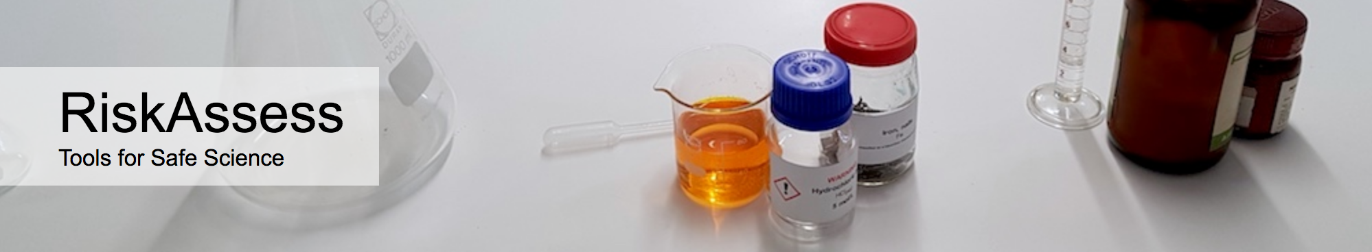
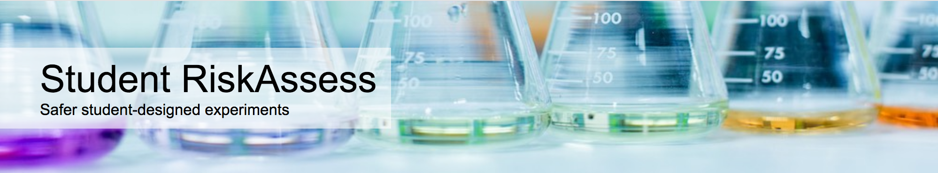
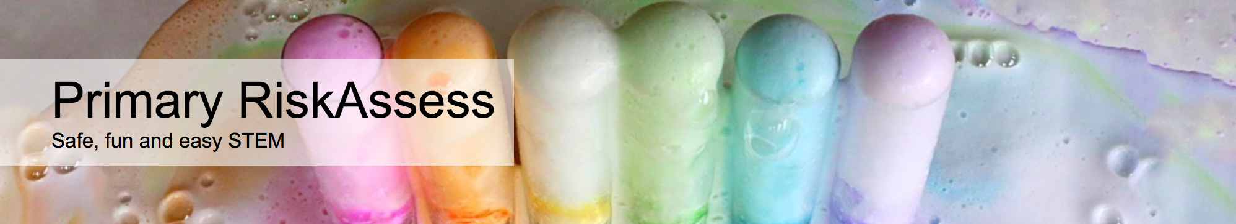

2700 schools VIC: 590 (101%)
580 schools VIC: 165 (28%)
200 schools
VIC: 10
50 schools VIC: 5

Slide 3
New Features

Slide 4
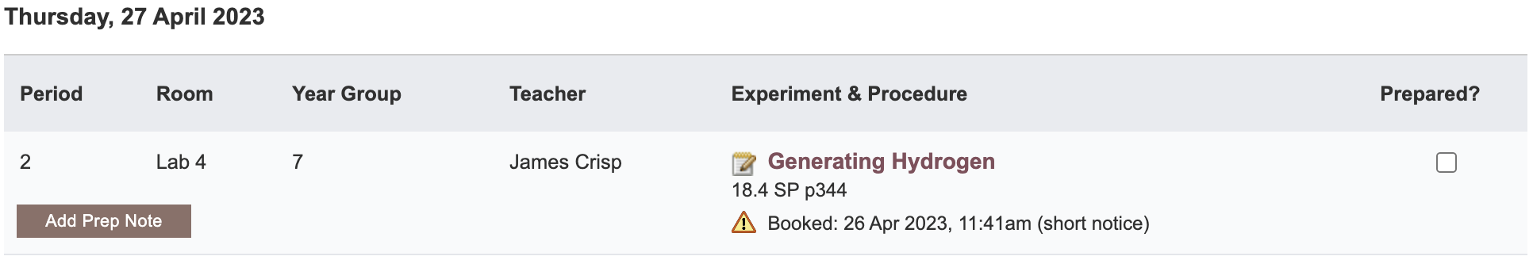
Notes:
Mandatory setting too in tools! Settable cut-off time coming soon (other than noon)

Slide 5
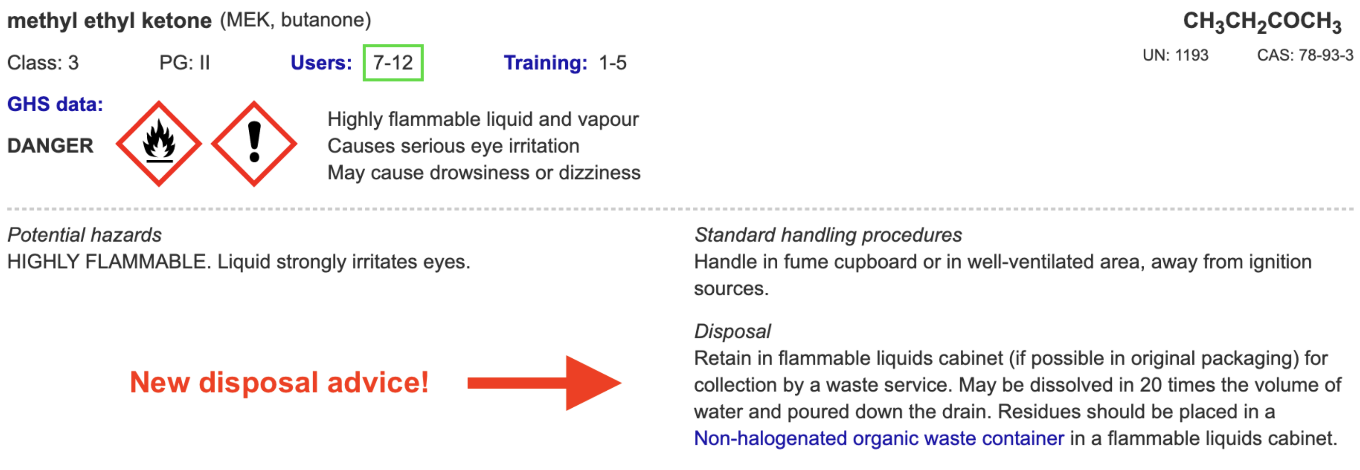
Disposal
Advice for all 3000 chemicals and solutions
Guide to disposal and waste container details
NEW Waste container labels!

Slide 6
Safety Databases
>650
new and updated items!
Especially expanded coverage of
+ saturated solutions
+ test papers & reaction products
+ geological minerals and rocks

Slide 7
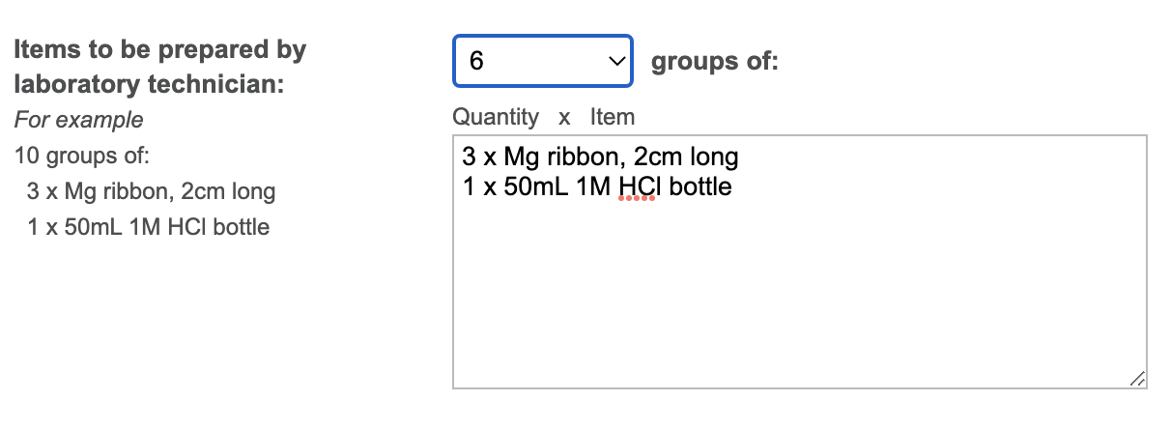
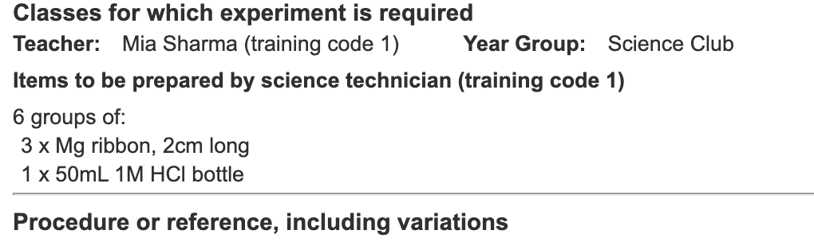
Notes:
Mandatory setting too in tools!

Slide 8
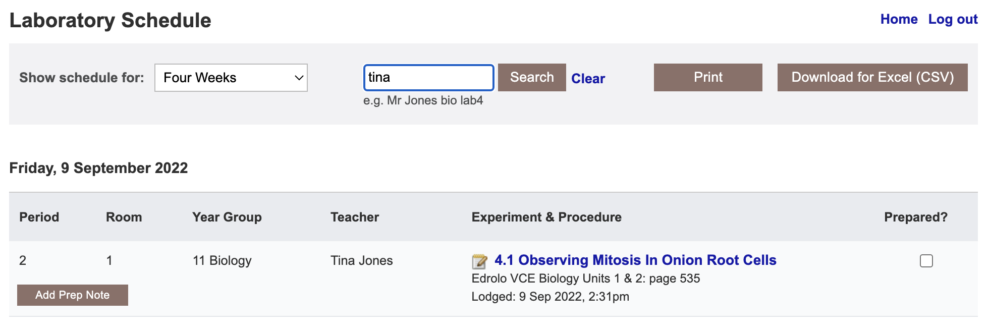

Slide 9
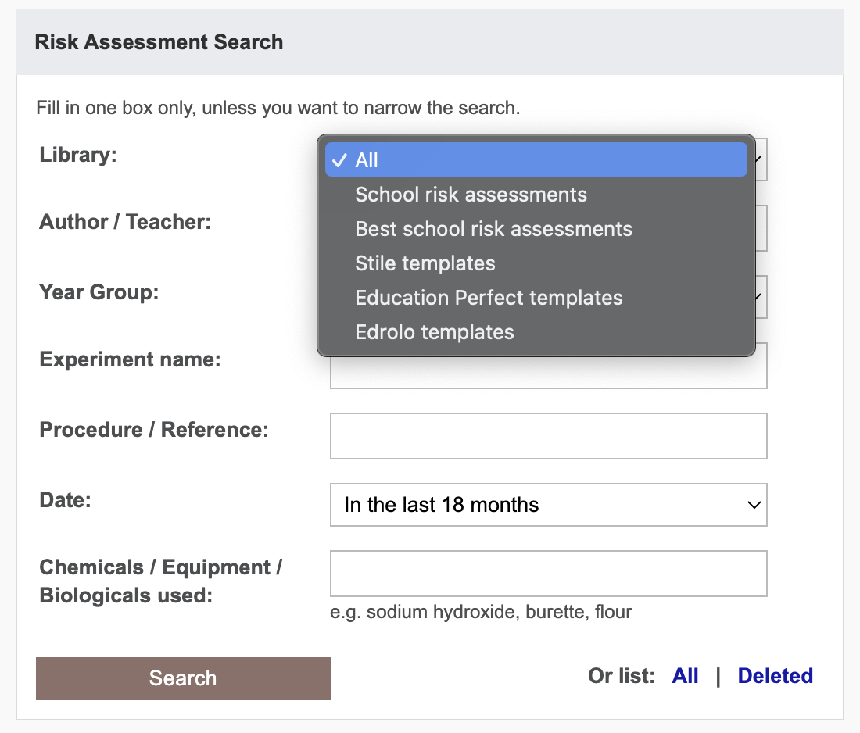

Slide 10
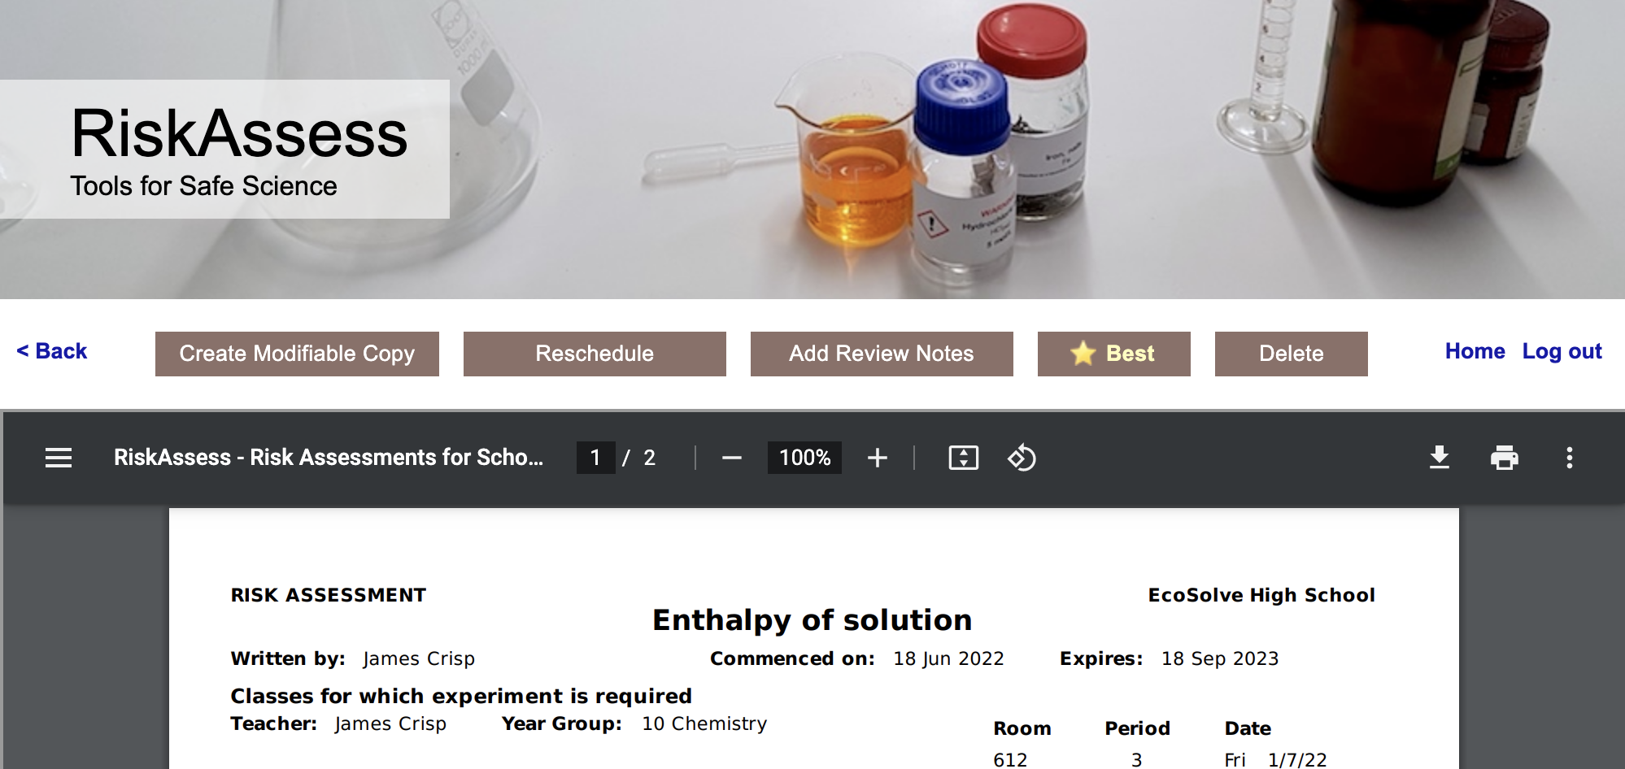
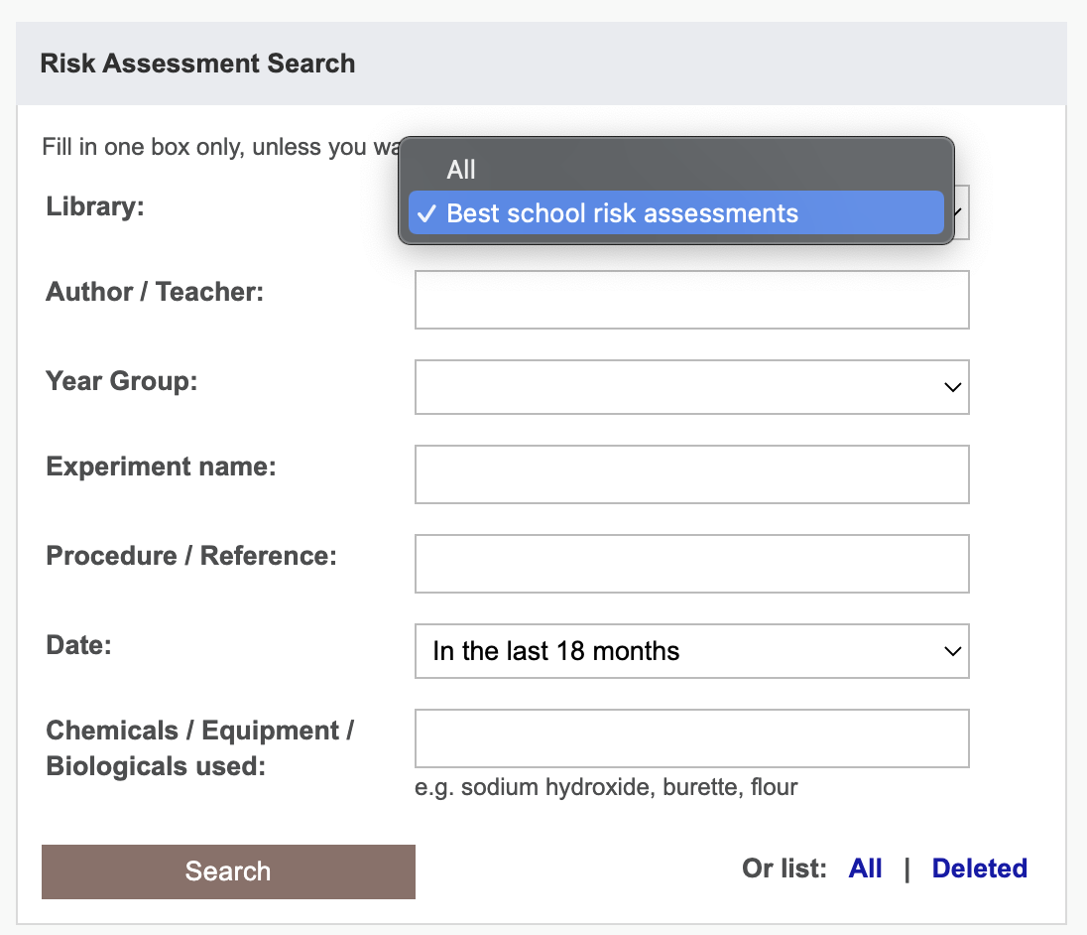
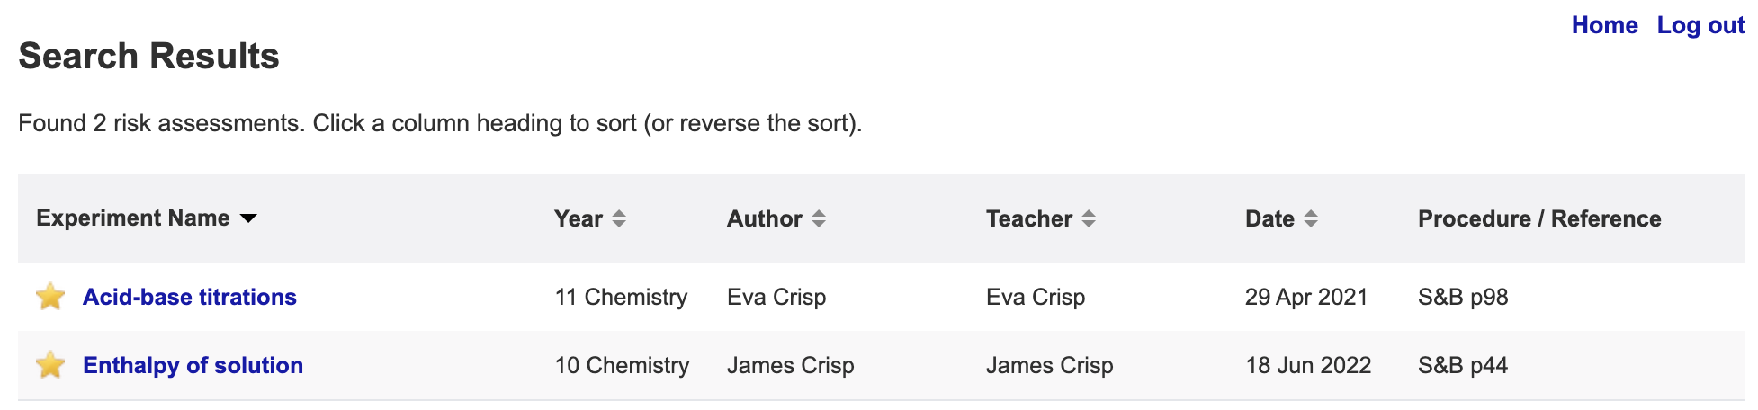

Slide 11

VCAA: 9-10 Syllabus
Science inquiry skills
…
Independently plan, select and use appropriate investigation types, including fieldwork and laboratory experimentation, to collect reliable data, assess risk and address ethical issues associated with these investigation types
…
Notes:
https://c.educationstandards.nsw.edu.au/wps/wcm/connect/57e31750-9802-4808-a6ce-7a3c2df0ff04/science-years-7-10-syllabus-2018.pdf?MOD=AJPERES&CVID=
From
https://c.educationstandards.nsw.edu.au/wps/portal/nesa/k-10/learning-areas/science/science-7-10-2018

Slide 12

VCAA: Science subjects, Years11-12
Study design
Knowledge and application of the safety considerations, including use of safety data sheets, and ethical guidelines associated with undertaking investigations is integral to the study of VCE Chemistry.…
Teachers and students should observe appropriate safety precautions when undertaking practical activities. Risk assessment should be undertaken for all chemicals used in practical investigations. All laboratory work should be supervised by the teacher. It is the responsibility of schools to ensure that they comply with health and safety requirements.
Key science skill
• demonstrate safe laboratory practices when planning and conducting investigations by using risk assessments that are informed by safety data sheets (SDS), and accounting for risks
Notes:
https://educationstandards.nsw.edu.au/wps/portal/nesa/11-12/stage-6-learning-areas/stage-6-science/biology-2017/working-scientifically
Same for chemistry, physics etc

Slide 13
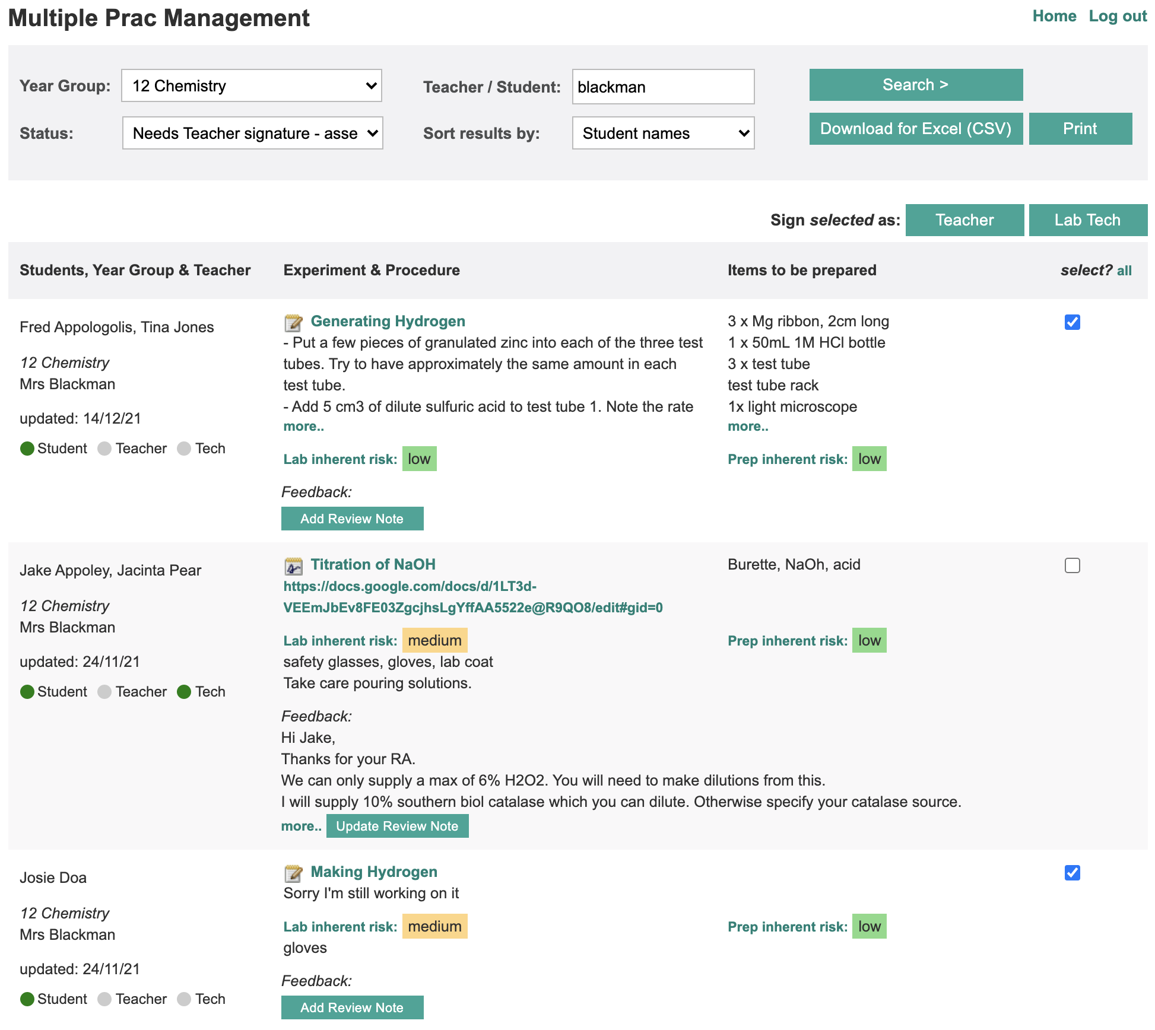

Slide 14
“Student RiskAssess helps students design their experiments more independently and become more aware of what they are doing rather than relying on the teacher to explain and confirm things like risks, and things to think about.”
Notes:
In the words of a teacher who put it better than I could..

Slide 15
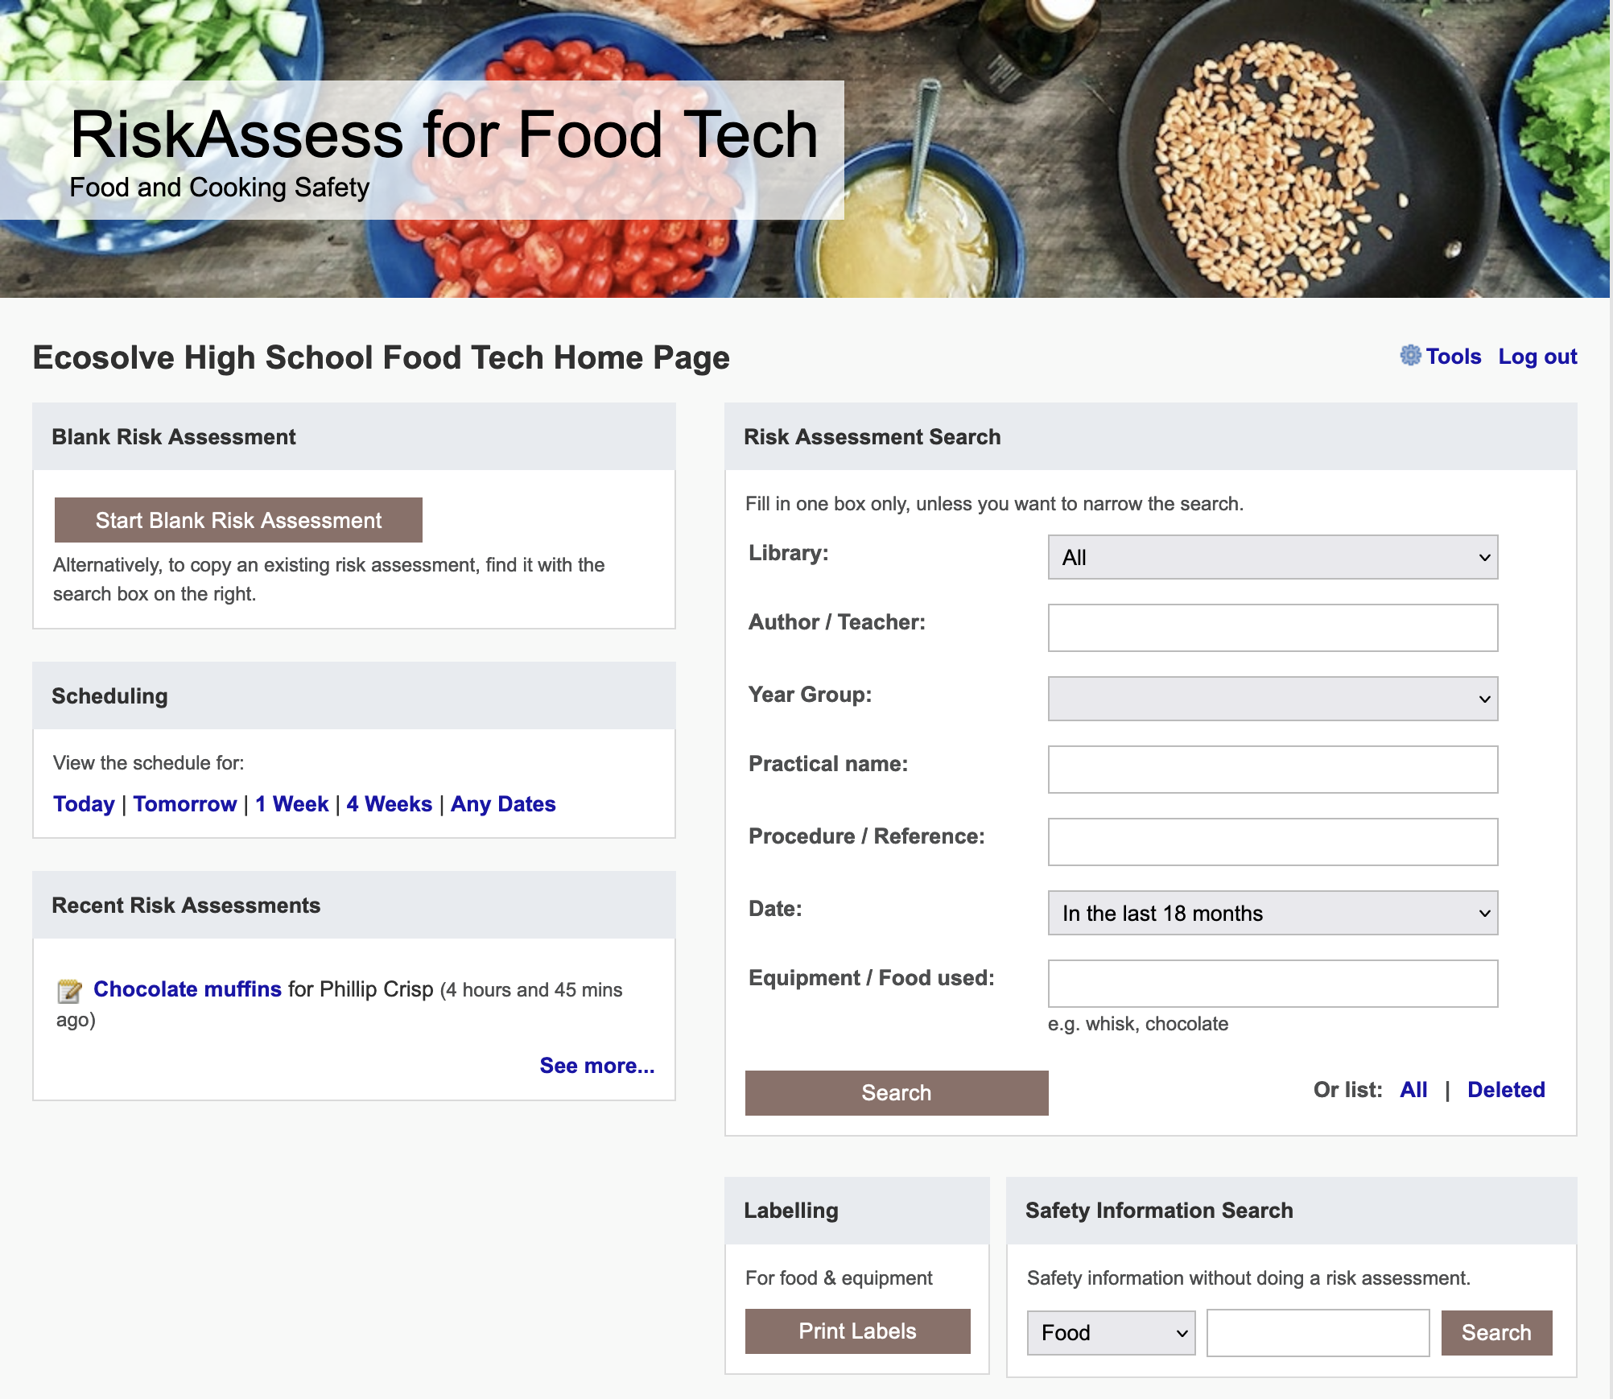

Slide 16
Future Ideas

Slide 17
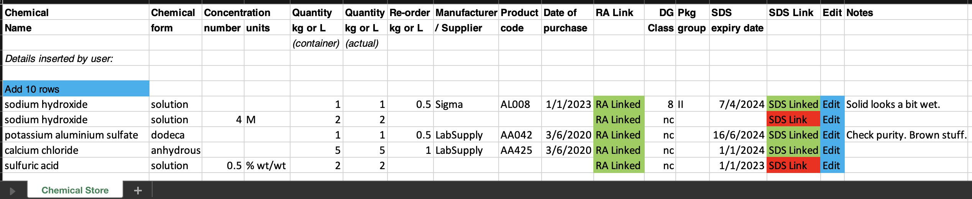
Chemical Register/Inventory DRAFT
Import from CSV/template
Easy print out
Reports on SDS that need updating / reorder
Access for outside Science – Link/export/edit?
Do we need Actual / Reorder Qty?

Slide 18
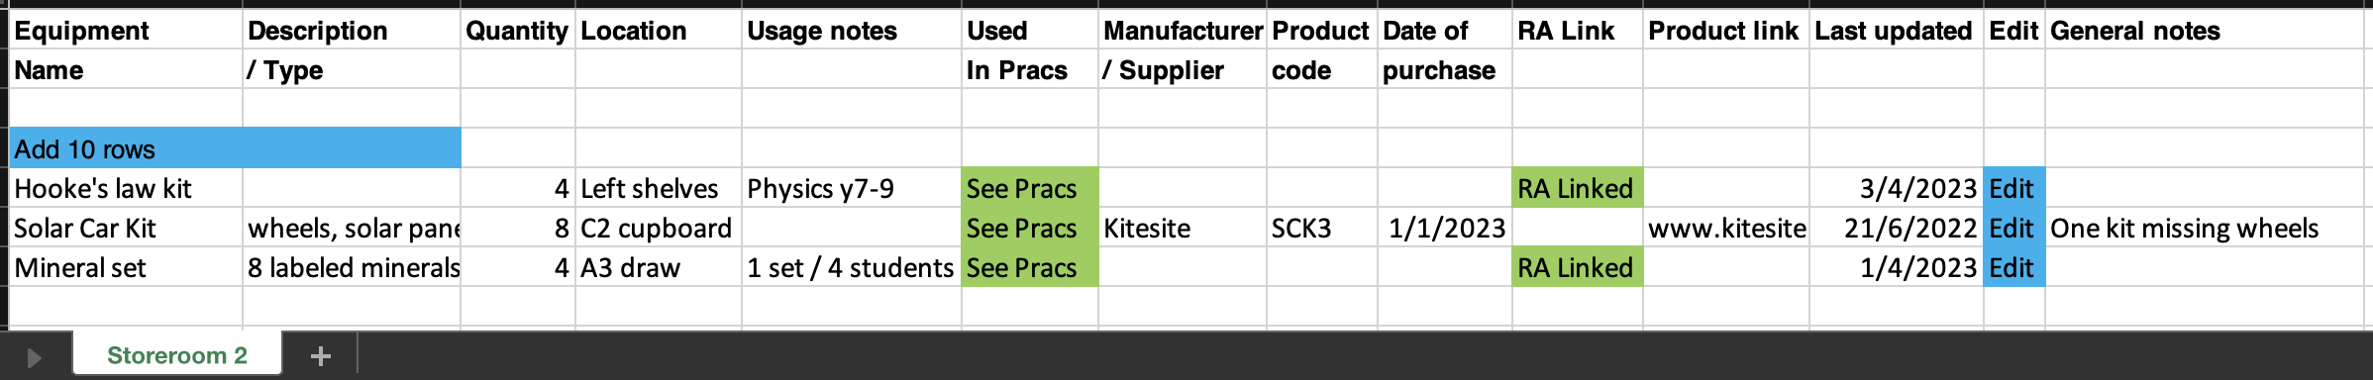
Equipment Inventory VERY DRAFT
Import from CSV/template
Easy print out
Reports on not updated for X time?
Access for outside Science – Link/export/edit?
Other fields/reports? Need “Used in Pracs”?

Slide 19
Tips & Tricks

Slide 20
Menu
Shortcuts
icons, hcl, part name, day/month,
click banner, links, hot links, delete,
Best RAs, search on less, # & sort
Scheduling
Excel/csv, any dates, last week,
search, no# pracs, prep notes,
double booking, lodged date
Tools
customise year groups,
stocktaking & usage, invoice,
backup system, defaults
Resources
learning resources, faq, eBook,
videos, libraries: Stile+EP+Edrolo
Labels
standard, custom & waste labels
multiple chemicals on sheet
mixtures, non-chemicals
free text, biohazard symbol
Operations
reschedule, archive risk
assessments, annual review,
tech-only RAs, review notes,
high/extreme: 3 signatures, list
Multiple classes
author update/modifiable copy
Student RiskAssess
view student PINs, not last year
multiple prac management

