Slide 1
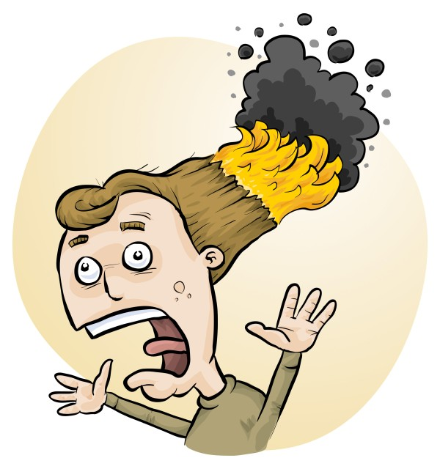
Safe Storage of Chemicals:
The Law and Best Practice
Phillip Crisp and Eva Crisp

Slide 2
Chemicals in Science
Chemical Store
• Bulk chemical storage of Dangerous Goods
• Segregate Dangerous Goods according to Classes
• Original labelling according to GHS
Prep room
• Minimum chemicals, as needed
• Label Hazardous Chemicals according to GHS
Laboratories
• Chemicals for immediately forthcoming experiments
• Label Hazardous Chemicals according to GHS

Slide 3
What are Dangerous Goods?
And what are its Classes?
What is the GHS?
And what do the letters mean?
What are Hazardous Chemicals?
And how do they differ from Dangerous Goods?
How do we store chemicals safely?
Questions

Slide 4
Dangerous Goods
Concept developed to allow safe transport of chemicals within and between countries
Focus on physical properties of chemicals for
• fire, spillage, corrosion, toxic gas release, . . .
DGs listed in Australian Dangerous Goods Code*
Chemical storage is seen as a stage in the transport of chemicals, so a school chemical store must follow Dangerous Goods regulations
*National Transport Commission, “Australian Code for the Transport of
Dangerous Goods by Road & Rail”, Edition 7.9, 2024

Slide 5
Classes of Dangerous Goods
Class 1 Explosive substances and articles
Class 2 Gases
2.1 Flammable gases
2.2 Non-flammable, non-toxic gases
2.3 Toxic gases
Class 3 Flammable liquids
Class 4 Flammable solids
4.1 Flammable solids, self-reactive substances, polymerizing substances
and solid desensitized explosives
4.2 Substances liable to spontaneous combustion
4.3 Substances which, in contact with water, emit flammable gases
Class 5 Oxidizing substances and organic peroxides
5.1 Oxidizing substances
5.2 Organic peroxides
Class 6 Toxic and infectious substances
6.1 Toxic substances
6.2 Infectious substances
Class 7 Radioactive material
Class 8 Corrosive substances
Class 9 Miscellaneous dangerous substances and articles

Slide 6
Rules for Dangerous Goods
Packaging of chemicals appropriate to the potential hazard
Packing Groups: I > II > III
Labelling for transport
Dangerous Goods Diamonds, placarding, etc
Segregation of Classes and Subclasses
depending on reactive hazards
by distance + secondary containment, e.g. cabinets, tubs
Minor storage <Placarding quantity < Manifest quantity
Chemical register (for minor storage)
= list of hazardous chemicals at each storage location,
usually with quantities, DG Classes and SDSs

Slide 7
GHS
Globally Harmonized System of Classification and Labelling of Chemicals
Developed to protect people from harm when using chemicals
Classification system for chemicals that pose
• Physical hazards
• Health hazards
• Environmental hazards*
A chemical that satisfies one or more hazard criteria is classified as a Hazardous Chemical
Labelling+SDSs required to advise people of hazards
*United Nations "Globally Harmonised System of Classification and Labelling of Chemicals (GHS)" 11th ed., 2025.

Slide 8
Dangerous Goods vs
Hazardous Chemicals
All Dangerous Goods are Hazardous Chemicals
Not all Hazardous Chemicals are Dangerous Goods
Hazardous Chemicals must be listed in the Chemical Register.
List of Dangerous Goods is almost static.
List of Hazardous Chemicals is continually updated as new data become available
European Chemicals Association (ECHA) is the best data source for classifications of Hazardous Chemicals

Slide 9
Chemical Store
• Location
• Door
• Bund
• Lighting
• Shelving
• Ventilation
• Electrical equipment
• Layout
• Ergonomics
• Safety Data Sheets
• Safety equipment
• Segregation
• Storage cabinets
• Housekeeping
See “Chemical storage in Science”
https://www.riskassess.com.au/docs/ChemicalStorageInScience

Slide 10
Air
3
8
SDSs
6.1
4.3
6.1
6.1
PREP
ROOM
Spills kit
4.1
6.1
9
Air
Bund
5.1
6.1
Light
& fan
switches
PREP
ROOM

Slide 11
Segregation of chemicals
• Segregation by Class/Subclass, then alphabetical
• Flammable liquids (Class 3) and Corrosives
(Class 8) in cabinets, far from door
• Chemicals that release flammable gases (Class 4.3)
in dry, ventilated box or cabinet
• Secondary containment (tub, glass/ceramic tray)
if <3 m separation
• Incompatible chemicals not above each other
• Liquids not above solids

Slide 12
Storage cabinets for DG Classes
• Essential: Flammable Liquids and Corrosives
Others: if sufficient quantity and space
• Plastic better than metal for Corrosives
• Bund at bottom of cabinet (25% total capacity)
• Avoid HCl and NH₃ in same cabinet
• Plastic coated bottles preferred for HNO₃, H₂SO₄
• Spark-proof fan for safe ventilation
• Flammable Liquids and Corrosives cabinets
furthest from door to allow emergency escape

Slide 13
Housekeeping in the chemical store
• Non-Dangerous Goods not in chemical store,
unless sufficient space.
• Most smell due to leakage of vapour around lid
seals. Tighten lids of volatile acids and organic
chemicals, but not if chemical releases a gas
• No chemicals on floor
• Check extremely hazardous chemicals,
e.g., sodium metal, every few months

Slide 14
Prep room
• Return Dangerous Goods to chemical store
as soon as possible
• GHS labelling of decanted or transferred
hazardous chemicals*
• NEVER use food containers
NEVER chemicals in a food refrigerator
• No ignition sources near flammable liquids
• Store chemical wastes as DGs
• Keep locked when no staff present
*Government of Western Australia (Department of Mines, Industry Regulation and Safety), Code of Practice: Labelling of workplace hazardous chemicals, 2022.

Slide 15
Laboratories
• Chemicals for immediately forthcoming
experiments only
• Good ergonomics
• Labelling according to GHS
• Separate chemical waste containers for
each heavy metal, non-halogenated
organics, . .
• Keep locked when no staff present

Slide 16
Help from RiskAssess
• Identification of Dangerous Goods
• Standard handling procedures
• Understanding potential hazards
• Labelling of chemicals according to GHS
• Labelling of chemical wastes
• Chemical inventory and chemical register
with SDS management

Slide 17
DEMONSTRATION
• Learning resources
• Examples
• Labelling, inc. chemical wastes
• Chemical inventory/register
+ SDS management
QUESTIONS
team@riskassess.com.au

