Slide 1

RiskAssess for Experienced Users latest features, tips and tricks
James Crisp

Slide 2
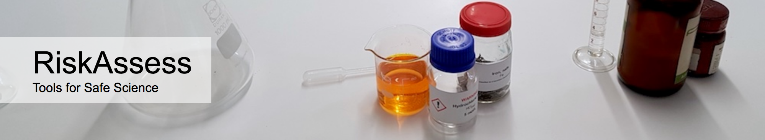

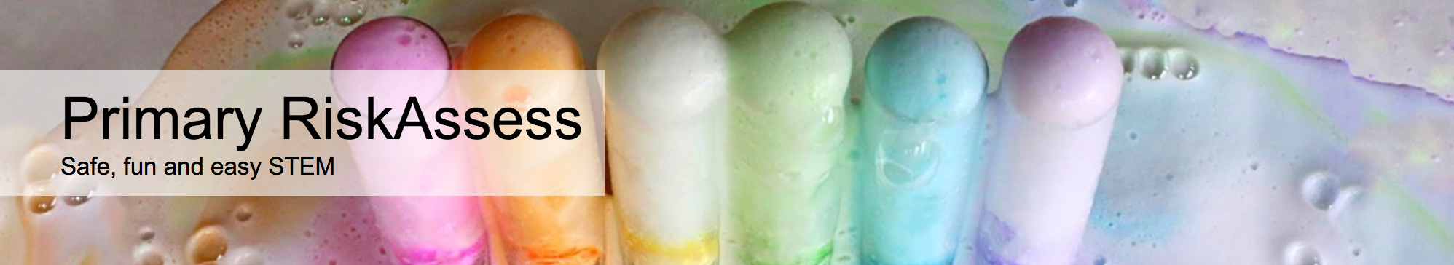

2700 schools
Qld: 451 (82%)
560 schools
Qld: 200 (36%)
200 schools
Qld: 7
50 schools
Qld: 13

Slide 3
New Features

Slide 4
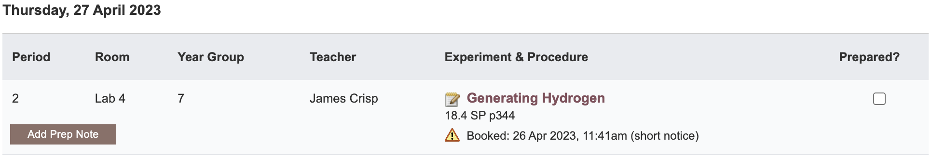
Notes:
Mandatory setting too in tools! Settable cut-off time coming soon (other than noon)

Slide 5
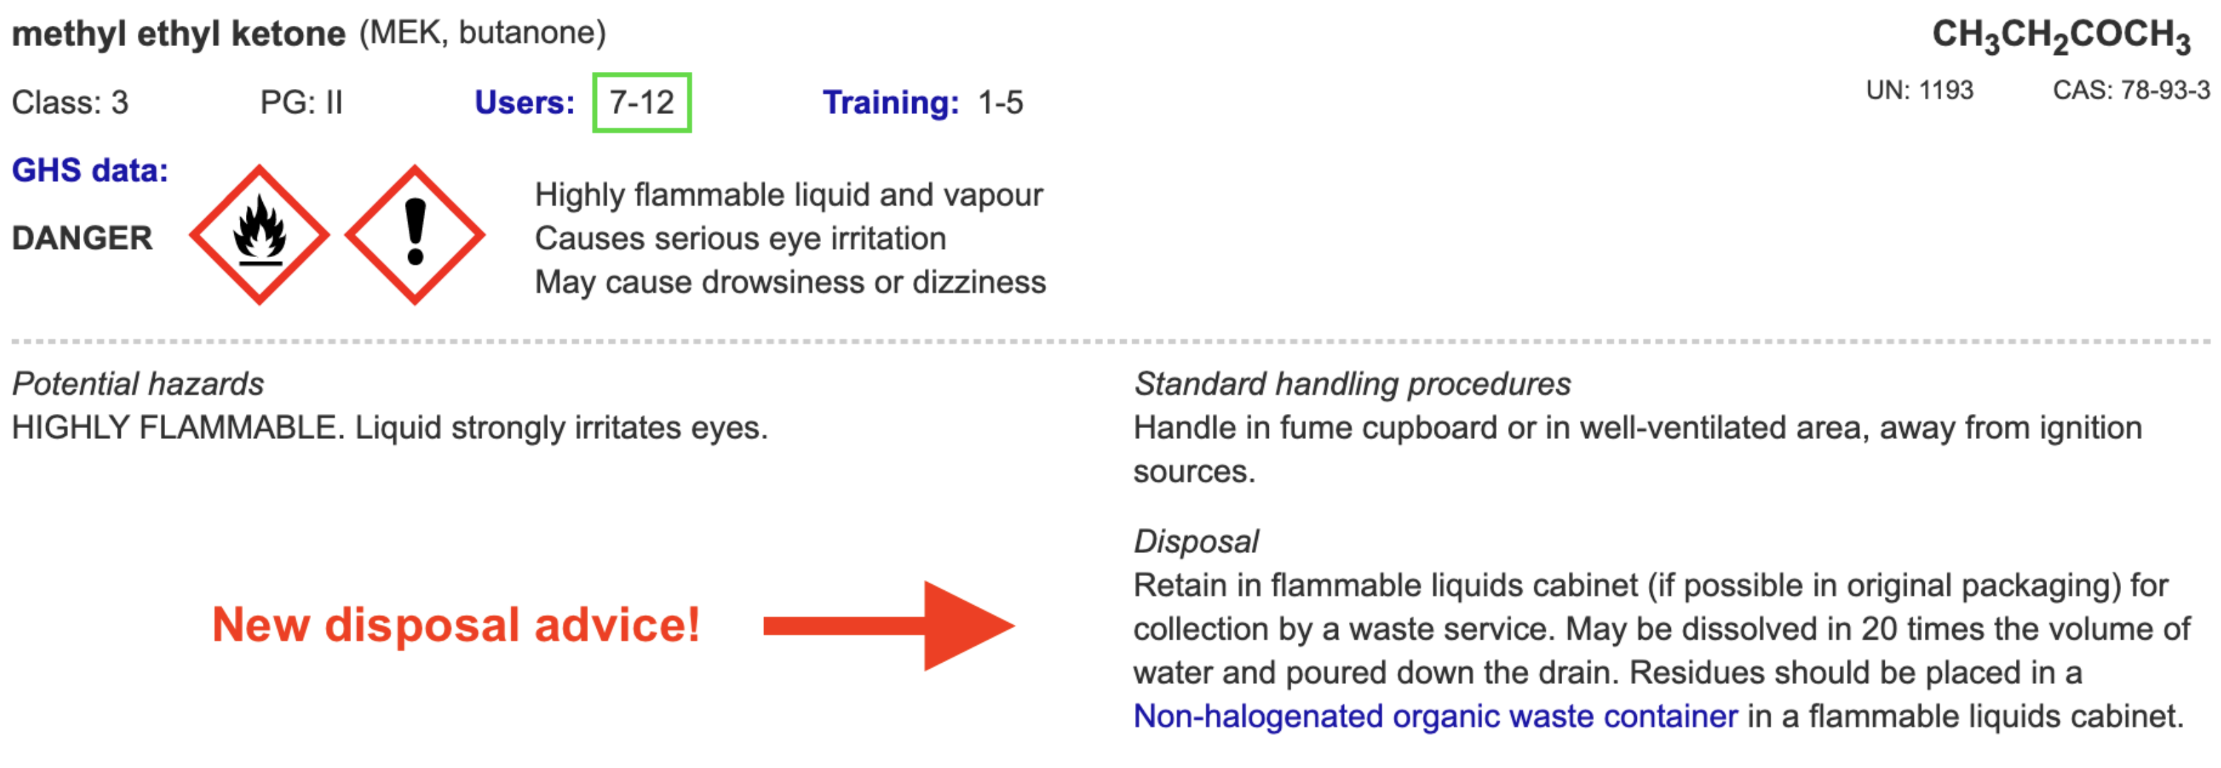
Disposal
Advice for all 3000 chemicals and solutions
Guide to disposal and waste container details
NEW Waste container labels!

Slide 6
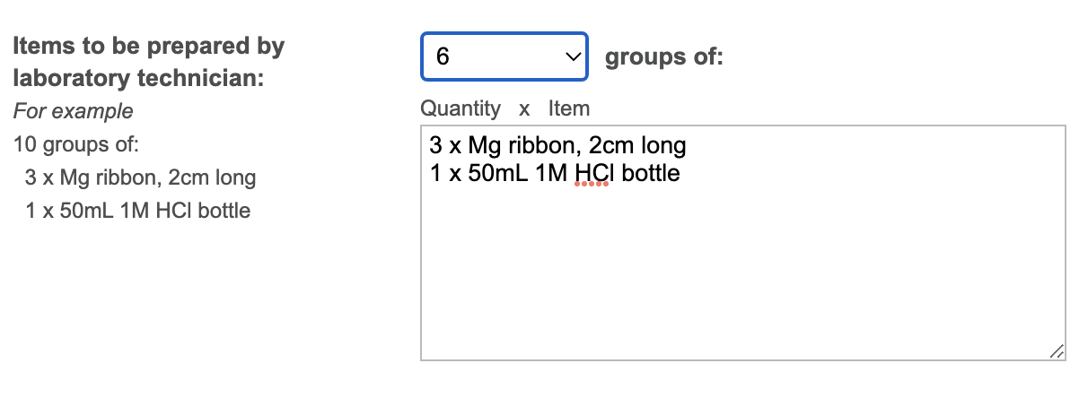
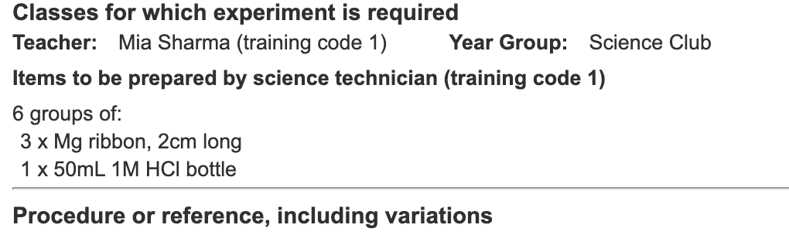
Notes:
Mandatory setting too in tools!

Slide 7
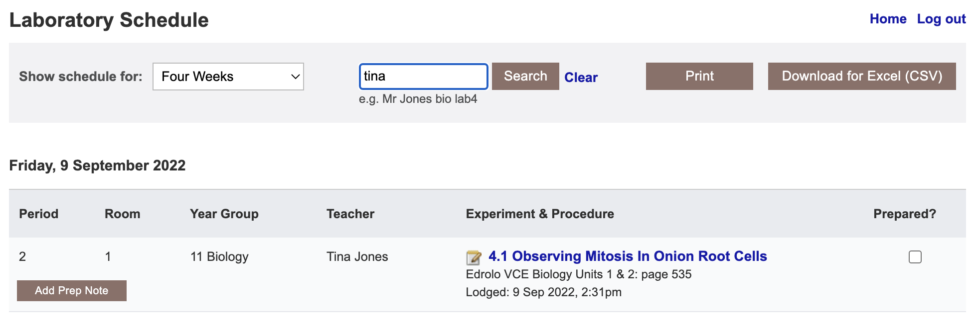

Slide 8
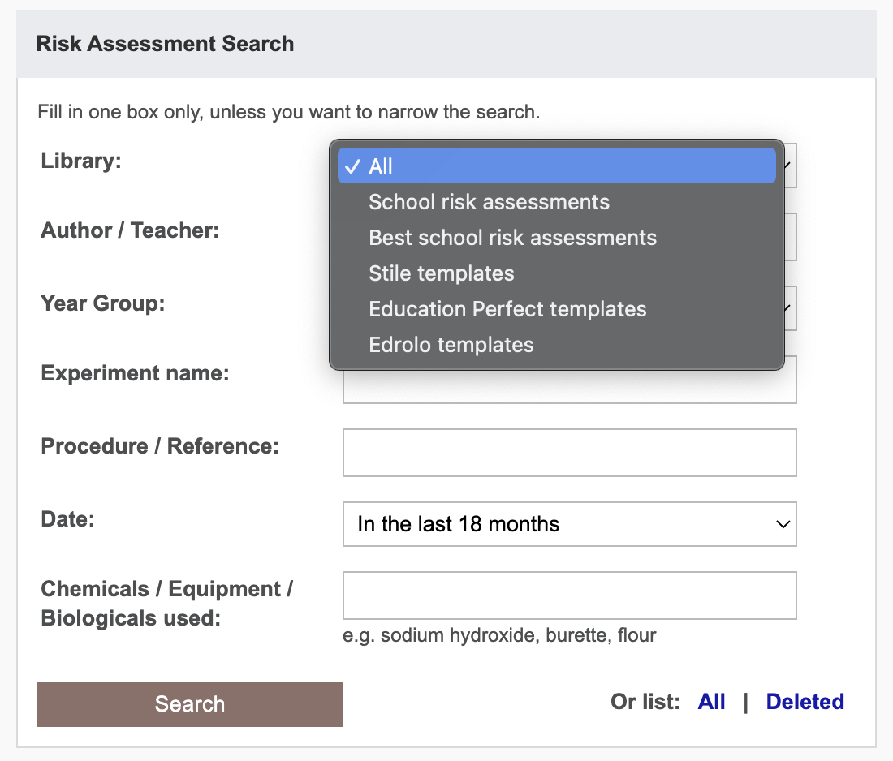

Slide 9
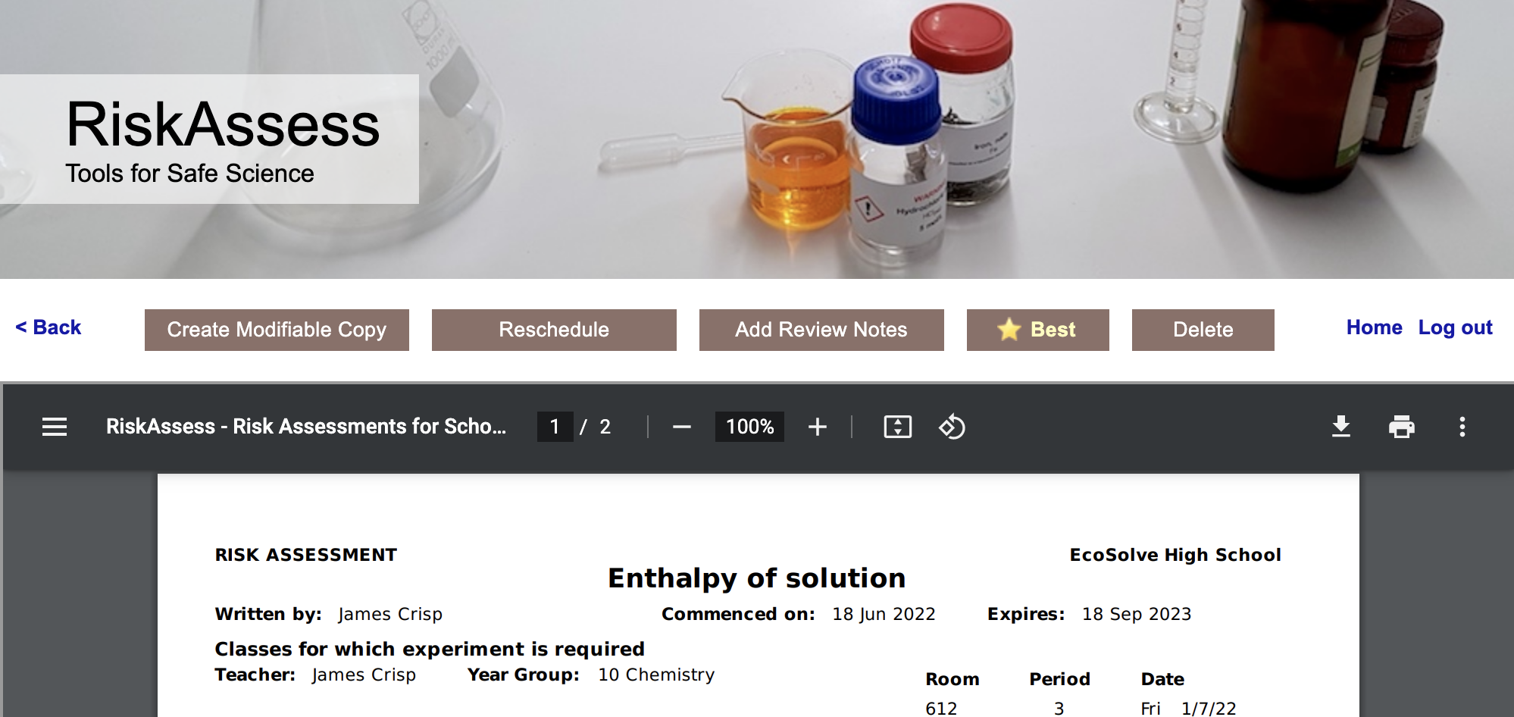
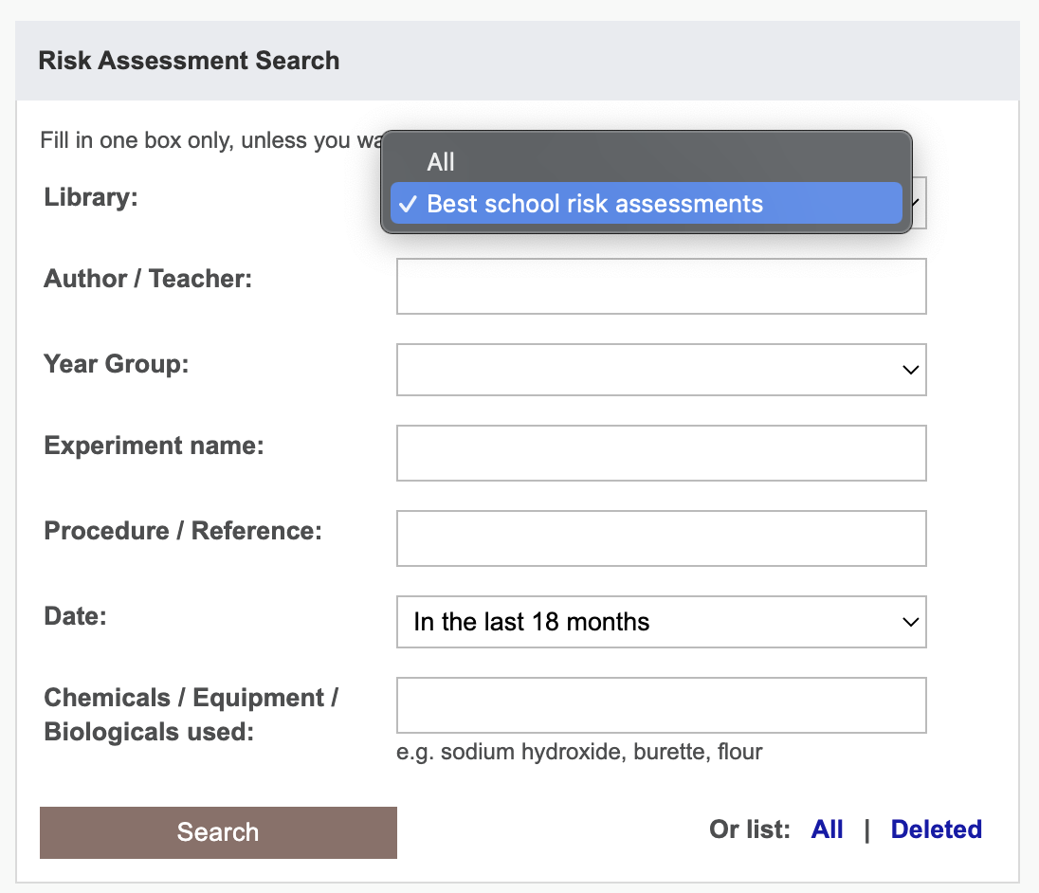
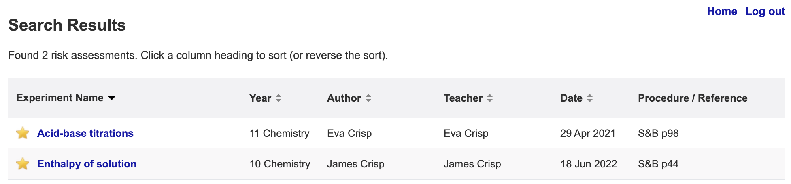

Slide 10
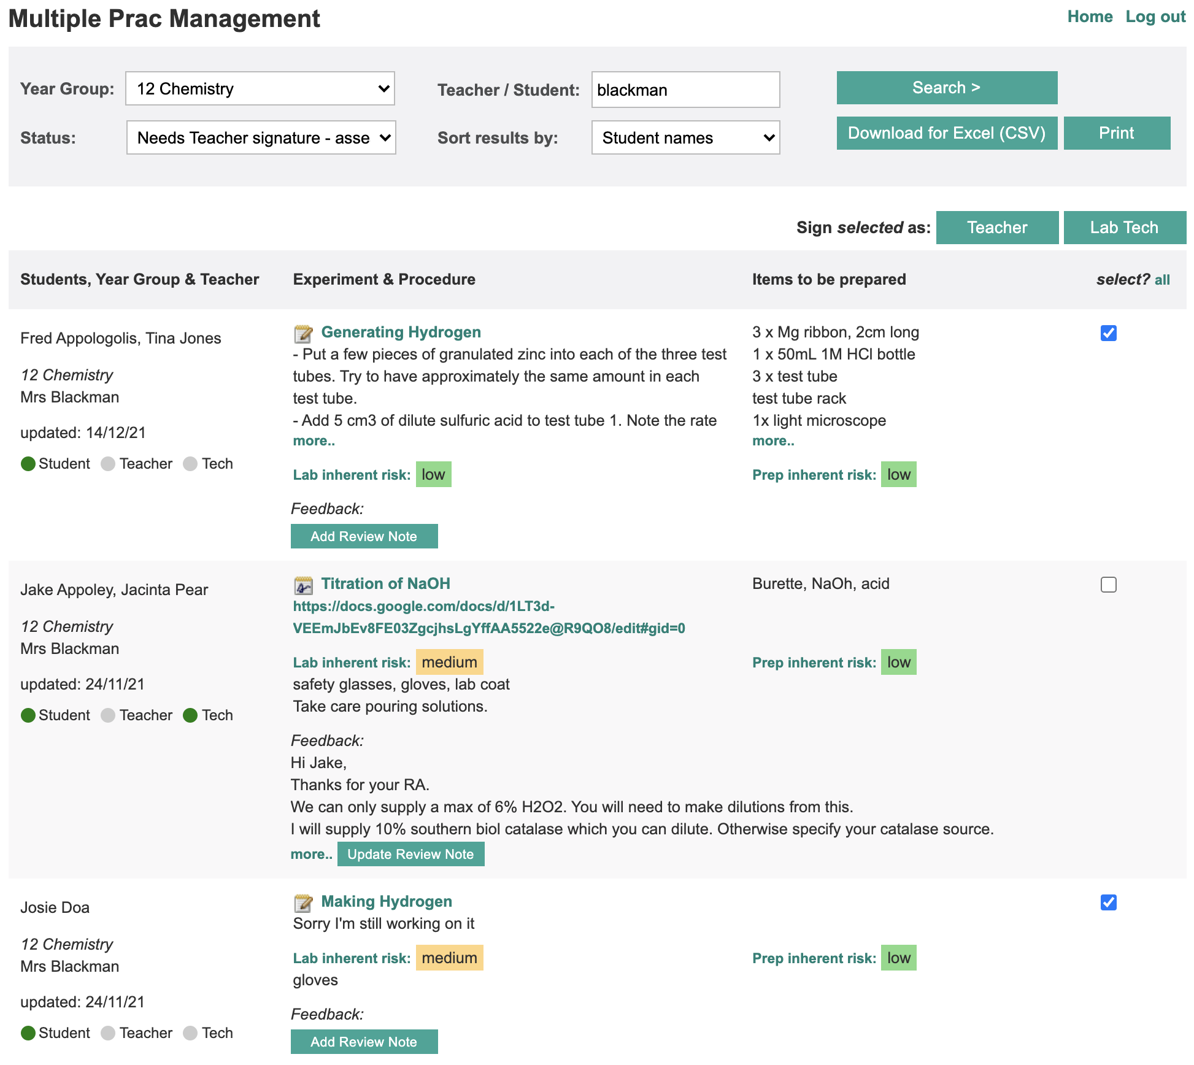

Slide 11
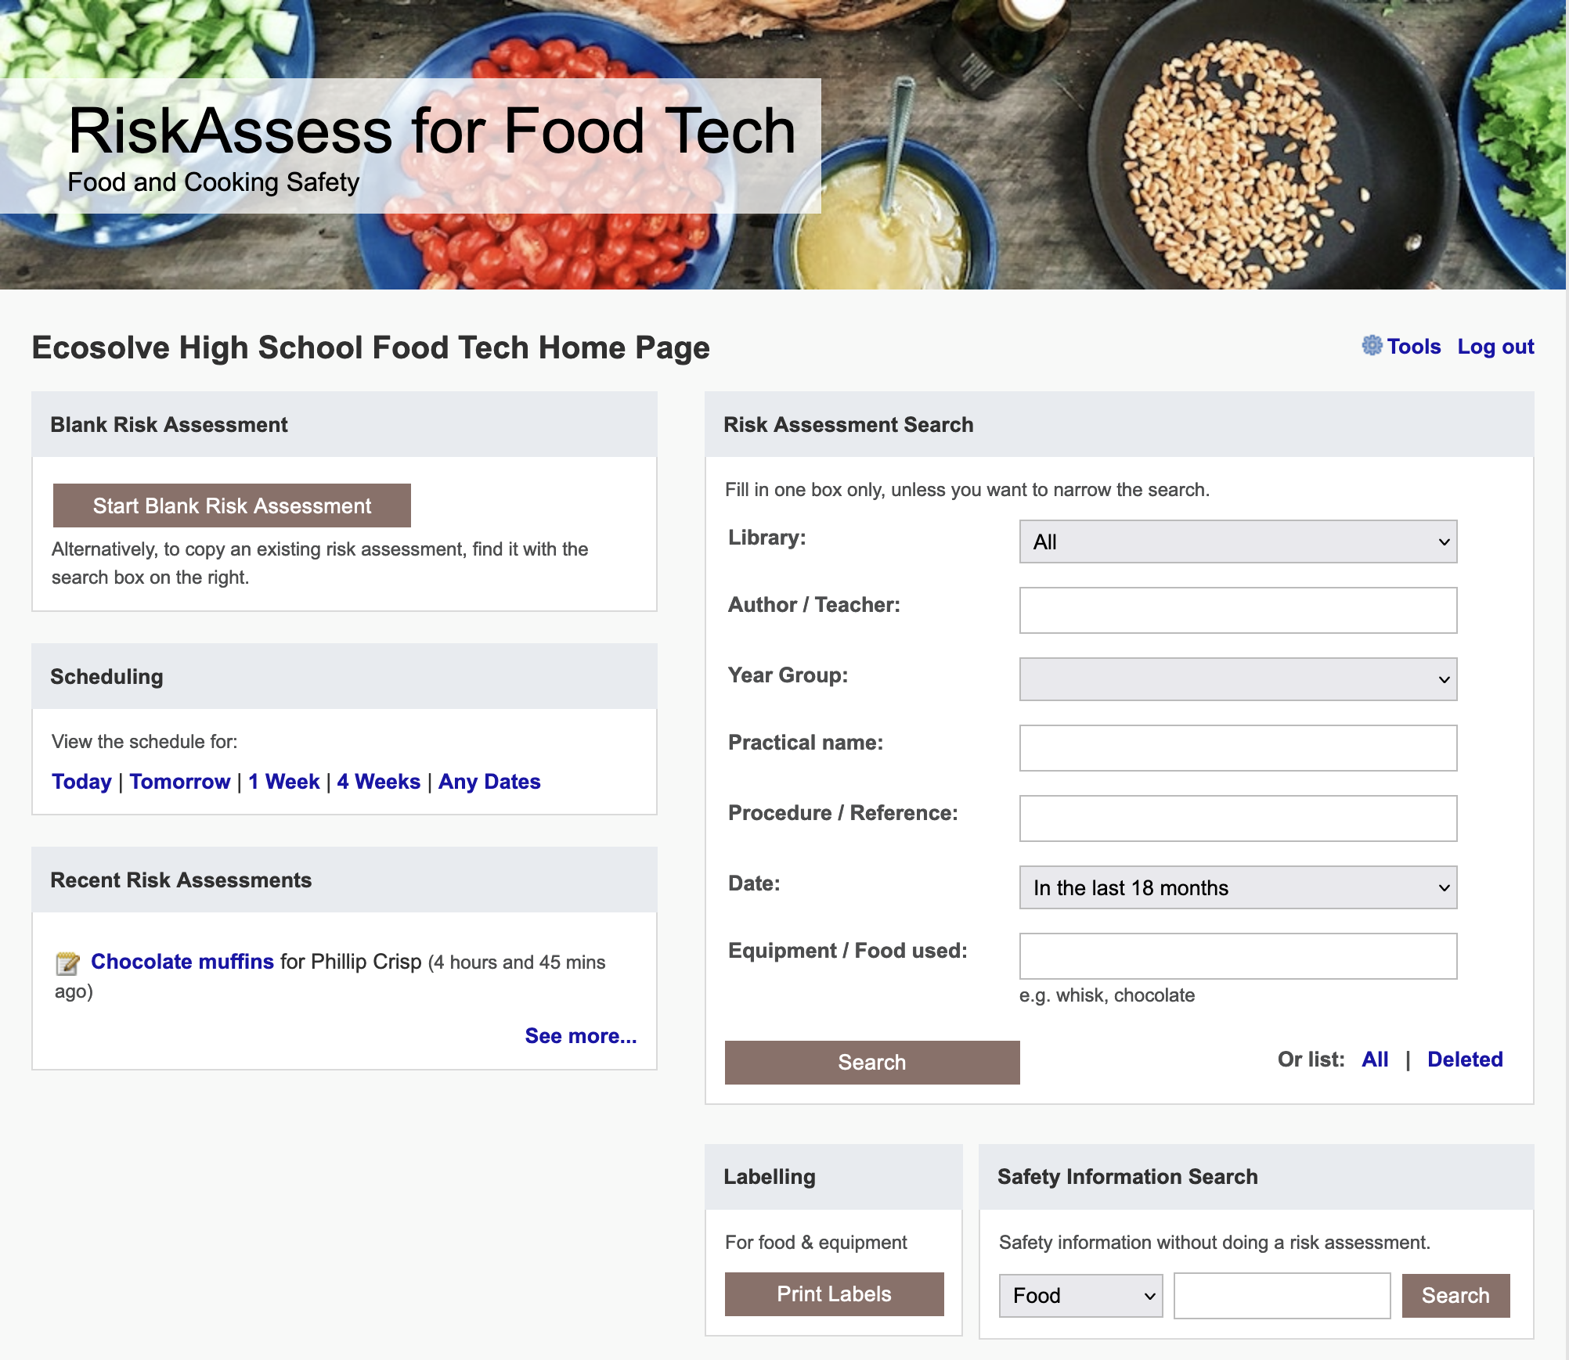

Slide 12
Future Ideas

Slide 13
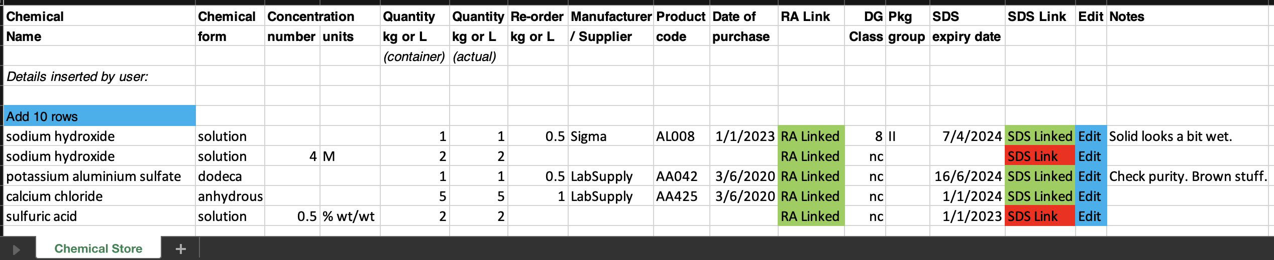
Chemical Register DRAFT
Import from CSV/template
Easy print out
Reports on SDS that need updating / reorder
Access for outside Science – Link/export/edit?
Do we need Actual / Reorder Qty?

Slide 14
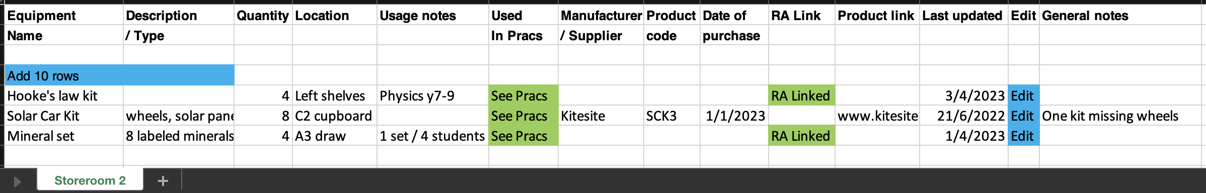
Equipment Inventory VERY DRAFT
Import from CSV/template
Easy print out
Reports on not updated for X time?
Access for outside Science – Link/export/edit?
Other fields/reports? Need “Used in Pracs”?

Slide 15
Tips & Tricks

Slide 16
Menu
Shortcuts
icons, hcl, part name, day/month,
click banner, links, hot links, delete,
Best RAs, search on less, # & sort
Scheduling
Excel/csv, any dates, last week,
search, no# pracs, prep notes,
double booking, lodged date
Tools
customise year groups,
stocktaking & usage, invoice,
backup system, defaults
Resources
learning resources, faq, eBook,
videos, libraries: Stile+EP+Edrolo
Labels
standard & custom labels
multiple chemicals on sheet
mixtures, non-chemicals
free text, biohazard symbol
Operations
reschedule, archive risk
assessments, annual review,
tech-only RAs, review notes,
high/extreme: 3 signatures, list
Multiple classes
author update/modifiable copy
Student RiskAssess
view student PINs, not last year
multiple prac management

